Slide 1
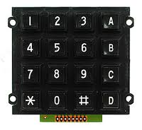
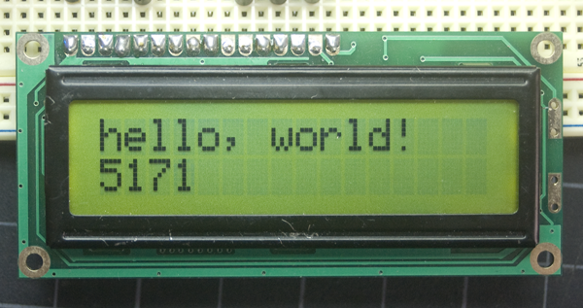
Physics 120B: Lecture 4
LCD Text Display
Keypads and Time Slicing
Interrupts

Slide 2
2×16 LCD
Typically 5×8 dots per character
Note 16 pins: indicator of common interface

Slide 3
Typical LCD Unit pinout
pin | function | Arduino pin (shield)
1 | ground | GND
2 | +5 V | +5 V
3 | VEE (contrast via potentiometer between 0 and 5 V) | pot on shield
4 | RS (LOW = command; HIGH = data/characters) | 8
5 | RW (LOW = write; HIGH = read) | GND
6 | E (enable strobe: toggle to load data and command) | 9
7-14 | data bus | 4,5,6,7 → D4,D5,D6,D7
15 | backlight +V
16 | backlight ground
Note that most features are accessible using only the 4 MSB data pins

Slide 4
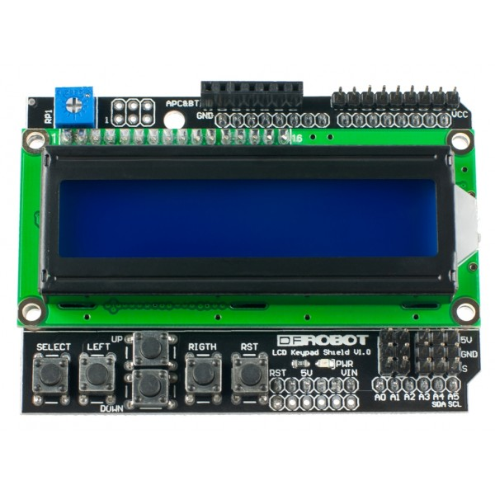
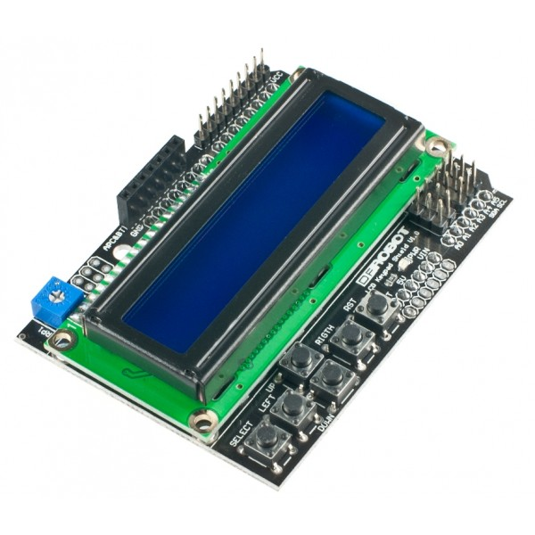
Arduino LCD Shield
Handy package, includes buttons, contrast pot, some pins/headers for other connections
consumes Arduino pins 4, 5, 6, 7, 8, 9
leaves 0, 1 for Serial, 2, 3, 10, 11, 12, 13
fails to make pin 10 available on header, though

Slide 5
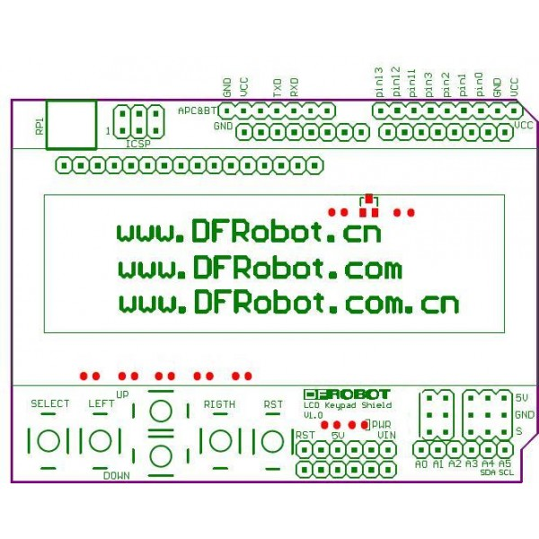
contrast adjust
Arduino pin breakout
a few other pins
A1—A5 on “S”
buttons utilize A0 analog input

Slide 6
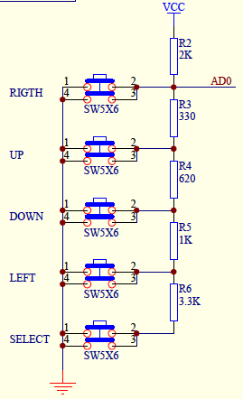
Buttons
The buttons use a voltage divider tree to present an analog voltage to A0
note “RIGTH” typo made it onto printed circuit board!
I measure the following:
none: 4.95 V
SELECT: 3.59 V
LEFT: 2.44 V
DOWN: 1.60 V
UP: 0.70 V
RIGHT: 0.0 V
Easily distinguishable

Slide 7
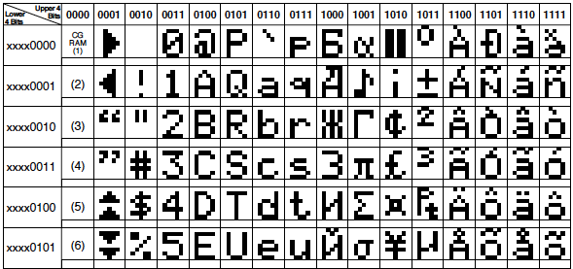
LCD Datasheet
For behind-the-scenes control of the LCD display, see the datasheet
http://www.physics.ucsd.edu/~tmurphy/phys120b/labs/doc/LCD_HD44780.pdf
Above is just one snippet of the sort of things within

Slide 8
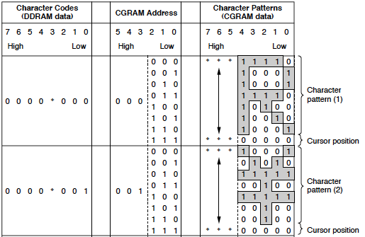
And one other snippet from LCD datasheet
Datasheets: they build character (at least characters)

Slide 9
The LiquidCrystal Library
This is one place I’m not itching for low-level control
or wait—where’s the fun/challenge in that attitude?
Library makes simple
#include <LiquidCrystal.h>
LiquidCrystal lcd(8, 9, 4, 5, 6, 7); // matches shield config
void setup() {
lcd.begin(16, 2); // # columns & rows
lcd.print("Phys 120B Rules!");
}
void loop() {
lcd.setCursor(0, 1); // first col, second row (0 base)
// print the number of seconds since reset:
lcd.print(millis()/1000);
}

Slide 10
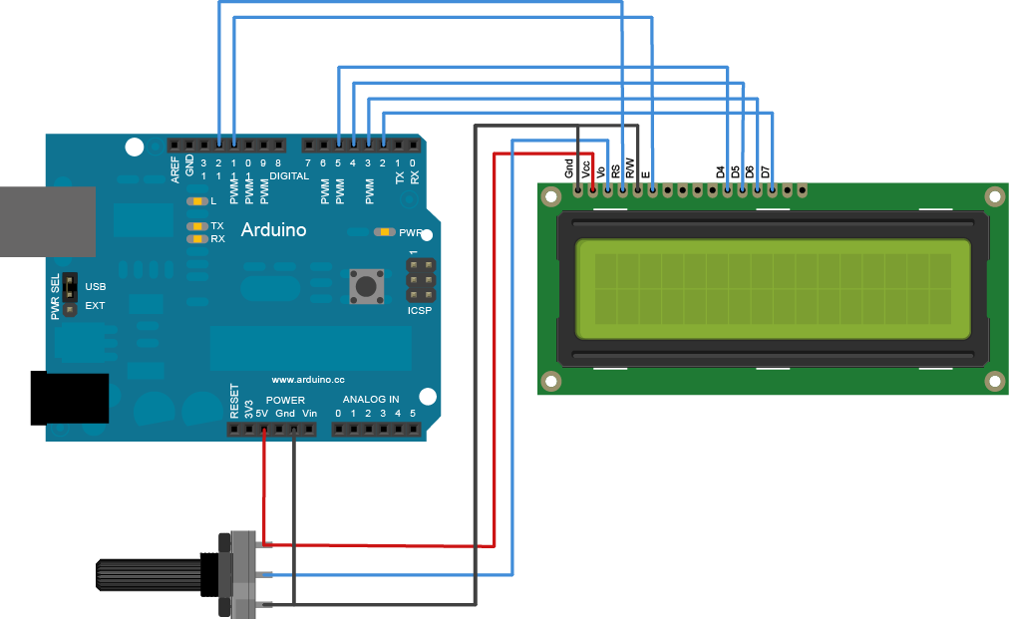
The setup call
Arguments in LiquidCrystal type are:
pins corresponding to: RS, Enable, D4, D5, D6, D7
don’t need shield at all; just those 6 pins and power/gnd
here’s one without shield: must hook R/W to gnd; rig pot

Slide 11
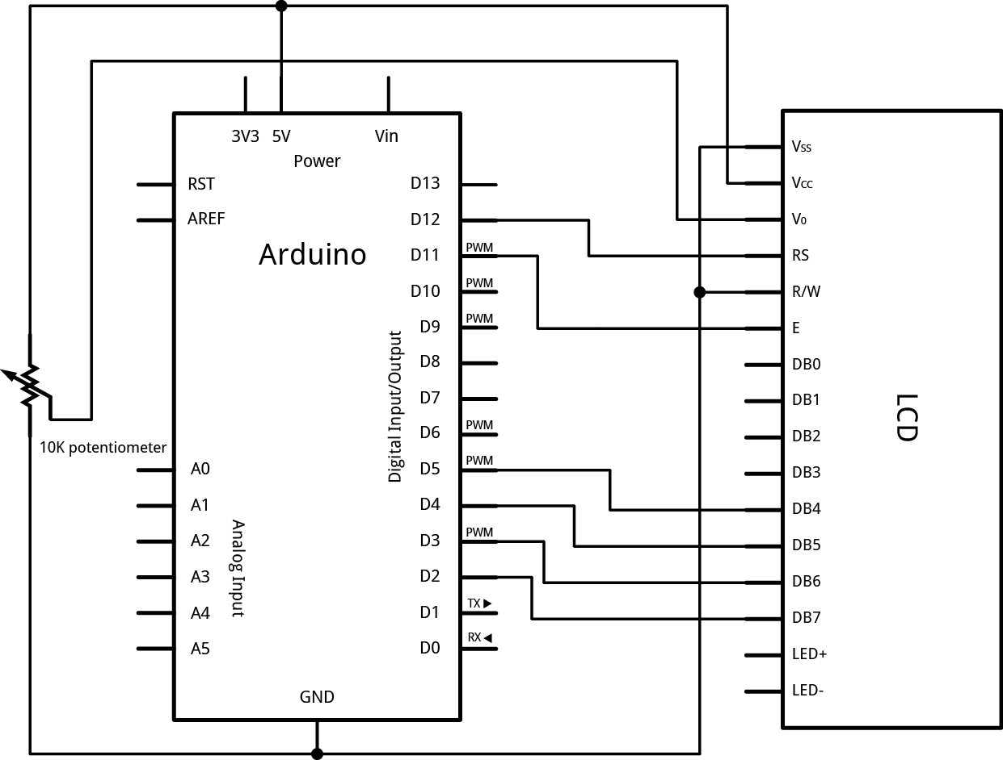
Same thing in schematic form
Note this pinout is different than shield’s mapping

Slide 12
Explore the library
Can do a lot with a few functions, but more available
LiquidCrystal() must use
begin() must use
clear()
home()
setCursor() almost certainly use
write()
print() almost certainly use
cursor()
noCursor()
blink()
noBlink()
display()
noDisplay()
scrollDisplayLeft()
scrollDisplayRight()
autoscroll()
noAutoscroll()
leftToRight()
rightToLeft()
createChar()

Slide 13
LCD References
Good general intro to LCD control
http://spikenzielabs.com/SpikenzieLabs/LCD_How_To.html
Arduino page
http://arduino.cc/en/Tutorial/LiquidCrystal
See links on course site:
http://www.physics.ucsd.edu/~tmurphy/phys120b/labs/useful_links.html
http://www.physics.ucsd.edu/~tmurphy/phys120b/labs/doc/LCD-shield-schem.pdf
http://www.physics.ucsd.edu/~tmurphy/phys120b/labs/doc/LCD_HD44780.pdf

Slide 14
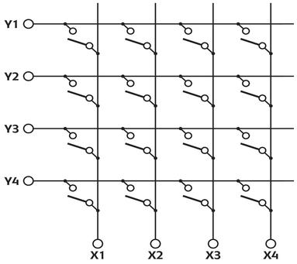
Keypads
Most keypads are matrix form: row contact and column contact
pressing button connects one row to one column
note crossings do not connect:
dots indicate connection

Slide 15
Reading the keypad
Imagine we hooked the rows (Y) to four digital inputs with pull-up resistors
and hooked the columns (X) up to digital outputs
Now cycle through X, putting each to zero (LOW) in turn
otherwise enforce high state
Read each row value and see if any inputs are pulled low
means switch closed, button pressed
Called time-slicing
+5
+5
+5
+5

Slide 16
Those Pesky Pullups
Arduino has a pinMode option to engage internal pullup resistors
pinMode(pin, INPUT_PULLUP);
does just what we want
Let’s start by defining our pins (example values)
and our key characters
#define ROW1 12 // or whatever pin is hooked to row1
etc.
#define COL1 8
etc.
#define ROWS 4
#define COLS 4
char keys[ROWS][COLS] = { // handy map of keys
{'1','2','3','A'}, // black 4x4 keypad
{'4','5','6','B'},
{'7','8','9','C'},
{'*','0','#','D'}
};

Slide 17
Now set up pins in setup()
pinMode(ROW1, INPUT_PULLUP);
etc.
pinMode(COL1, OUTPUT);
etc.
digitalWrite(COL1, HIGH); // def. state is high; start high
Now in loop()
pressed = 0; // value for no press
digitalWrite(COL1, LOW); // assert col 1 low
if (digitalRead(ROW1) == LOW)
pressed = 0x11; // upper digit is row
if (digitalRead(ROW2) == LOW)
pressed = 0x21; // lower digit is col
etc.
digitalWrite(COL1, HIGH); // reset col1 to high
etc. for all 4 columns; the scheme for pressed is just one way, my first impulse

Slide 18
Piecing together at end of loop
if (pressed != 0 && pressed != last)
{
row = pressed >> 4; // drop 4 LSB, look at upper 4
col = pressed & 0x0f; // kill upper 4 bits; keep 4 LSB
ch = keys[row-1][col-1]; // what character, from map
if (ch != '#’) // treat # as newline
Serial.print(ch);
else
Serial.println(""); // just want return
}
last = pressed; // preserve knowledge
delay(40); // debounce delay
print only if new press, new line if ‘#’ pressed
note >> bit shift row look at high nibble;
and mask lower 4 bits for isolating lower nibble
thus decode into row and column (at least this is one way)

Slide 19
Cleaning up code
Repeating the sweep four times during the loop is a bit clumsy, from a coding point of view
begs to be function()-ized
int readCol(int column)
{
int row_press = 0;
digitalWrite(column, LOW);
if (digitalRead(ROW1) == LOW)
row_press = 1;
if (digitalRead(ROW2) == LOW)
row_press = 2;
etc.
digitalWrite(column, HIGH);
return row_press;
}

Slide 20
Now a function to sweep columns
int sweepCols()
{
int row_press;
pressed = 0;
row_press = readCol(COL1);
if (row_press > 0)
pressed = (row_press << 4) + 1;
etc.
row_press = readCol(COL4);
if (row_press > 0)
pressed = (row_press << 4) + 4;
return pressed;
}
now in main loop, just: pressed = sweepCols(); and otherwise same

Slide 21
And, there’s a Library
Of course there is…
http://playground.arduino.cc/code/Keypad
installed in sketch folder libraries/ directory
#include <Keypad.h> const byte ROWS = 4; //four rows const byte COLS = 3; //three columns char keys[ROWS][COLS] = {{'1','2','3'}, {'4','5','6'},
{'7','8','9'}, {'#','0','*’}}; byte rowPins[ROWS] = {5, 4, 3, 2}; //conn. to the row pins of the keypad byte colPins[COLS] = {8, 7, 6}; //conn. to the col pins of the keypad Keypad keypad = Keypad( makeKeymap(keys), rowPins, colPins, ROWS, COLS ); void setup(){ Serial.begin(9600);} void loop(){ char key = keypad.getKey(); if (key != NO_KEY) Serial.println(key); }

Slide 22
Some Notes on the Keypad Library
Note that the key map is taken seriously by Keypad.h
if any character appears twice, it messes up
therefore more than a printing convenience; a core functional element of the operation
Functions
void begin(makeKeymap(userKeymap))
char waitForKey()
char getKey()
KeyState getState()
boolean keyStateChanged()
setHoldTime(unsigned int time)
setDebounceTime(unsigned int time)
addEventListener(keypadEvent)
Consult link on previous slide for descriptions

Slide 23
Combining LCD and Keypad?
The LCD uses six digital pins
A 4x4 keypad needs 8 pins
Uno has 14, but pins 0 and 1 are used by Serial
could forgo serial communications, and max out pins
Need a better way, less greedy
Take a page from LCD shield buttons: use analog input
Many schemes are possible
generally: +5 V on rows/cols, GND on other, resistors between
could have all 16 buttons map to a single analog input
interesting problem in designing appropriate network
or make it easier and map to four analog inputs

Slide 24
Four-Input Scheme
+5
R1
R2
R3
R4
A1
A2
A3
A4
R5
R6
R7
R8
GND
R1 thru R4 could be 10 kΩ, 4.7 kΩ, 2.2 kΩ, 1 kΩ
R5 thru R7 could be all 3.3 kΩ, or in that ballpark
voltages will be 0 (nothing pressed), 1.25 V (top row), 2.06V; 3 V; and 3.8 V for resp. rows — lots of separation
Poll each A# input to ascertain keypress

Slide 25
Interrupts
Sometimes we can’t afford to miss a critical event, while the main loop is busy, or in a delay, etc.
Interrupts demand immediate attention
Uno has two interrupts
int.0 on pin 2; int.1 on pin 3
Mega has 6 available interrupts
You can exempt some of loop from interruption
may be rare that you need to do this, but…
void loop()
{
noInterrupts();
// critical, time-sensitive code here
interrupts();
// other code here
}

Slide 26
Easily implemented
Just have to attach an interrupt to a service routine
attachInterrupt(int#, function, trigger_type);
the interrupt number is 0 or 1 on Uno (pins 2 or 3)
the function is some function you’ve created to service the interrupt: name it whatever makes sense
trigger_type can be
RISING: detects edge from logic low to logic high
FALLING: detects falling edge
CHANGE: any change between high/low (watch out for bounce!)
LOW: a low state will trigger an interrupt
note that delay() will not work within the service routine
need delayMicroseconds(), only good up to 16383 μs
but not often interested in delay in interrupt routine

Slide 27
Simple example
Turn on/off LED via interrupt; note volatile variable
int pin = 13; volatile int state = LOW; void setup() { pinMode(pin, OUTPUT); attachInterrupt(0, blink, CHANGE); } void loop() { digitalWrite(pin, state); } void blink() { state = !state; }

Slide 28
Interrupt Notes
Inside the attached function, delay() won't work and the value returned by millis() will not increment. Serial data received while in the function may be lost. You should declare as volatile any variables that you modify within the attached function.
See the page for attachInterrupts():
http://arduino.cc/en/Reference/AttachInterrupt

Slide 29
Interrupts from analog?
What if we need to make a digital interrupt out of an analog signal like the analog-scheme keypad?
Can use a comparator to sense if we’re above or below some threshold voltage
output is digital state
could also use a high-pass (differentiator) to sense any significant change in the analog level, fed into a comparator

Slide 30
Comparator Basics
+5 V
V
+
R
V_{out}
V_{in}
5 V
V_{out}
V_{in}
V_{ref}
−
V_{ref}
time
Scheme is: when + input larger than − input, transistor driven to ON
then current flows through transistor and output is pulled low
When V_{in} < V_{ref}, V_{out} is pulled high (through the pull-up resistor—usually 1 kΩ or more)
this arrangement is called “open collector” output: the output is basically the collector of an npn transistor: in saturation it will be pulled toward the emitter (ground), but if the transistor is not driven (no base current), the collector will float up to the pull-up voltage
The output is a “digital” version of the signal
with settable low and high values (here ground and 5V)

Slide 31
Can Gang Open-Collector Comparators into Chain
Put same (or different) threshold values on − inputs and four different analog signals on +
tie all four open collectors together with common pull-up
if any comparator activates, the associated transistor will pull the combined output low, and the other (off) transistors won’t care
The “311” comparator is standard
+
−
+
−
+
−
+
−

Slide 32
Upcoming Lab
Monday is a holiday, so this is it for lab prep!
In Week 3 lab, we will:
make an LCD analog voltage meter
read a 4x4 keypad using the time-slice method and 8 pins
combine the keypad, LCD, and interrupts into a party

