Slide 1
Physics 120B: Lecture 6
Projects

Slide 2
The Rubric, Once Again
Sense some real-world quantity
  input: analog or digital
  sensor or user input (switches, keypad)
Process the information
  code in software
  analog processing could play a role
Do something externally
  in reaction to the input and processing
  LCD display at simple end; controlled motion on the other

Slide 3
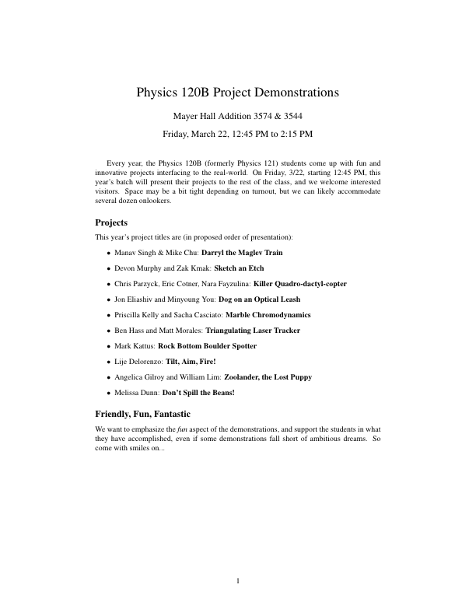

Slide 4
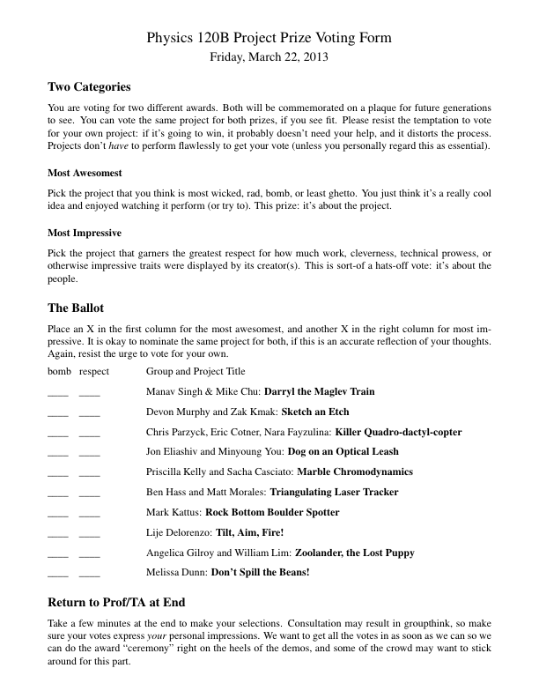

Slide 5
Getting Ready
Find a partner
  not committed to stay in initial group
Bat around project ideas
  useful to have several in mind, if you can
  could be based around a sensor, a technology, an action
  we’ll look at a variety of examples from the past
Create a written, detailed proposal so that
  we can evaluate the feasibility and level-appropriateness of the project
  we can suggest expansions or reductions, easier alternatives, or come up with fallback de-scope options
  you think through what the project needs in advance

Slide 6
Proposal Contents
Motivation and overall concept
  the big picture: why and what
Functional definition
  more detailed description of what the thing should do, and how it will react to all foreseeable operating states/stimuli
  when you code the behavior, it is this section that defines what you are trying to do
Sensors
  what input devices are you going to use
  how do they behave and how are they to be used

Slide 7
Proposal, Continued
Mechanical Considerations
  this is where things can get janky
  it’s easy to wave this off as not a big issue, but can be the hardest part in getting the project to work well
  how is the device supported?
  how are elements attached?
  what custom pieces will have to be made?
  out of what material?
  do we have the necessary materials on hand?
Electrical Considerations
  what elements are needed, and how are they hooked up?
  analog electronics needs/functions
  circuit diagram
  wiring (mechanical aspect: what wires, connectors, etc.)

Slide 8
Proposal, continued
Interface
  what (presumably) Arduino unit?
  what pins/inputs/outputs are needed?
  what communications?
Software
  how will the programming go?
  what are the tricky parts?
  what libraries might you use?
  what new capabilities do you need to explore?
Testing
  how easy is it to test performance in the lab?
Safety
  flame, sharp objects, high velocity, high voltage, chemicals, etc.
  how will you manage safety if these things are involved?

Slide 9
Proposal, continued
Parts and Reusability
  what parts do you need?
  what parts are on hand?
  what new parts are needed?
  which parts will be consumed vs. reusable by future projects?
  are there long lead-time items on the list?
Expansion Options
  what enhancements might you consider if things are going very well?
De-scope Options
  what ambitions might you shed if things are tough
  fallback positions defining minimum capability

Slide 10
Proposal, continued
What you will turn in
  a brief section of the proposal explaining the contents of the report you expect to hand in at the end
  a well-written proposal can serve as 70% of the final report
Why all the work?
  proposals are a key part of science
    a spear with which to chase down Mammoth (NSF, NASA, DoE)
  proposals focus the mind to clearly think through a project
  the proposal becomes a template or guide to your work
    helps organize/prioritize actions
  gives a chance to sync up to class expectations

Slide 11
A Template Proposal
For the fourth-week lab, we will switch gears a bit and make a mini-project following a proposal-form write-up
  light-tracker with optical collision sensor/interrupt
  you get a good example of what a proposal contains
  you learn more about what a project takes to accomplish, on a smaller scale
  you are turned loose to apply the skills acquired in first few weeks of the course
  extra time to turn this in; proposal comes first

Slide 12
Due Dates
Proposals are due by the end of 5th week; Feb. 7
  Gives us weekend to read and offer feedback next week
You will have about two weeks to work on both the project proposal and the mini-project
Don’t worry about a complete report for the mini-project
  usual functionality check by TA/prof
  turn in code
  paragraph about contributions
Mini-project due Feb. 11/12
Will stick midterm sometime after these due dates

Slide 13
Equipment Needs
We have an amazing array of useful junk/parts
  start here
Stuff we don’t have, you either purchase yourself, or UCSD buys
  do you intend to keep it afterwards?
  will it be usable/useful in future student projects?
  is it reasonably-priced?

Slide 14
Work Shop
You have access to a workshop with power tools
  dangerous: rule is someone else must be in room when you are operating the band-saw, drill-press, sander, or anything else that could be dangerous
Keep it clean!
  restock drill index after you are done
  put away tools when you are finished
  sweep up chips/dust/scraps

Slide 15
List of previously used devices/techniques
Compiled by Fred Driscoll; • represent instances in past several years; w represents Arduino-based
  I’m not clear on what all these things refer to
Digital Out
  many LEDs •••w
  Relay/Valve/Solenoid •••
  AC power control (relay) ••••
  Stepper motor ••w
Digital In
  pushbutton •••••w
  light break (photogate) •••
  magnetic sensor (present or not) •
  IR proximity ••ww
  Passive IR (thermal) •

Slide 16
Components, continued
Analog In
  potentiometer •
  joystick ••
  phototransistor •••ww
  thermistor •
  flex strip •••
  accelerometer •wwww
  gyro w
  weight •
  audio bands ••••
  coherent detection •
  audio input (yes in past, no records) w
  audio output (yes in past, no records)
  40 kHz ultrasonic ••w

Slide 17
Components, continued
Analog Out (PWM)
  LED brightness control ••••w
  motor speed (drive; optoisolated) •••••••••www
  motor position (servo) •••••••••••••wwwww
  buzz w
  signal conditioning (yes in past, no records) www
  electromagnets/coils (yes in past, no records) w
  ESC/brushless DC (no prior records) w

Slide 18
Components/techniques, continued
Serial I/O
  MIDI •••
I²C protocol
  Temperature •••••
  blood pressure •
  PC input ••
  Camera •w
  Sound synthesizer •
  USB
  RF communications (yes in past, no records) w
Parallel I/O
  Liquid Crystal Display (LCD) •••
  DAC •
  8 LEDs

Slide 19
Components/techniques, continued
Timing
  RPM ••
  echo-distance ••ww
  valve time •••
  data logging •
Time Slicing
  7-segment display •
  keypad ••
  touch-sensitive caps ••
  remotes ••
High Current or Voltage
  kill switches ww
  power transistors ww
  opto-isolators ww

Slide 20
Some Time Touring Old Projects
http://www.physics.ucsd.edu/~tmurphy/phys120b/projects/projects.html
  covers Arduino revolution, starting Winter 2013
http://nnp.ucsd.edu/Phy120B/tour_121/
  before 2013: lots of images, and brief descriptions
Should also be past project reports to thumb through (in lab 3574, rear bookshelves)
  more complete descriptions and how they were done

