Slide 1
Physics 120B: Lecture 7
Sensors
(bit incomplete, still)

Slide 2
Sensing Categories
Voltage
starting easy: analog in
Distance
acoustic or light
Speed
hard; usu. via distance
Acceleration
accelerometers
Light Level
phototransistors, photodiodes
Object Passage
photogate (light source/sense)
Sound Level
microphone to rectifier?
Temperature
RTD, thermistor, AD-590
Magnetic Flux
coil and EMF
Pressure
pads?
Mass
spring stretch?
Strain
strain gauge
http://en.wikipedia.org/wiki/List_of_sensors for overwhelming list

Slide 3
Voltage
Crudest version is digital: HIGH or LOW: 1-bit resolution
lots of digital inputs to handle this
option for internal pull-up resistor to V_{cc}
Analog in provides 10-bit (0−1023) on Arduino
considered on crude-to-modest side: 50 mV in 5 V
high-end is 16-bit (65536 values)
seldom meaningful to carry more precision than this
12-bit is also common, and 4× improvement over 10-bit
8-bit is painful: 0.2 V in 5 V
but fine for some applications
Voltage is seldom what you fundamentally want to know, but is often the electronic analog of a physical quantity of greater interest
generally, “converter” can be termed transducer

Slide 4
Distance
Popular 120B metric
collision avoidance; parallel park; target approach
Acoustic variety
ultrasound burst and time-of-flight measurement
Parallax Ping unit is integrated unit, $30
2 cm to 3 m (dep. on surface type)
must send 2 μs pulse on SIG pin
then listen for return pulse
duration of pulse is round-trip time
must switch same pin between input/output
use pulseIn() to measure input duration
Other modules in lab to roll your own acoustic sensor

Slide 5
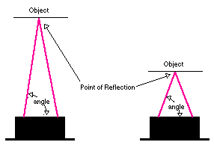
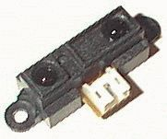
Distance via Light?
Not time-of-flight; forget about it! Leave that to pros
Clever sensing of angle between emitter and receiver
Detector is linear array behind lens
angle maps to position, indicating distance
Smarts on board, so GND, +5 V in; analog voltage out proportional to distance, though not linearly so
Also a proximity version: logic out dep. on “too close”
from http://roborugby.ucd.ie/distsensor.html

Slide 6
Measure Speed?
Galileo and Einstein would both agree that this is hard to directly sense
Options
measure distance and rate of change
noise in distance measurement can make for ratty/spiky velocity
Doppler?
measure rotation rate of wheel or axle engaged in motion
what speedometers do
can use photogate for once/revolution knowledge

Slide 7
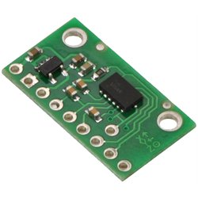
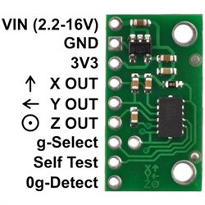
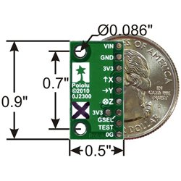
Acceleration
This is something we can directly sense
Recent rapid advances; driven by MEMs and smartphones
3-axis accelerometer based on micro-cantilevers capacitively sensed
bitty MMA7361L unit, $15
centers output on ½ of 3.3 V
default roughly ±1.5g, but can config. for ±6g
zero-g detection and digital flag

Slide 8
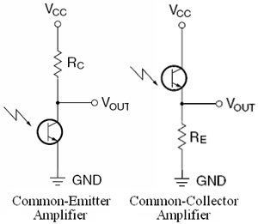
Light Level
Lots of options: phototransistor, photodiode most common
photons knock electrons loose, which either constitute a base current (phototransistor) or direct into current (photodiode)
Phototransistor (right) effectively has some gain already
10 kΩ usually about right

Slide 9
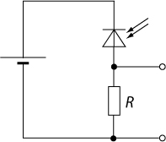
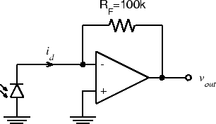
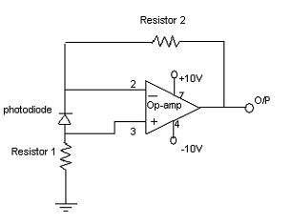
Photodiode Read Out
Many options for photodiode
reverse bias, developing voltage across resistor
zero bias, in op-amp feedback mode
Typically < 0.4 A per Watt incident
stream of photons at 550 nm → 0.447 A at 100% Q.E.
so 1 mm² detector in full sun (1000 W/m²) is 1 mW
thus at best 0.5 mA current (puny)
tend to want pretty large resistor to build up voltage

Slide 10
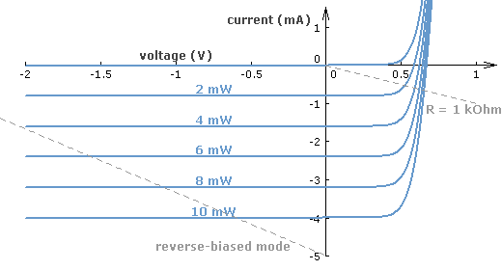
Photodiode IV Curve
At zero or reverse bias, current is proportional to incident light power
note approximate relation: I ≈ 0.4P
matches quantum expectations

Slide 11
Object Passage
We often need to know if something is physically present, has passed through, count rotations, etc.
Can have simple scheme of light source and light detector, where the something of interest passes between
termed a photogate
interruption of light level pretty unmistakably sensed
pulse duration, via pulseIn(), may even speak to velocity
Magnetic

Slide 12
Temperature
Exploit temperature dependence of materials
RTD: resistive temperature device
usually laser-etched platinum spiral, often 1000 Ω + 3.85×(T °C)Ω
linear, good absolute calibration
but a resistor: need to fashion accurate current source and read off voltage (make ohmmeter)
thermistor: exploits conduction electron density as e^{T}
nonlinear, due to exponential dependence on T
AD-590: Analog Devices
supply 5 V and a route for current (resistor), and output current is proportional to temperature
measure current as voltage across provided resistor
Caution: resistors often 200 ppm per °C
for accuracy, may want low “tempco” resistors

Slide 13
Sound Level
Microphone is transducer for acoustic vibrations into voltage
usually membrane that vibrates is part of capacitor
can rectify resulting waveform, low-pass, and measure level

Slide 14
Magnetic Flux
A loop of wire (or many loops) will develop EMF according to changing magnetic field
can amplify, rectify, etc.
A Hall sensor can measure DC magnetic field

Slide 15
Pressure
Pressure pads: 2 conductors separated by carbon film, squeezes out; so more conductivity: bite pads
Capacitive pressure deflects membrane (lab pressure meter)
Party-roller paper tube

Slide 16
Mass/Weight
“Spring” stretch plus flexometer (strain gauge)

Slide 17
Strain
Strain gauge can tell you about minute flexing of a structural beam/material

Slide 18
Other Sensors
Direction
HM55B Compass Module from Parallax ($30)
Motion
infrared motion sensor

