Slide 1
Physics 120B: Lecture 8
Odds and Ends
Binary/Hex/ASCII
Memory & Pointers in C
Decibels & dB Scales
Coherent Detection

Slide 2
Binary, Hexadecimal Numbers
Computers store information in binary
1 or 0, corresponding to V_{CC} and 0 volts, typically
the CC subscript originates from “collector” of transistor
Become familiar with binary counting sequence
binary | decimal | hexadecimal
0000 0000 | 0 | 0x00
0000 0001 | 1 | 0x01
0000 0010 | 2 | 0x02
0000 0011 | 2+1 = 3 | 0x03
0000 0100 | 4 | 0x04
0000 0101 | 4+1 = 5 | 0x05
etc.
1111 1100 | 128+64+32+16+8+4 = 252 | 0xfc
1111 1101 | 128+64+32+16+8+4+1 = 253 | 0xfd
1111 1110 | 128+64+32+16+8+4+2 = 254 | 0xfe
1111 1111 | 128+64+32+16+8+4+2+1 = 255 | 0xff

Slide 3
Binary to Hex: easy!
Note separation of previous 8-bit (one-byte) numbers into two 4-bit pieces (nibbles)
makes expression in hex (base-16; 4-bits) natural
_{binary} | _{hexadecimal} | _{decimal}
₀₀₀₀ | ₀ | ₀
₀₀₀₁ | ₁ | ₁
₀₀₁₀ | ₂ | ₂
₀₀₁₁ | ₃ | ₃
₀₁₀₀ | ₄ | ₄
₀₁₀₁ | ₅ | ₅
₀₁₁₀ | ₆ | ₆
₀₁₁₁ | ₇ | ₇
₁₀₀₀ | ₈ | ₈
₁₀₀₁ | ₉ | ₉
₁₀₁₀ | _{A (lower case fine)} | ₁₀
₁₀₁₁ | _{B} | ₁₁
₁₁₀₀ | _{C} | ₁₂
₁₁₀₁ | _{D} | ₁₃
₁₁₁₀ | _{E} | ₁₄
₁₁₁₁ | _{F} | ₁₅

Slide 4
ASCII Table in Hex
first hex digit
 | 0 | 1 | 2 | 3 | 4 | 5 | 6 | 7
0 | NUL ^@ null (\0) | DLE ^P | SP space | 0 | @ | P | ` | p
1 | SOH ^A start of hdr | DC1 ^Q | ! | 1 | A | Q | a | q
2 | STX ^B start text | DC2 ^R | “ | 2 | B | R | b | r
3 | ETX ^C end text | DC3 ^S | # | 3 | C | S | c | s
4 | EOT ^D end trans | DC4 ^T | $ | 4 | D | T | d | t
5 | ENQ ^E | NAK ^U | % | 5 | E | U | e | u
6 | ACK ^F acknowledge | SYN ^V | & | 6 | F | V | f | v
7 | BEL ^G bell | ETB ^W | ‘ | 7 | G | W | g | w
8 | BS ^H backspace | CAN ^X | ( | 8 | H | X | h | x
9 | HT ^I horiz. tab (\t) | EM ^Y | ) | 9 | I | Y | i | y
A | LF ^J linefeed (\r) | SUB ^Z | * | : | J | Z | j | z
B | VT ^K vertical tab | ESC escape | + | ; | K | [ | k | {
C | FF ^L form feed | FS | , | < | L | \ | l | |
D | CR ^M carriage ret (\n) | GS | - | = | M | ] | m | }
E | SO ^N | RS | . | > | N | ^ | n | ~
F | SI ^O | US | / | ? | O | _ | o | DEL
second hex digit

Slide 5
ASCII in Hex
Note the patterns and conveniences in the ASCII table
0 thru 9 is hex 0x30 to 0x39 (just add 0x30)
A-Z parallels a-z; just add 0x20
starts at 0x41 and 0x61, so H is 8th letter, is 0x48, etc.
the first 32 characters are control characters, often represented as Ctrl-C, denoted ^C, for instance
associated control characters mirror 0x40 to 0x5F
put common control characters in red; useful to know in some primitive environments

Slide 6
Two’s Complement
Unsigned are direct binary representation
Signed integers usually follow “two’s complement”
rule: to get neg. number, flip all bits and add one
example: -2: 0000 0010 → 1111 1101 + 1 = 1111 1110
adding pos. & neg. → 0000 0000 (ignore overflow bit)
binary | hex | unsigned | 2’s complement
0000 0000 | 0x00 | 0 | 0
0000 0001 | 0x01 | 1 | 1
0000 0010 | 0x02 | 2 | 2
0111 1111 | 0x7F | 127 | 127
1000 0000 | 0x80 | 128 | -128
1000 0001 | 0x81 | 129 | -127
1111 1110 | 0xFE | 254 | -2
1111 1111 | 0xFF | 255 | -1

Slide 7
Floating Point Numbers
Most standard is IEEE format
http://en.wikipedia.org/wiki/IEEE_754-1985
Three parts: sign, exponent, mantissa
single-precision (float) has 32 bits (1, 8, 23, resp.)
7 digits; 10^{±38}; log(10)/log(2) = 3.32, so 2²³ ≈ 10⁷; ±127/3.32 ≈ 38
double precision (double) has 64 bits (1, 11, 52, resp.)
16 digits; 10^{±308}
The actual convention is not critical for us to understand, as much as:
limitations to finite representation
space allocation in memory: just 32 or 64 bits of 1’s & 0’s
1.01×2⁻³, 1 is implied, exp. offset by 127

Slide 8
Arrays & Storage in C
We can hold more than just one value in a variable
but the program needs to know how many places to save in memory
Examples:
we can either say how many elements to allow and leave them unset; say how many elements and initialize all elements to zero; leave out the number of elements and specify explicitly; specify number of elements and contents
character arrays are strings
strings must end in ‘\0’ to signal the end
must allow room: char name[4]=“Bob”
fourth element is ‘\0’ by default
int i[8], j[8]={0}, k[]={9,8,6,5,4,3,2,1,0};
double x[10], y[10000]={0.0}, z[2]={1.0,3.0};
char name[20], state[]=“California”;

Slide 9
Indexing Arrays
int i,j[8]={0},k[]={2,4,6,8,1,3,5,7};
double x[8]={0.0},y[2]={1.0,3.0},z[8];
char name[20],state[]="California";
for (i=0; i<8; i++)
{
z[i] = 0.0;
printf(”j[%d] = %d, k[%d] = %d\n",i,j[i],i,k[i]);
}
name[0]='T';
name[1]='o';
name[2]='m';
name[3] = '\0';
printf("%s starts with %c and lives in %s\n",name,name[0],state);
Index array integers, starting with zero
Sometimes initialize in loop (z[] above)
String assignment awkward outside of declaration line
#include <string.h> provides “useful” string routines
done automatically in Arduino, but also String type makes many things easier

Slide 10
Memory Allocation in Arrays
state[]=“California”; →
name[11]=“Bob”; →
empty spaces at the end could contain any random garbage
int i[] = {9,8,7,6,5,4,3,2}; →
indexing i[8] is out of bounds, and will either cause a segmentation fault (if writing), or return garbage (if reading)
each block is 8-bit char
C
a
l
i
f
o
r
n
i
a
\0
B
o
b
\0
9
8
7
6
5
4
3
2
each block is 16 or 32-bit int

Slide 11
Multi-Dimensional Arrays
j
int i,j,arr[2][4];
for (i=0; i<2; i++){
for (j=0; j<4; j++){
arr[i][j] = 4+j-2*i;
}
}
0
1
2
3
0
4
5
6
7
i
1
2
3
4
5
in memory space:
4
5
6
7
2
3
4
5
C is a row-major language: the first index describes which row (not column), and arranged in memory row-by-row
memory is, after all, strictly one-dimensional
Have the option of treating a 2-D array as 1-D
arr[5] = arr[1][1] = 3
Can have arrays of 2, 3, 4, … dimensions

Slide 12
Arrays and functions
How to pass arrays into and out of functions?
An array in C is actually handled as a “pointer”
a pointer is a direction to a place in memory
A pointer to a variable’s address is given by the & symbol
you may remember this from scanf functions
For an array, the name is already an address
because it’s a block of memory, the name by itself doesn’t contain a unique value
instead, the name returns the address of the first element
if we have int arr[i][j];
arr and &arr[0] and &arr[0][0] mean the same thing: the address of the first element
By passing an address to a function, it can manipulate the contents of memory directly, without having to pass bulky objects back and forth explicitly

Slide 13
Example: 3x3 matrix multiplication
void mm3x3(double a[], double b[], double c[])
// Takes two 3x3 matrix pointers, a, b, stored in 1-d arrays nine
// elements long (row major, such that elements 0,1,2 go across a
// row, and 0,3,6 go down a column), and multiplies a*b = c.
{
double *cptr; // pointer type variable: * gets at contents
int i,j;
cptr = c; // without *, it’s address; point to addr. for c
for (i=0; i<3; i++){
for (j=0; j<3; j++){
*cptr++ = a[3*i]*b[j] + a[3*i+1]*b[j+3] + a[3*i+2]*b[j+6];
// calc value to stick in current cptr location, then
// increment the value for cptr to point to next element
}
}
}

Slide 14
mm3x3, expanded
The function is basically doing the following:
which you could confirm is the proper set of operations for multiplying out 3×3 matrices
*cptr++ = a[0]*b[0] + a[1]*b[3] + a[2]*b[6];
*cptr++ = a[0]*b[1] + a[1]*b[4] + a[2]*b[7];
*cptr++ = a[0]*b[2] + a[1]*b[5] + a[2]*b[8];
*cptr++ = a[3]*b[0] + a[4]*b[3] + a[5]*b[6];
*cptr++ = a[3]*b[1] + a[4]*b[4] + a[5]*b[7];
*cptr++ = a[3]*b[2] + a[4]*b[5] + a[5]*b[8];
*cptr++ = a[6]*b[0] + a[7]*b[3] + a[8]*b[6];
*cptr++ = a[6]*b[1] + a[7]*b[4] + a[8]*b[7];
*cptr++ = a[6]*b[2] + a[7]*b[5] + a[8]*b[8];

Slide 15
Notes on mm3x3
The function is constructed to deal with 1-d instead of 2-d arrays
9 elements instead of 3×3
it could have been done either way
There is a pointer, *cptr being used
by specifying cptr as a double pointer, and assigning its address (just cptr) to c, we can stock the memory by using “pointer math”
cptr is the address; *cptr is the value at that address
just like &x_val is an address, while x_val contains the value
cptr++ bumps the address by the amount appropriate to that particular data type, called “pointer math”
*cptr++ = value; assigns value to *cptr, then advances the cptr count

Slide 16
Using mm3x3
#include <stdio.h>
void mm3x3(double a[], double b[], double c[]);
int main()
{
double a[]={1.0, 2.0, 3.0, 4.0, 5.0, 6.0, 7.0, 8.0, 9.0};
double b[]={1.0, 2.0, 3.0, 4.0, 5.0, 4.0, 3.0, 2.0, 1.0};
double c[9];
mm3x3(a,b,c);
printf("c = %f %f %f\n",c[0],c[1],c[2]);
printf(" %f %f %f\n",c[3],c[4],c[5]);
printf(" %f %f %f\n",c[6],c[7],c[8]);
return 0;
}
passing just the names (addresses) of the arrays
filling out a and b, but just making space for c
note function declaration before main

Slide 17
Another way to skin the cat
double a[3][3]={{1.0, 2.0, 3.0},
{4.0, 5.0, 6.0},
{7.0, 8.0, 9.0}};
double b[3][3]={{1.0, 2.0, 3.0},
{4.0, 5.0, 4.0},
{3.0, 2.0, 1.0}};
double c[3][3];
mm3x3(a,b,c);
Here, we define the arrays as 2-d, knowing that in memory they will still be 1-d
we will get compiler warnings, but the thing will still work
not a recommended approach, just presented here for educational purposes
Note that we could replace a with &a[0][0] in the function call, and the same for the others, and get no compiler errors

Slide 18
Decibels
Sound is measured in decibels, or dB
as are many radio-frequency (RF) applications
Logarithmic scale
common feature is that every 10 dB is a factor of 10 in power/intensity
other handy metrics
3 dB is 2×
7 dB is 5×
obviously piling 2× and 5× is 10×, which is 10 dB = 3 dB + 7 dB
decibels thus combine like logarithms: addition represents multiplicative factors

Slide 19
Sound Intensity
Sound requires energy (pushing atoms/molecules through a distance), and therefore a power
Sound is characterized in decibels (dB), according to:
sound level = 10×log(I/I₀) = 20×log(P/P₀) dB
I₀ = 10⁻¹² W/m² is the threshold power intensity (0 dB)
P₀ = 2×10⁻⁵ N/m² is the threshold pressure (0 dB)
atmospheric pressure is about 10⁵ N/m²
20 out front accounts for intensity going like P²
Examples:
60 dB (conversation) means log(I/I₀) = 6, so I = 10⁻⁶ W/m²
and log(P/P₀) = 3, so P = 2×10⁻² N/m² = 0.0000002 atmosphere!!
120 dB (pain threshold) means log (I/I₀) = 12, so I = 1 W/m²
and log(P/P₀) = 6, so P = 20 N/m² = 0.0002 atmosphere
10 dB (barely detectable) means log(I/I₀) = 1, so I = 10⁻¹¹ W/m²
and log(P/P₀) = 0.5, so P ≈ 6×10⁻⁵ N/m²

Slide 20
Sound hitting your eardrum
Pressure variations displace membrane (eardrum, microphone) which can be used to measure sound
my speaking voice is moving your eardrum by a mere 1.5×10⁻⁴ mm = 150 nm = 1/4 wavelength of visible light!
threshold of hearing detects 5×10⁻⁸ mm motion, one-half the diameter of a single atom!!!
pain threshold corresponds to 0.05 mm displacement
Ear ignores changes slower than 20 Hz
so though pressure changes even as you climb stairs, it is too slow to perceive as sound
Eardrum can’t be wiggled faster than about 20 kHz
just like trying to wiggle resonant system too fast produces no significant motion

Slide 21
dB Scales
In the radio-frequency (RF) world, dB is used several ways
dB is a relative scale: a ratio: often characterizing a gain or loss
+3 dB means a factor of two more
−17 dB means a factor of 50 loss, or 2% throughput
dBm is an absolute scale, in milliwatts: 10×log(P/1 mW)
a 23 dBm signal is 200 mW
36 dBm is 4 W (note 6 dB is two 3 dB, each a factor of 2 → 4×)
−27 dBm is 2 μW
dBc is signal strength relative to the carrier
often characterizes distortion from sinusoid
−85 dBc means any distortions are almost nine orders-of-magnitude weaker than the main sinusoidal “carrier”

Slide 22
Coherent Detection
Sometimes fighting to discern signal against background noise
photogate in bright setting, for instance
One approach is coherent detection
modulate signal at known phase, in ON/OFF pattern at 50% duty cycle
accumulate (add) in-phase parts, while subtracting out-of-phase parts
have integrator perform accumulation, or try in software
but if background is noisy in addition to high, integration better
basically background subtraction
gain more the greater the number of cycles integrated

Slide 23
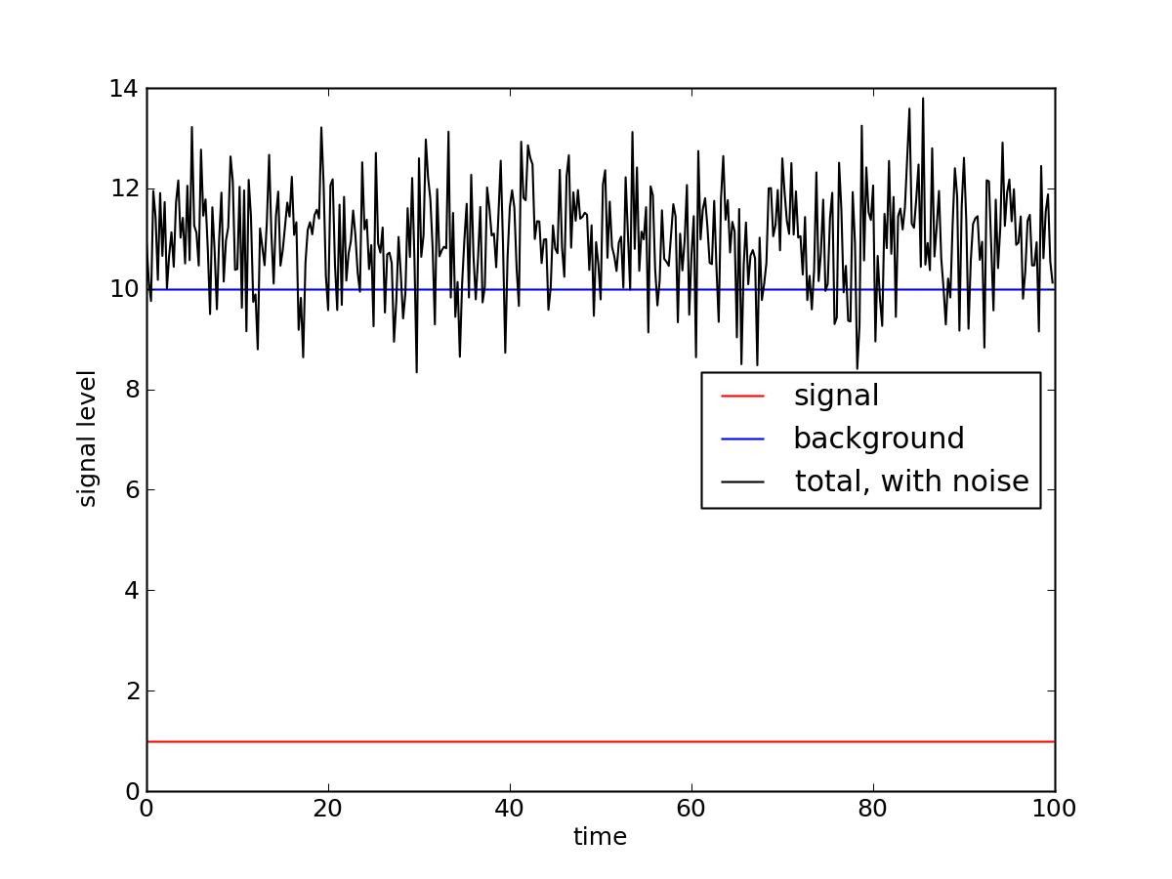
Raw Signal, Background, and Noise

Slide 24
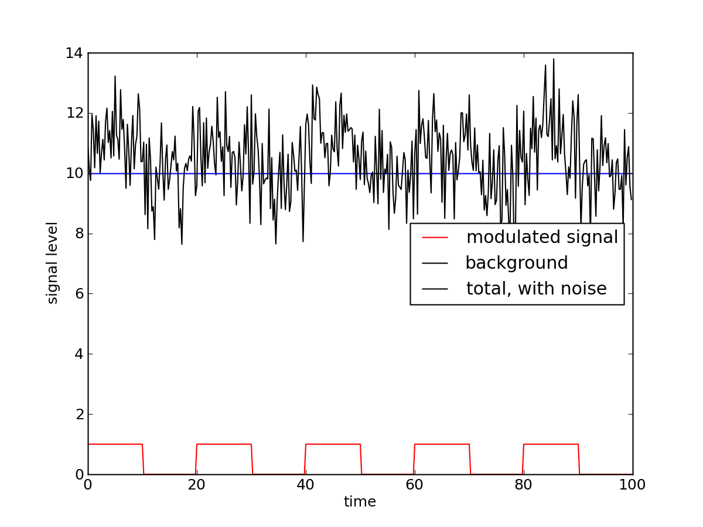
Modulated Signal; still hard to discern

Slide 25
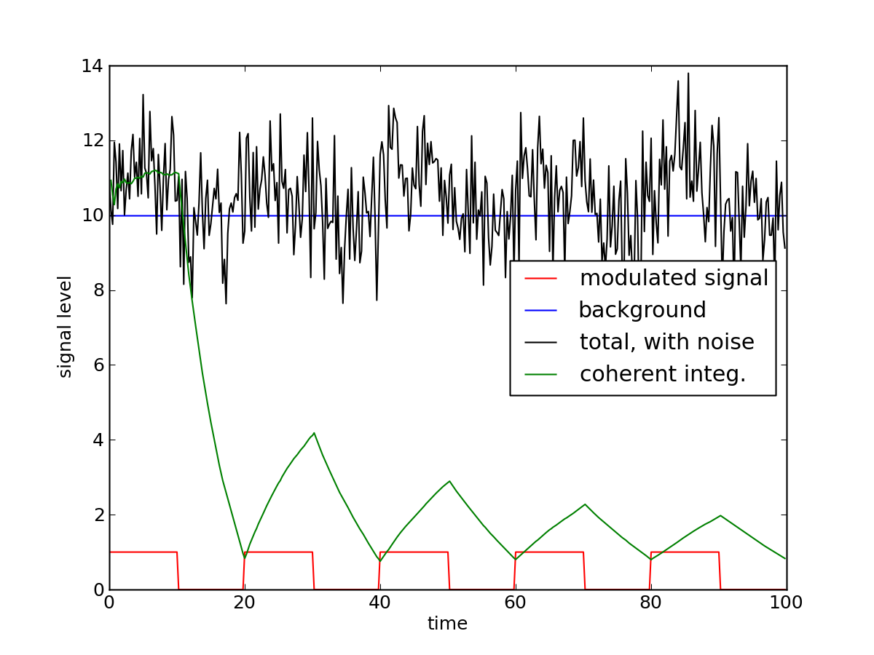
Integration, subtracting “OFF” portions

Slide 26
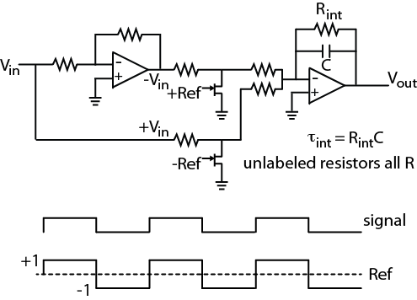
Expressed in Electronics
first op-amp just inverting; second sums two inputs, only one on at a time
has effect of adding parts when Ref = +1, subtracting where Ref = -1
clears “memory” on timescale of τ_{int} = R_{int}C
could also conceive of performing math in software

Slide 27
Announcements
Project Proposals due next Friday, Feb 7
Lab 4 due following Tu/Wed (2/11, 2/12)

