Slide 1
Physics 120B: Lecture 9
Project-related Issues

Slide 2
Analog Handling
Once the microcontroller is managed, it’s often the analog end that rears its head
getting adequate current/drive
signal conditioning
noise/glitch avoidance
debounce is one example
dealing with crude simplicity of analog sensors

Slide 3
Computers are pretty dumb
Operating in the real world requires advanced pattern recognition
the Achilles Heel of computers
examples of failures/disappointments
voice recognition (simple 1-D time series, and even that’s hard)
autopilot cars?
intolerance for tiny mistakes/variations
many projects require discerning where a source is, avoiding obstacles, ignoring backgrounds, etc.
just keep in mind that things that are easy for our big brains (which excel at pattern matching; not so good at tedious precision) may prove very difficult indeed for basic sensors and basic code

Slide 4
Getting Enough Current
Some devices/sensors are not able to source or sink much current
Arduino can do 40 mA per pin, which is big for this business
On the very low end, an op-amp buffer fixes many ills
consider phototransistor hooked to 3 kΩ sensing resistor
we’re talking mA of current, so drawing even 0.5 mA away from the circuit to do something else will change the voltage across the resistor substantially
enter op-amp with inverting input jumped ‘round to output
can now source something like 25 mA without taxing V_{in} one iota
−
V_{in}
+

Slide 5
Transistor Buffer
V_{cc}
in
out
R
In the hookup above (emitter follower), V_{out} = V_{in} − 0.6
sounds useless, right?
there is no voltage “gain,” but there is current gain
Imagine we wiggle V_{in} by ΔV: V_{out} wiggles by the same ΔV
so the transistor current changes by ΔI_{e} = ΔV/R
but the base current changes 1/β times this (much less)
so the “wiggler” thinks the load is ΔV/ΔI_{b} = β·ΔV/ΔI_{e} = βR
the load therefore is less formidable
The “buffer” is a way to drive a load without the driver feeling the pain (as much): it’s impedance isolation

Slide 6
Push-Pull for Bipolar Signals
Sometimes one-sided buffering is not adequate
need two transistors: npn for + side, pnp for −
idea is that input sees high-impedance
the current into the base is < 1/100 of I_{CE}
current provided by power supply, not source
Called a Push-Pull transistor arrangement
Only problem is “crossover distortion”
npn does not turn on until input is +0.6 V
pnp does not turn on until input is < −0.6 V
V⁺
in
out
V⁻

Slide 7
Hiding Distortion
Consider the “push-pull” transistor arrangement to the right
an npn transistor (top) and a pnp (bot)
wimpy input can drive big load (speaker?)
base-emitter voltage differs by 0.6V in each transistor (emitter has arrow)
input has to be higher than ~0.6 V for the npn to become active
input has to be lower than −0.6 V for the pnp to be active
There is a no-man’s land in between where neither transistor conducts, so one would get “crossover distortion”
output is zero while input signal is between −0.6 and 0.6 V
V⁺
in
out
V⁻
crossover distortion

Slide 8
Stick it into an op-amp feedback loop!
V⁺
−
out
V_{in}
+
V⁻
input and output
now the same
By sticking the push-pull into an op-amp’s feedback loop, we guarantee that the output faithfully follows the input!
after all, the golden rule demands that + input = − input
Op-amp jerks up to 0.6 and down to −0.6 at the crossover
it’s almost magic: it figures out the vagaries/nonlinearities of the thing in the loop
Now get advantages of push-pull drive capability, without the mess

Slide 9
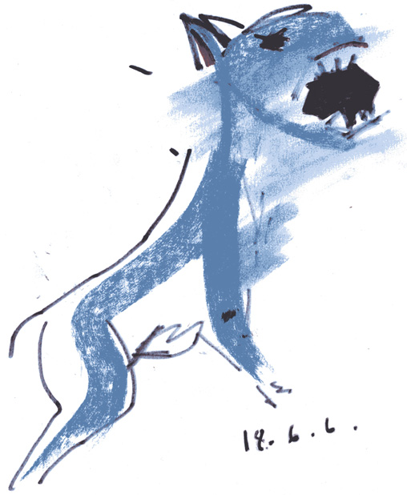
Dogs in the Feedback
−
“there is no dog”
V_{in}
+
inverse dog
dog
The op-amp is obligated to contrive the inverse dog so that the ultimate output may be as tidy as the input.
Lesson: you can hide nasty nonlinearities in the feedback loop and the op-amp will “do the right thing”
We owe thanks to Hayes & Horowitz, p. 173 of the student manual companion to
the Art of Electronics for this priceless metaphor.

Slide 10
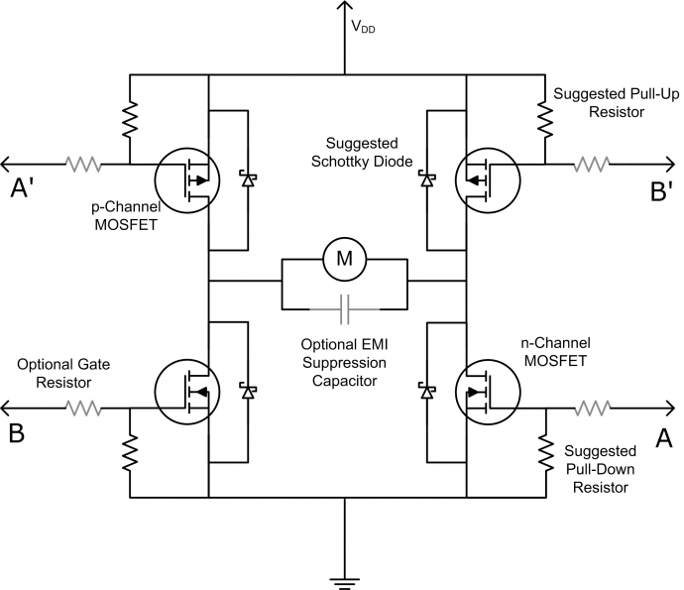
MOSFETs often a good choice
MOSFETs are basically voltage-controlled switches
n-channel becomes “short” when logic high applied
p-channel becomes “short” when logic low applied
otherwise open
Can arrange in H-bridge (or use pre-packaged H-bridge on a chip)
so A=HI; A’=LOW applies VDD to left, ground to right
B=HI; B’=LOW does the opp.
A and A’ always opposite, etc.
A and B default to LOW state

Slide 11
Timing Issues
Microcontrollers are fast, but speed limitations may well become an issue for some
Arduino processor runs at clock speed of 16 MHz
62.5 ns = 0.0625 μs
machine commands take 1, 2, 3, or 4 cycles to complete
see chapter 32 of datasheet (pp. 537−539) for table by command
but Arduino C commands may have dozens of associated machine commands
for example, digitalWrite() has 78 commands, though not all will be visited, as some are conditionally branched around (~36 if not PWM pin)
testing reveals 4 μs per digitalWrite() operation (5 if PWM pin)
implies about 64 (80) clock cycles to carry out

Slide 12
Timing Exploration, continued
Program is basically repetitive commands, with micros() bracketing actions
micros() itself (in 16 repeated calls, nothing between) comes in at taking 4 μs to complete
Serial.print() takes 1040 μs per character at 9600 baud
8 data bits, start bit, stop bit → 10 bits, expect 1041.7 μs
println() adds 2-character delay
digitalRead() takes 4 μs per read
analogRead() takes 122 μs per read
Also keep in mind 20 ms period on servo 50 Hz PWM
And when thinking about timing, consider inertia
might detect obstacle 5 cm ahead in < 1 ms, but can you stop in time?

Slide 13
Another Way to Explore Timing
Don’t be shy of using the oscilloscope
a pair of digitalWrite() commands, HIGH, then LOW, will create a pulse that can be easily triggered, captured, and measured
for that matter, you can use digital output pins expressly for the purpose of establishing relative timings between events
helps if you have to choreograph, synchronize, or just troubleshoot in the time domain
think of the scope as another debugging tool, complementary to Serial, and capable of faster information

Slide 14
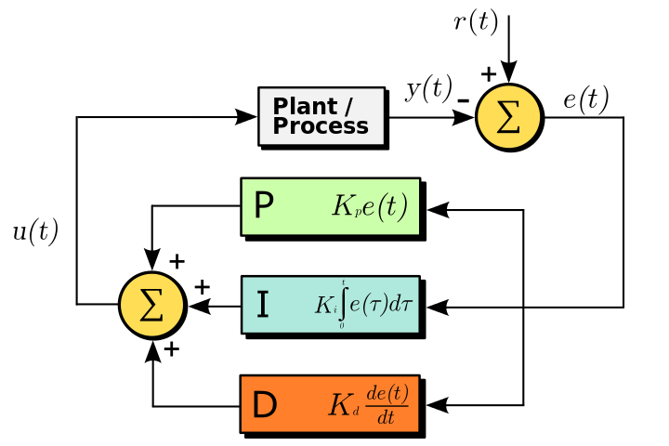
Control Problems
When it comes to controlling something through feedback, always think PID first
PID: proportional, integral, derivative
desired output
actual output
subtract
error signal
control value:
add

Slide 15
PID, in pieces
Proportional (Ghost of Conditions Present)
where are we now?
simple concept: take larger action for larger error
in light-tracker, drive more degrees the larger the difference between phototransistors
higher gain could make unstable; lower gain sluggish
Integral (Ghost of Conditions Past)
where have we been?
sort of an averaging effect: error × time
responds to nagging offset, fixing longstanding errors
looking to past can lead to overshoot, however, if gain is too high
Derivative (Ghost of Conditions Future)
where are we heading?
damps changes that are too fast; helps control overshoot
gain too high amplifies noise and can produce instability

Slide 16
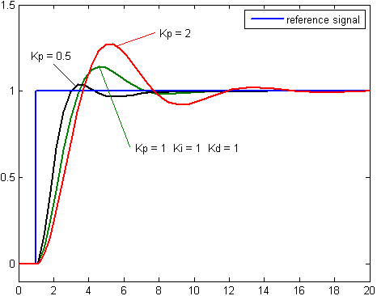
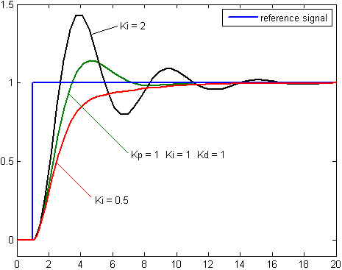
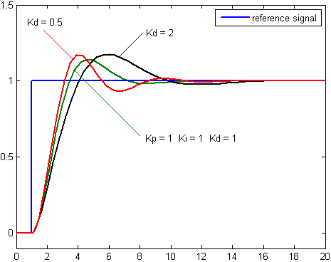
PID, in pictures
P
I
Impact of changing different gains, while others held fixed
blue is desired response
green is nominal case
K_{p} = K_{i} = K_{d} = 1 in this case
ideal values depend on system
D

Slide 17
Tuning PID Control
See http://en.wikipedia.org/wiki/PID_controller
One attractive suggested procedure:
first control the system only with proportional gain
note ultimate gain, K_{u}, at which oscillation sets in
note period of oscillation at this ultimate gain, P_{u}
If dealing with P only, set K_{p} = 0.5K_{u}
If PI control: set K_{p} = 0.45 K_{u}; K_{i} = 1.2K_{p}/P_{u}
If full PID: K_{p} = 0.6K_{u}; K_{i} = 2K_{p}/P_{u}; K_{d} = K_{p}×P_{u}/8
Control Theory is a rich, complicated, PhD-earning subject
not likely to master it in this class, but might well scratch the surface and use some well-proven techniques

Slide 18
Announcements
Project Proposals due Friday, 2/8, in class
This week’s lab:
could work on light-tracker (due by next week, 2/12, 2/13)
could work on proposals with “consultants” at hand
Next week we’ll begin project mode, with new schedule

