Slide 1
Physics 120B: Lecture 11
Assembly Language and Arduino

Slide 2
Behind the C code (or sketch)
C provides a somewhat human-readable interface
  but it gets compiled into machine instruction set
  ultimately just binary (or hex) instructions loaded into the ATMega program memory (flash)
  even so, each instruction can be expressed in human terms
  called “assembly language” or “machine code”
Assembly instruction set is very low level
  dealing with the processing of one data parcel (byte, usu.) at a time
  a C command may break out into a handful of machine instructions

Slide 3
Viewing assembly produced by Arduino
Look within the Arduino install directory:
  On a Mac:
    /Applications/Arduino.app/Contents/Resources/Java/
  we looked before in hardware/arduino/ for code details
  in hardware/arduino/tools/avr/bin/ are some utilities
RXTXcomm.jar lib/ quaqua.jar
core.jar libquaqua.jnilib reference/
ecj.jar libquaqua64.jnilib revisions.txt
examples/ libraries/ tools/
hardware/ librxtxSerial.jnilib
jna.jar pde.jar
avarice* avr-gcc* avr-gprof* avr-project* ice-insight*
avr-addr2line* avr-gcc-3.4.6* avr-help* avr-ranlib* kill-avarice*
avr-ar* avr-gcc-4.3.2* avr-info* avr-readelf* libusb-config*
avr-as* avr-gcc-select* avr-ld* avr-size* make*
avr-c++* avr-gccbug* avr-man* avr-strings* simulavr*
avr-c++filt* avr-gcov* avr-nm* avr-strip* simulavr-disp*
avr-cpp* avr-gdb* avr-objcopy* avrdude* simulavr-vcd*
avr-g++* avr-gdbtui* avr-objdump* ice-gdb* start-avarice*

Slide 4
AVR, Dude?
AVR is an 8-bit architecture developed by Atmel
  http://en.wikipedia.org/wiki/Atmel_AVR
  used by ATMega chips, on which Arduino is based
Note in particular avr-objdump, avrdude
  the latter mostly because it has a cool name (it can be used to shove machine code (.hex) onto chip)
    DUDE means Downloader UploaDEr (a stretch)
Running avr-objdump on .o or .elf files in your local Arduino/build/ directory disassembles code
  the -d flag produces straight code
  the -S flag intersperses with commented C-like code

Slide 5
Use .o or .elf?
Can dump either stuff in the .o file or the .elf file
  the .o file contains just the pieces you programmed
    thus leaves out the code behind built-in functions
  the .elf file contains the rest of the ATMega interface
  so .o output will be smaller, but lack full context

Slide 6
Example: Simple Blink program
const int LED=13;
void setup()
{
pinMode(LED,OUTPUT);
}
void loop()
{
digitalWrite(LED,HIGH);
delay(250);
digitalWrite(LED,LOW);
delay(500);
}
Look how small it is, when written in high-level human terms!

Slide 7
Compiled, in build directory
Compilation produces following in IDE message box:
  Binary sketch size: 1,076 bytes (of a 30,720 byte maximum)
Listing of build directory:
  note file size in bytes
  .d file is list of header files
  .eep is about EEPROM data
  .o and .elf are compiled
  .hex is what is sent to chip
    note that the ASCII representation is at least 2× larger than binary version (e.g., 9C takes 2 bytes to write in ASCII, 1 byte in memory)
-rw-r--r-- 1 tmurphy tmurphy 239 Feb 3 08:42 simple_blink.cpp
-rw-r--r-- 1 tmurphy tmurphy 1062 Feb 3 08:42 simple_blink.cpp.d
-rw-r--r-- 1 tmurphy tmurphy 13 Feb 3 08:42 simple_blink.cpp.eep
-rwxr-xr-x 1 tmurphy tmurphy 14061 Feb 3 08:42 simple_blink.cpp.elf*
-rw-r--r-- 1 tmurphy tmurphy 3049 Feb 3 08:42 simple_blink.cpp.hex
-rw-r--r-- 1 tmurphy tmurphy 3892 Feb 3 08:42 simple_blink.cpp.o

Slide 8
simple_blink.cpp
Basically what’s in the sketch, with some wrapping
#include "Arduino.h"
void setup();
void loop();
const int LED=13;
void setup()
{
pinMode(LED,OUTPUT);
}
void loop()
{
digitalWrite(LED,HIGH);
delay(250);
digitalWrite(LED,LOW);
delay(500);
}

Slide 9
avr-objdump -d on .o file
simple_blink.cpp.o: file format elf32-avr
Disassembly of section .text.loop:
00000000 <loop>:
0: 8d e0 ldi r24, 0x0D ; 13
2: 61 e0 ldi r22, 0x01 ; 1
4: 0e 94 00 00 call 0 ; 0x0 <loop>
8: 6a ef ldi r22, 0xFA ; 250
a: 70 e0 ldi r23, 0x00 ; 0
c: 80 e0 ldi r24, 0x00 ; 0
e: 90 e0 ldi r25, 0x00 ; 0
10: 0e 94 00 00 call 0 ; 0x0 <loop>
14: 8d e0 ldi r24, 0x0D ; 13
16: 60 e0 ldi r22, 0x00 ; 0
18: 0e 94 00 00 call 0 ; 0x0 <loop>
pgm hex cmd arguments ; comments
Just the start of the 32-line file
Entries are:
  program memory address; hex command; assembly command, arguments, comments

Slide 10
avr-objdump -S on .o file
00000000 <loop>:
pinMode(LED,OUTPUT);
}
void loop()
{
digitalWrite(LED,HIGH);
0: 8d e0 ldi r24, 0x0D ; 13
2: 61 e0 ldi r22, 0x01 ; 1
4: 0e 94 00 00 call 0 ; 0x0 <loop>
delay(250);
8: 6a ef ldi r22, 0xFA ; 250
a: 70 e0 ldi r23, 0x00 ; 0
c: 80 e0 ldi r24, 0x00 ; 0
e: 90 e0 ldi r25, 0x00 ; 0
10: 0e 94 00 00 call 0 ; 0x0 <loop>
digitalWrite(LED,LOW);
14: 8d e0 ldi r24, 0x0D ; 13
16: 60 e0 ldi r22, 0x00 ; 0
18: 0e 94 00 00 call 0 ; 0x0 <loop>
Now has C code interspersed; 49 lines in file
  but does not make sense on its own; call references wrong

Slide 11
avr-objdump -d on .elf file
00000100 <loop>:
100: 8d e0 ldi r24, 0x0D ; 13
102: 61 e0 ldi r22, 0x01 ; 1
104: 0e 94 b5 01 call 0x36a ; 0x36a <digitalWrite>
108: 6a ef ldi r22, 0xFA ; 250
10a: 70 e0 ldi r23, 0x00 ; 0
10c: 80 e0 ldi r24, 0x00 ; 0
10e: 90 e0 ldi r25, 0x00 ; 0
110: 0e 94 e2 00 call 0x1c4 ; 0x1c4 <delay>
114: 8d e0 ldi r24, 0x0D ; 13
116: 60 e0 ldi r22, 0x00 ; 0
118: 0e 94 b5 01 call 0x36a ; 0x36a <digitalWrite>
Now loop starts at memory location (program counter) 100 (hex)
  and calls to other routines no longer just address 0
  note useful comments for writes and delays
  note also extensive use of registers r22, r24, etc.

Slide 12
avr-objdump -S on .elf file
void loop()
{
digitalWrite(LED,HIGH);
100: 8d e0 ldi r24, 0x0D ; 13
102: 61 e0 ldi r22, 0x01 ; 1
104: 0e 94 b5 01 call 0x36a ; 0x36a <digitalWrite>
delay(250);
108: 6a ef ldi r22, 0xFA ; 250
10a: 70 e0 ldi r23, 0x00 ; 0
10c: 80 e0 ldi r24, 0x00 ; 0
10e: 90 e0 ldi r25, 0x00 ; 0
110: 0e 94 e2 00 call 0x1c4 ; 0x1c4 <delay>
digitalWrite(LED,LOW);
114: 8d e0 ldi r24, 0x0D ; 13
116: 60 e0 ldi r22, 0x00 ; 0
118: 0e 94 b5 01 call 0x36a ; 0x36a <digitalWrite>
delay(500);
11c: 64 ef ldi r22, 0xF4 ; 244
11e: 71 e0 ldi r23, 0x01 ; 1
Embedded C code
  note 500 delay is 1×256 + 244 (0x01F4)

Slide 13
A look at .hex file
:100100008DE061E00E94B5016AEF70E080E090E070
:100110000E94E2008DE060E00E94B50164EF71E0B2
:1001200080E090E00E94E20008958DE061E00E948E
Snippet of ASCII .hex file around sections displayed on previous four slides
  first: how many bytes in line (2 hex characters/byte)
  next, program counter for 1st instr. in line: 0100, 0110, 0120
  then 00, then, instructions, like: 8DE0, 61E0, 0E94B501
    just contents of assembly, in hex terms
  checksum at end
100: 8d e0 ldi r24, 0x0D ; 13
102: 61 e0 ldi r22, 0x01 ; 1
104: 0e 94 b5 01 call 0x36a ; 0x36a <digitalWrite>
108: 6a ef ldi r22, 0xFA ; 250
10a: 70 e0 ldi r23, 0x00 ; 0
10c: 80 e0 ldi r24, 0x00 ; 0
10e: 90 e0 ldi r25, 0x00 ; 0
110: 0e 94 e2 00 call 0x1c4 ; 0x1c4 <delay>

Slide 14
Counting bytes
The end of the hex file looks like:
And the corresponding assembly:
  last 4 bytes on penultimate line; note 04 leader (4 bytes)
    normal (full) line has 16 bytes (hex 0x10)
    67 full-size lines is 1072 bytes, plus four at end → 1076 bytes
    Recall: Binary sketch size: 1,076 bytes (of a 30,720 byte maximum)
Last line in hex file likely a standard ending sequence
:10042000D0E00E9480002097E1F30E940000F9CF05
:04043000F894FFCF6E
:00000001FF
42a: 0e 94 00 00 call 0 ; 0x0 <__vectors>
42e: f9 cf rjmp .-14 ; 0x422 <main+0x10>
00000430 <_exit>:
430: f8 94 cli
00000432 <__stop_program>:
432: ff cf rjmp .-2 ; 0x432 <__stop_program>

Slide 15
Great, but what does it mean?
We’ve seen some patterns, and seen assembly code
  but what do we make of it?
See Chapter 32 of ATMega datasheet, pp. 537–539
  or http://en.wikipedia.org/wiki/Atmel_AVR_instruction_set
But won’t learn without a lot of effort
Some examples:
  in the copied code, we really only saw LDI and CALL
  LDI puts contents of byte K (2nd arg.) into register Rd (1st arg.)
  CALL loads K (only arg.) into PC (program counter)
    so next operation takes place there; saves place for call origin
  note info on how many clock cycles are taken

Slide 16
Inserting Assembly Code into C Sketch
The Arduino interface provides a means to do this
  via asm() command
Can send digital values directly to port
Why would you do this?
  consider that digitalWrite() takes > 60 clock cycles
    maybe you need faster action
    maybe you need several pins to come on simultaneously
  might need delays shorter than 1 μs
    insert nop (no operation) commands, taking 1 cycle each
  might need to squeeze code to fit into flash memory
    direct low-level control without bells & whistles is more compact
Why wouldn’t you do this?
  lose portability, harder to understand code, mistake prone

Slide 17
Direct Port Manipulation
Can actually do this without going all the way to assembly language
  see http://arduino.cc/en/Reference/PortManipulation
  PORTD maps to pins 0−7 on Arduino
  PORTB (0:5) maps to pins 8−13 on Arduino
  PORTC (0:5) maps to analog pins 0−5
  Each (D/B/C) has three registers to access; e.g., for port D:
    DDRD: direction: 11010010 has pins 1, 4, 6, 7 as output
      must keep pin 0 as input, pin 1 as output if Serial is used
    PORTD: read/write values (can probe PORTD as well as set it)
    PIND: read values (cannot set it)
  So DDR replaces pinMode()
  writing PORTD = B01010010 puts pins 6, 4, 1 HIGH at once

Slide 18
Example: Hard-coded Outputs
void setup()
{
DDRD |= B00010010;
}
void loop()
{
PORTD |= B00010000;
delay(250);
PORTD &= B11101111;
delay(500);
}
Serial-friendly, and sets pin 4 (D:4) as output
Uses bitwise logic AND, OR, and NOT to set pin values
  virtue of this is that it leaves other pin values undisturbed
Sketch compiles to 676 bytes
  compare to 1076 using Arduino commands

Slide 19
More Flexible Coding of Same
const int OUTBIT=4;
void setup()
{
DDRD = B00000010 | (1 << OUTBIT);
}
void loop()
{
PORTD |= (1 << OUTBIT);
delay(250);
PORTD &= ~(1 << OUTBIT);
delay(500);
}
Again sets port D to be Serial-friendly and pin 4 as output
Still 676 bytes (no penalty for flexibility)
  compiles to same actions, but now easier to modify
  compiles to 474 bytes without delay functions
  adding back pinMode() → 896 bytes
  then restoring digitalWrite() → 1076 bytes

Slide 20
Resulting Assembly Code
0001 0010
DDRD = B00000010 | (1 << OUTPIN);
a6: 82 e1 ldi r24, 0x12 ; 18
a8: 8a b9 out 0x0a, r24 ; 10
PORTD |= (1 << OUTPIN);
ac: 5c 9a sbi 0x0b, 4 ; 11
PORTD &= ~(1 << OUTPIN);
ba: 5c 98 cbi 0x0b, 4 ; 11
Tiny commands
  load (LDI) B00010010 (0x12) into r24 (register 24)
  write r24 out (OUT) to port 0x0a (see ATMega register summary)
  set 4th bit (SBI) of register 0x0b (write HIGH to that pin)
  clear 4th bit (CBI) of register 0x0b (write LOW to that pin)

Slide 21
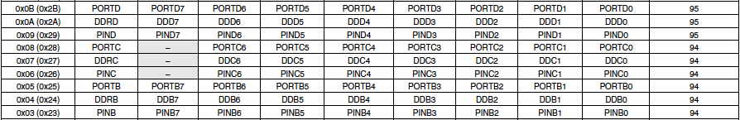
What’s with addresses 0x0a and 0x0b?
From the ATMega short datasheet
  we see 0x0a is DDRD
  and 0x0b is PORTD
  0x09 is PIND, if anyone cares (Port D input pin address)
And the commands used in previous clip…

Slide 22
Direct Assembly in Sketch
void setup()
{
asm("ldi\tr24, 0x12\n\t" "out\t0x0a, r24\n\t");
// could replace with asm("sbi\t0x0a,4\n\t");
}
void loop()
{
asm("sbi\t0x0b, 4\n\t");
delay(250);
asm("cbi\t0x0b, 4\n\t");
delay(500);
}
Use if you’re really feeling black-belt…
  note use of tabs (\t), and each instruction ending (\n\t)
  can gang several instructions into same asm() command
  no advantage in this program over PORTD approach (in fact, far less intelligible), but illustrates method (and actually works!)

Slide 23
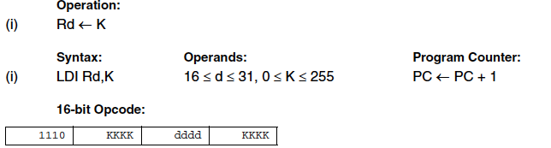
Packing command into hex
a6: 82 e1 ldi r24, 0x12 ; 18
a8: 8a b9 out 0x0a, r24 ; 10
ac: 5c 9a sbi 0x0b, 4 ; 11
ba: 5c 98 cbi 0x0b, 4 ; 11
The human-readable form gets packed into hex code
Prescription varies by command, found in instruction set reference (link from course website); for LDI:
  r24 → d = 24, which is 8 off minimum of 16, so dddd → 1000
  K = 0x12 = 0001 0010
  1110 0001 1000 0010 = E 1 8 2 → 82 E1, as in line a6 above

Slide 24
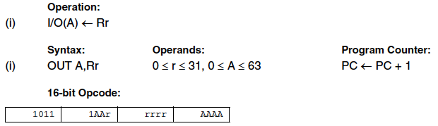
More Examples
a8: 8a b9 out 0x0a, r24 ; 10
OUT command
  r = 24 = 0x18 = 0001 1000, or 1 1000 split to r rrrr
  A = 0x0a = 0000 1010, or 00 1010 split to AA AAAA
  so get 1011 1001 1000 1010 = B 9 8 A → 8A B9

Slide 25
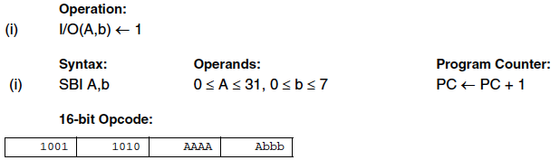
One More Example
ac: 5c 9a sbi 0x0b, 4 ; 11
SBI command
  A = 0x0b = 0000 1011 → 0101 1 when split to AAAA A
  b = 4 = 100
  so have 1001 1010 0101 1100 = 9 A 5 C → 5C 9A

Slide 26
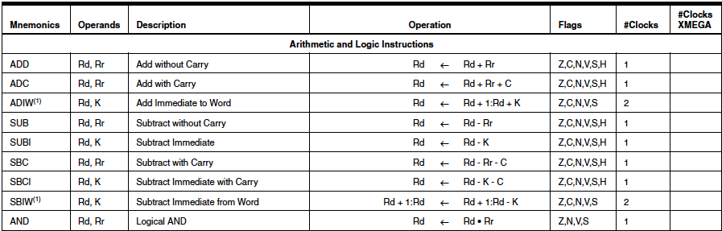
Language Reference
First portion of 3 page instruction set (119 cmds.)
  29 arithmetic and logic; 38 branch; 20 data transfer; 28 bit and bit-test; 4 MCU control
Flags store results from operation, like:
  was result zero (Z)?, was there a carry (C)?, result negative (N)?, and more

Slide 27
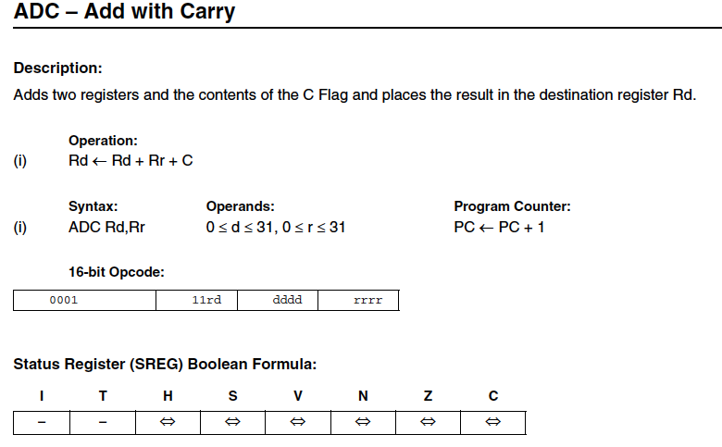
Example from Instruction Reference
First half of page for add with carry
Note use of C status bit

Slide 28
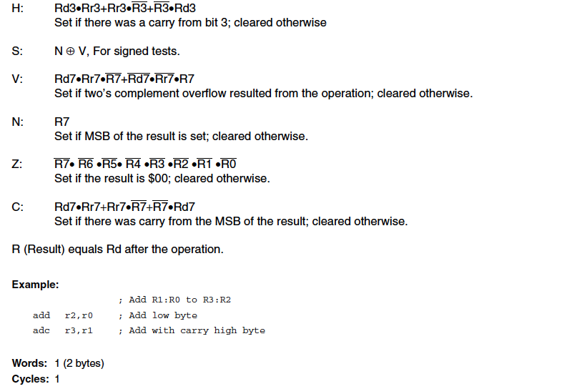
ADC, Continued

Slide 29
Example code: delay function
delay(2000);
ac: 60 ed ldi r22, 0xD0 ; 208
ae: 77 e0 ldi r23, 0x07 ; 7
b0: 80 e0 ldi r24, 0x00 ; 0
b2: 90 e0 ldi r25, 0x00 ; 0
b4: 0e 94 ac 00 call 0x158 ; 0x158 <delay>
Want to wait for 2000 ms
Load registers 22..25 with 2000
  0×2²⁴ 0×2¹⁶ 7×2⁸ 208×2⁰ = 2000
Call program memory location 0x158
  first store address of next instruction (0xb8) in STACK
  set program counter (PC) to 0x158
  next instruction will be at program address 0x158
  return from routine will hit program at location 0xb8

Slide 30
Delay Function
Has 81 lines of assembly code
  many instructions repeated in loops
  uses commands MOVW, IN, CLI, LDS, SBIS, RJMP, CPI, BREQ, ADDIW, ADC, MOV, EOR, ADD, LDI, BRNE, SUB, SBC, SUBI, SBCI, BRCS, CP, CPC, RET
  essentially loads a counter with how many milliseconds
  and another counter with 1000
  rifles through a microsecond (16 clock cycles), decrementing microsecond counter (down from 1000)
  when 1k counter reaches zero, 1 ms elapsed, decrement ms counter
  after each decrement, check if zero and return if so

Slide 31
Announcements
Project proposals due Friday, 2/07
Tracker check-off, turn in code by 2/11 or 2/12
Will move to new lab schedule next week
  fill out Doodle poll if you haven’t and want a say
  partners can both fill out poll, so not underrepresented
Lectures will terminate after this week
Let’s plan “midterm” for Wednesday, 2/19
  will give example of some simple task you are to do in Arduino, and you write down C-code on blank paper that would successfully compile and perform the desired task

