Slide 1
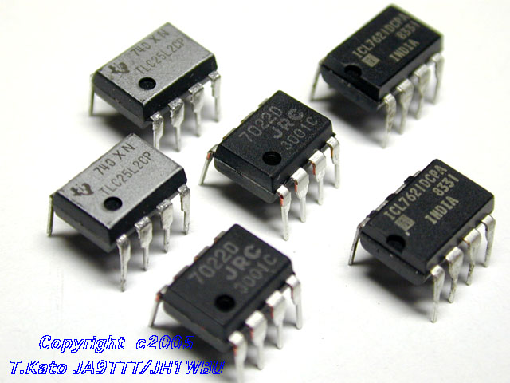
Operational Amplifiers
Magic Rules
Application Examples

Slide 2
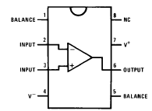
Op-Amp Introduction
Op-amps (amplifiers/buffers in general) are drawn as a triangle in a circuit schematic
There are two inputs
inverting and non-inverting
And one output
Also power connections (note no explicit ground)
divot on pin-1 end
V⁺
2
−
7
inverting input
6
output
non-inverting input
+
3
4
V⁻

Slide 3
The ideal op-amp
Infinite voltage gain
a voltage difference at the two inputs is magnified infinitely
in truth, something like 200,000
means difference between + terminal and − terminal is amplified by 200,000!
Infinite input impedance
no current flows into inputs
in truth, about 10¹² Ω for FET input op-amps
Zero output impedance
rock-solid independent of load
roughly true up to current maximum (usually 5–25 mA)
Infinitely fast (infinite bandwidth)
in truth, limited to few MHz range
slew rate limited to 0.5–20 V/μs

Slide 4
Op-amp without feedback
The internal op-amp formula is:
V_{out} = gain×(V₊ − V₋)
So if V₊ is greater than V₋, the output goes positive
If V₋ is greater than V₊, the output goes negative
A gain of 200,000 makes this device (as illustrated here) practically useless
V₋
−
V_{out}
V₊
+

Slide 5
Infinite Gain in negative feedback
Infinite gain would be useless except in the self-regulated negative feedback regime
negative feedback seems bad, and positive good—but in electronics positive feedback means runaway or oscillation, and negative feedback leads to stability
Imagine hooking the output to the inverting terminal:
If the output is less than V_{in}, it shoots positive
If the output is greater than V_{in}, it shoots negative
result is that output quickly forces itself to be exactly V_{in}
−
negative feedback loop
V_{in}
+

Slide 6
Even under load
Even if we load the output (which as pictured wants to drag the output to ground)…
the op-amp will do everything it can within its current limitations to drive the output until the inverting input reaches V_{in}
negative feedback makes it self-correcting
in this case, the op-amp drives (or pulls, if V_{in} is negative) a current through the load until the output equals V_{in}
so what we have here is a buffer: can apply V_{in} to a load without burdening the source of V_{in} with any current!
−
Important note: op-amp output terminal
sources/sinks current at will: not like
inputs that have no current flow
V_{in}
+

Slide 7
Positive feedback pathology
In the configuration below, if the + input is even a smidge higher than V_{in}, the output goes way positive
This makes the + terminal even more positive than V_{in}, making the situation worse
This system will immediately “rail” at the supply voltage
could rail either direction, depending on initial offset
−
V_{in}
+
positive feedback: BAD

Slide 8
Op-Amp “Golden Rules”
When an op-amp is configured in any negative-feedback arrangement, it will obey the following two rules:
The inputs to the op-amp draw or source no current (true whether negative feedback or not)
The op-amp output will do whatever it can (within its limitations) to make the voltage difference between the two inputs zero

Slide 9
Inverting amplifier example
R₂
R₁
V_{in}
−
V_{out}
+
Applying the rules: − terminal at “virtual ground”
so current through R₁ is I_{f} = V_{in}/R₁
Current does not flow into op-amp (one of our rules)
so the current through R₁ must go through R₂
voltage drop across R₂ is then I_{f}R₂ = V_{in}×(R₂/R₁)
So V_{out} = 0 − V_{in}×(R₂/R₁) = −V_{in}×(R₂/R₁)
Thus we amplify V_{in} by factor −R₂/R₁
negative sign earns title “inverting” amplifier
Current is drawn into op-amp output terminal

Slide 10
Non-inverting Amplifier
R₂
R₁
−
V_{out}
V_{in}
+
Now neg. terminal held at V_{in}
so current through R₁ is I_{f} = V_{in}/R₁ (to left, into ground)
This current cannot come from op-amp input
so comes through R₂ (delivered from op-amp output)
voltage drop across R₂ is I_{f}R₂ = V_{in}×(R₂/R₁)
so that output is higher than neg. input terminal by V_{in}×(R₂/R₁)
V_{out} = V_{in} + V_{in}×(R₂/R₁) = V_{in}×(1 + R₂/R₁)
thus gain is (1 + R₂/R₁), and is positive
Current is sourced from op-amp output in this example

Slide 11
Summing Amplifier
R_{f}
R₁
V₁
−
R₂
V_{out}
V₂
+
Much like the inverting amplifier, but with two input voltages
inverting input still held at virtual ground
I₁ and I₂ are added together to run through R_{f}
so we get the (inverted) sum: V_{out} = −R_{f}×(V₁/R₁ + V₂/R₂)
if R₂ = R₁, we get a sum proportional to (V₁ + V₂)
Can have any number of summing inputs
we’ll make our D/A converter this way

Slide 12
Differencing Amplifier
R₂
R₁
V⁻
−
V_{out}
V⁺
+
R₁
R₂
The non-inverting input is a simple voltage divider:
V_{node} = V⁺R₂/(R₁ + R₂)
So I_{f} = (V⁻ − V_{node})/R₁
V_{out} = V_{node} − I_{f}R₂ = V⁺(1 + R₂/R₁)(R₂/(R₁ + R₂)) − V⁻(R₂/R₁)
so V_{out} = (R₂/R₁)(V⁺ − V⁻)
therefore we difference V⁺ and V⁻

Slide 13
Differentiator (high-pass)
R
C
V_{in}
−
V_{out}
+
For a capacitor, Q = CV, so I_{cap} = dQ/dt = C·dV/dt
Thus V_{out} = −I_{cap}R = −RC·dV/dt
So we have a differentiator, or high-pass filter
if signal is V₀sinωt, V_{out} = −V₀RCωcosωt
the ω-dependence means higher frequencies amplified more

Slide 14
Low-pass filter (integrator)
C
R
V_{in}
−
V_{out}
+
I_{f} = V_{in}/R, so C·dV_{cap}/dt = V_{in}/R
and since left side of capacitor is at virtual ground:
−dV_{out}/dt = V_{in}/RC
so
and therefore we have an integrator (low pass)

Slide 15
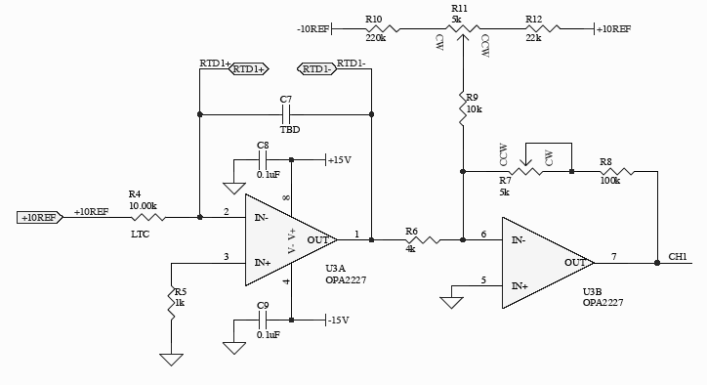
RTD Readout Scheme

Slide 16
Notes on RTD readout
RTD has resistance R = 1000 + 3.85×T(°C)
Goal: put 1.00 mA across RTD and present output voltage proportional to temperature: V_{out} = V₀ + αT
First stage:
put precision 10.00 V reference across precision 10kΩ resistor to make 1.00 mA, sending across RTD
output is −1 V at 0°C; −1.385 V at 100°C
Second stage:
resistor network produces 0.25 mA of source through R9
R6 slurps 0.25 mA when stage 1 output is −1 V
so no current through feedback → output is zero volts
At 100°C, R6 slurps 0.346 mA, leaving net 0.096 that must come through feedback
If R7 + R8 = 10389 ohms, output is 1.0 V at 100°C
Tuning resistors R11, R7 allows control over offset and gain, respectively: this config set up for V_{out} = 0.1T

Slide 17
Hiding Distortion
Consider the “push-pull” transistor arrangement to the right
an npn transistor (top) and a pnp (bot)
wimpy input can drive big load (speaker?)
base-emitter voltage differs by 0.6V in each transistor (emitter has arrow)
input has to be higher than ~0.6 V for the npn to become active
input has to be lower than −0.6 V for the pnp to be active
There is a no-man’s land in between where neither transistor conducts, so one would get “crossover distortion”
output is zero while input signal is between −0.6 and 0.6 V
V⁺
in
out
V⁻
crossover distortion

Slide 18
Stick it in the feedback loop!
V⁺
−
out
V_{in}
+
V⁻
input and output
now the same
By sticking the push-pull into an op-amp’s feedback loop, we guarantee that the output faithfully follows the input!
after all, the golden rule demands that + input = − input
Op-amp jerks up to 0.6 and down to −0.6 at the crossover
it’s almost magic: it figures out the vagaries/nonlinearities of the thing in the loop
Now get advantages of push-pull drive capability, without the mess

Slide 19
Dogs in the Feedback
−
“there is no dog”
V_{in}
+
inverse dog
dog
The op-amp is obligated to contrive the inverse dog so that the ultimate output may be as tidy as the input.
Lesson: you can hide nasty nonlinearities in the feedback loop and the op-amp will “do the right thing”
We owe thanks to Hayes & Horowitz, p. 173 of the student manual companion to
the Art of Electronics for this priceless metaphor.

Slide 20
Reading
Read 6.4.2, 6.4.3
Pay special attention to Figure 6.66 (6.59 in 3rd ed.)

