Slide 1
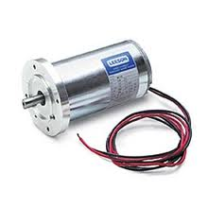
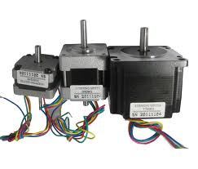
Physics 124: Lecture 3
Motors: Servo; DC; Stepper
Messing with PWM (and 2-way serial)
The Motor Shield

Slide 2
Three Types (for us)
Servo motor
PWM sets position, used for R/C planes, cars, etc.
180° range limit, typically
5 V supply
Stepper motor
For precise angular control or speed control
Can rotate indefinitely
Lots of holding torque
DC motor
simplest technology; give up on precise control
good when you just need something to SPIN!

Slide 3
When any old PWM won’t do
The function analogWrite() gives you easy control over the duty cycle of PWM output
but no control at all over frequency
Consider the Hitec servo motors we’ll be using:
Wants a 50 Hz pulse rate, and a duty cycle from 4.5% to 10.5% (11/255 to 27/255) to drive full range

Slide 4
What frequency is Arduino PWM?
Depends on which output is used
Pins 5 and 6: default ~977 Hz
16 MHz clock rate divided by 2¹⁴ = 16384
Pins 3, 9, 10, 11: default 488 Hz
16 MHz / 2¹⁵
Neither is at all like the 50 Hz we need for the servo motor

Slide 5
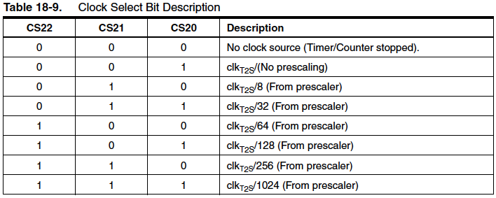
What choice do we have?
We can change the clock divider on any of three counters internal to the ATMega328
timer/counter 0, 1, and 2
consider this snippet from the register map:
note in particular the lowest 3 bits in TCCR2B
setting these according to the following rubric scales speed

Slide 6
Valid Divider Options
PWM pins | Register | scaler values | frequencies (Hz)
5, 6 | TCCR0B | 1, 2, 3, 4, 5 | 62500, 7812, 977, 244, 61.0
9, 10 | TCCR1B | 1, 2, 3, 4, 5 | 31250, 3906, 488, 122, 30.5
3, 11 | TCCR2B | 1, 2, 3, 4, 5, 6, 7 | 31250, 3906, 977, 488, 244, 122, 30.5
Defaults are shown in red
Obviously, choices are limited, and we can’t precisely hit our 50 Hz target
Closest is to use timer 0 with divider option 5 (61 Hz)
0.9 to 2.1 ms pulses correspond to 14/255 to 33/255
only 20 possible steps by this scheme

Slide 7
How to set divider and change PWM freq.
It’s actually not that hard
can do in setup or in main loop
Broken Down:
modifying TCCR0B associated with pins 5 & 6
& is bitwise AND operator
0b11111000 is binary mask, saying “keep first five as-is”
while zeroing final three bits (because 0 AND anything is 0)
| is bitwise OR operator, effectively combining two pieces
0x05 is hex for 5, which will select 61.0 Hz on Timer0
if TCCR0B started as vwxyzabc, it ends up as vwxyz101
TCCR0B = TCCR0B & 0b11111000 | 0x05;

Slide 8
Code to interactively explore PWM frequencies
Will use serial communications in both directions
continued on next slide…
const int LED = 5; // or any PWM pin (3,5,6,9,10,11)
char ch; // holds character for serial command
void setup()
{
pinMode(LED,OUTPUT); // need to config for output
Serial.begin(9600);
}

Slide 9
…continued
void loop()
{
analogWrite(LED,128); // 50% makes freq. meas. easier
if (Serial.available()){ // check if incoming (to chip)
ch = Serial.read(); // read single character
if (ch >=‘0’ && ch <=‘7’){ // valid range
if (LED == 3 || LED == 11){ // will use timer2
TCCR2B = TCCR2B & 0b11111000 | int(ch - ‘0’);
Serial.print(“Switching pin ”);
Serial.print(LED);
Serial.print(“ to setting “);
Serial.println(ch);
}
}
if (ch >=‘0’ && ch <=‘5’){ // valid for other timers
if (LED == 5 || LED == 6){ // will use timer0
TCCR0B = TCCR0B & 0b11111000 | int(ch – ‘0’);
Serial.print(same stuff as before…);
}
if (LED == 9 || LED == 10){ // uses timer1
TCCR1B etc.
} } } } // would indent more cleanly if space

Slide 10
Using the interactive program
Use serial monitor (Tools: Serial Monitor)
make sure baud rate in lower right is same as in setup()
can send characters too
in this case, type single digit and return (or press send)
get back message like:
Switching pin 11 to setting 6
and should see frequency change accordingly

Slide 11
Rigging a Servo to sort-of work
Original motivation was getting a 50 Hz servo to work
continued next slide…
const int SERVO = 5;
char ch; // for interactive serial control
int level = 23; // 23 is 1.5 ms; 14 is 0.9; 33 is 2.1
void setup()
{
pinMode(SERVO, OUTPUT); // set servo pin for output
Serial.begin(9600);
TCCR0B = TCCR0B & 0b11111000 | 0x05; // for 61 Hz
analogWrite(SERVO, level); // start centered
}

Slide 12
Continuation: main loop
void loop()
{
if (Serial.available()){ // check if incoming serial data
ch = Serial.read(); // read single character
if (ch >=‘0’ && ch <=‘9’){ // use 10 step range for demo
level = map(ch-’0’,0,9,14,33); // map 0-9 onto 14-33
analogWrite(SERVO, level); // send to servo
Serial.print(“Setting servo level to: “);
Serial.println(level);
}
}
delay(20); // interactive program, so slow
}
Being lazy and only accepting single-character commands, limited to ten values, mapping onto 20
the map() function is useful here
the ch - ‘0’ does “ASCII subtraction”

Slide 13
A better (and easier!) way
The previous approach was a poor fit
poor match to frequency, and not much resolution
Arduino has a library specifically for this: Servo.h
Various libraries come with the Arduino distribution
in /Applications/Arduino.app/Contents/Resources/Java/libraries on my Mac
Handles stepper and servo motors, LCDs, memory storage in either EEPROM (on-board) or SD card; several common communication protocols (ethernet—for use with shield, SPI, 2-wire, and emulated serial)
can look at code as much as you want
EEPROM/ Firmata/ SD/ Servo/ Stepper/
Ethernet/ LiquidCrystal/ SPI/ SoftwareSerial/ Wire/

Slide 14
Example using Servo library
Watch how easy: one degree resolution
// servo_test . . . . slew servo back and forth thru 180 deg
#include <Servo.h>
Servo hitec; // instantiate a servo
int deg; // where is servo (in degrees)
void setup(){
hitec.attach(9,620,2280); // servo physically hooked to pin 9
// 620, 2280 are min, max pulse duration in microseconds
// default is 544, 2400; here tuned to give 0 deg and 180 deg
}
void loop(){
for(deg = 0; deg <= 180; deg++){ // visit full range
hitec.write(deg); // send servo to deg
delay(20);
}
for(deg = 180; deg >= 0; deg--){ // return trip
hitec.write(deg); // send servo to deg
delay(20);
}
}

Slide 15
Available Servo Methods
attach(pin)
Attaches a servo motor to an i/o pin.
attach(pin, min, max)
Attaches to a pin setting min and max values in microseconds; default min is 544, max is 2400
write(deg)
Sets the servo angle in degrees. (invalid angle that is valid as pulse in microseconds is treated as microseconds)
writeMicroseconds(us)
Sets the servo pulse width in microseconds (gives very high resolution)
read()
Gets the last written servo pulse width as an angle between 0 and 180.
readMicroseconds()
Gets the last written servo pulse width in microseconds
attached()
Returns true if there is a servo attached.
detach()
Stops an attached servo from pulsing its i/o pin.

Slide 16
Libraries: Documentation
Learn how to use standard libraries at:
http://arduino.cc/en/Reference/Libraries
But also a number of contributed libraries
Upside: work and deep understanding already done
Downside: will you learn anything by picking up pre-made sophisticated pieces?

Slide 17
DC Motor
Coil to produce magnetic field, on rotating shaft
Permanent magnet or fixed electromagnet
Commutator to switch polarity of rotating magnet as it revolves
the “carrot” is always out front (and will also get push from behind if switchover is timed right)

Slide 18
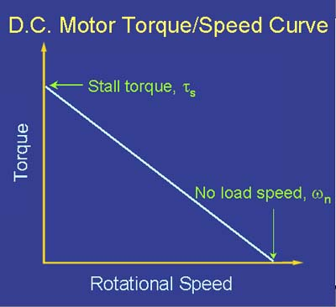
DC Torque-speed Curve
See http://lancet.mit.edu/motors/motors3.html
Stalls at τ_{s}; no load at ω_{n}
Output mechanical power is τω
area of rectangle touching curve
max power is then P_{max} = ¼ τ_{s}ω_{n}

Slide 19
Electrical Expectations
Winding has resistance, R, typically in the 10 Ω range
If provided a constant voltage, V
winding eats power P_{w} = V²/R
motor delivers P_{m} = τω
current required is I_{tot} = (P_{w} + P_{m})/V
At max power output (P_{m} = ¼ τ_{s}ω_{n})
turns out winding loss is comparable, for ~50% efficiency

Slide 20
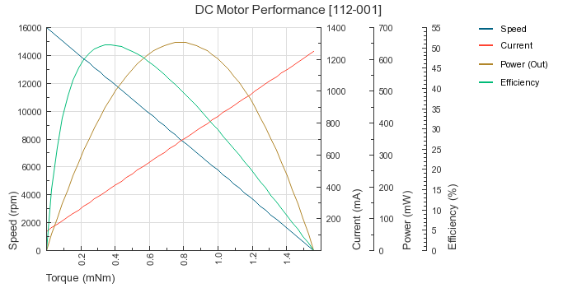
Example 2.4 V motor
Random online spec for 2.4 V motor (beware flipped axes)
note at power max 0.0008 Nm; 0.7 A; 8000 RPM (837 rad/s)
total consumption 2.4×0.7 = 1.68 W
output mechanical power 0.0008×837 = 0.67 W; efficiency 40%
at constant V = 2.4, total power consumption rises → 3 W toward stall
1.25 A at stall implies winding R = V/I = 1.9 Ω

Slide 21
Another random example
Note provision of stall torque and no-load speed
suggests max output power of ¼×2π(5500)/60×0.0183 = 2.6 W
about half this at max efficiency point
2π(4840)/60×0.00248 = 1.25 W
at max efficiency, 0.17×12 = 2.04 W, suggesting 61% eff.
implied coil resistance 12/1.06 ≈ 11 Ω (judged at stall)
Lesson: for DC motors, electrical current depends on loading condition
current is maximum when motor straining against stall

Slide 22
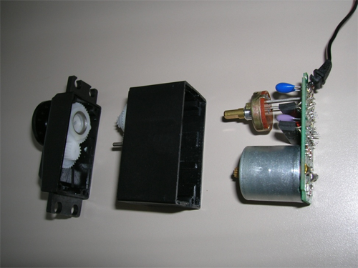
Servo Internals
A Servo motor is just a seriously gear-reduced DC motor with a feedback mechanism (e.g, potentiometer) to shut it off when it is satisfied with its position
and drive motor faster or slower depending on how far off target
potentiometer
gear reduction
DC motor

Slide 23
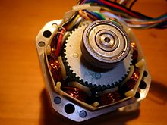
Clever Steppers
Stepper motors work in baby steps
In simplest version, there are two DC windings
typically arranged in numerous loops around casing
depending on direction of current flow, field is reversible
Rotor has permanent magnets periodically arranged
but a differing number from the external coils
teeth on rotor
8 “dentures”
around outside

Slide 24
A Carefully Choreographed Sequence
Four different combinations can be presented to the two coils (A & B; each bi-directional)
each combination attracts the rotor to a (usu. slightly) different position/phase
stepping through these combinations in sequence walks the rotor by the hand to the next step
In practice, rotor has many poles around (in teeth, often), so each step is much finer.

Slide 25
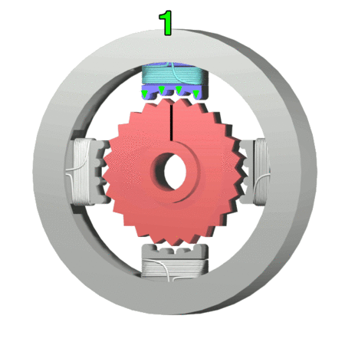
Toothed Animation
Note teeth are not phased with “dentures” all the way around
each is 90° from neighbor
This sequence is typical of center-tap steppers
can activate one side of coil at a time
Note usually have more than four “dentures” around outside

Slide 26
Stepping Schemes
Can go in full steps, half steps, or even microstep
full step is where one coil is on and has full attention of rotor
if two adjacent coils are on, they “split” position of rotor
so half-stepping allows finer control, but higher current draw
every other step doubles nominal current
instead of coils being all on or all off, can apply differing currents (or PWM) to each; called microstepping
so can select a continuous range of positions between full steps
Obviously, controlling a stepper motor is more complicated than our other options
must manage states of coils, and step through sequence sensibly

Slide 27
The Stepper Library
Part of the Arduino Standard Library set
Available commands:
Stepper(steps, pin1, pin2)
Stepper(steps, pin1, pin2, pin3, pin4)
setSpeed(rpm)
step(steps)
But Arduino cannot drive stepper directly
can’t handle current
need transistors to control current flow
arrangement called H-bridge ideally suited

Slide 28
Example stripped code
#include <Stepper.h> #define STEPS 100 // change for your stepper Stepper stepper(STEPS, 8, 9, 10, 11); int previous = 0; void setup(){ stepper.setSpeed(30); // 30 RPM } void loop(){ int val = analogRead(0); // get the sensor value // move a number of steps equal to the change in the // sensor reading stepper.step(val - previous); // remember the previous value of the sensor previous = val; }

Slide 29
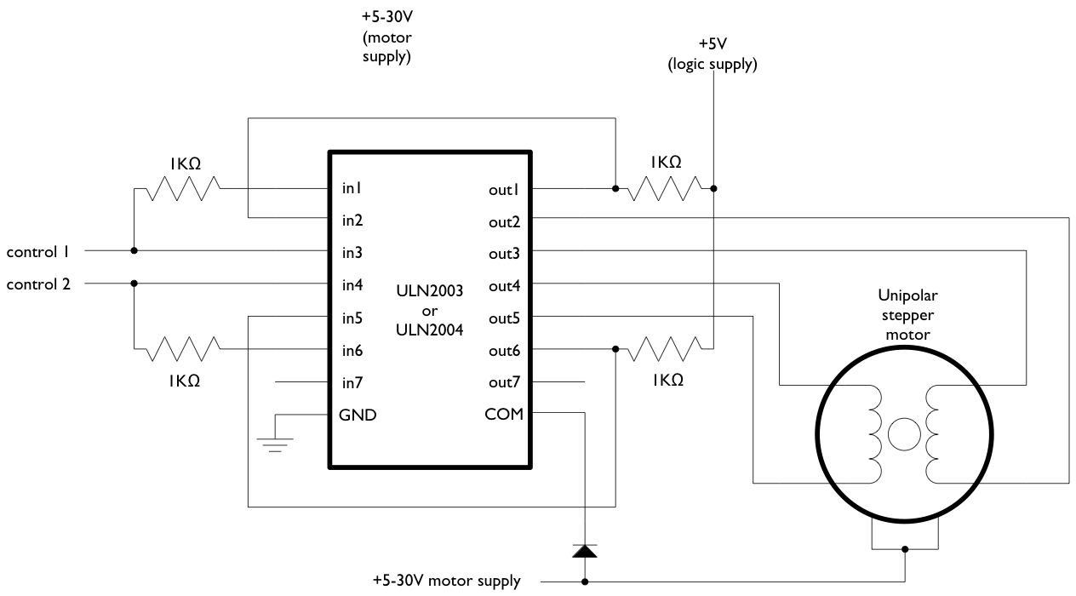
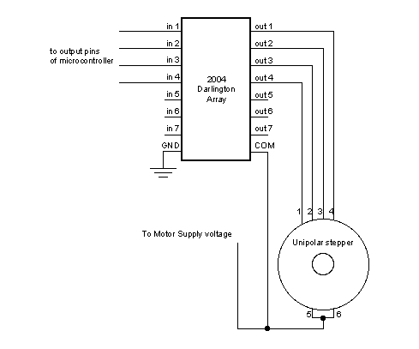
A Unipolar Stepper Motor: Center Tap
A unipolar stepper has a center tap for each coil
half of coil can be activated at a time
can drive with two Arduino pins (left arrangement)
or four pins (right)
both use ULN2004 Darlington Array

Slide 30
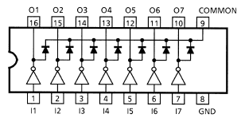
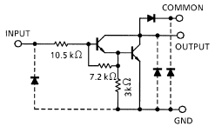
What’s in the Darlington Array?
The ULN2004 array provides buffers for each line to handle current demand
Each channel is essentially a pair of transistors in a Darlington configuration
when input goes high, the output will be pulled down near ground
which then presents motor with voltage drop across coil (COMMON is at the supply voltage)

Slide 31
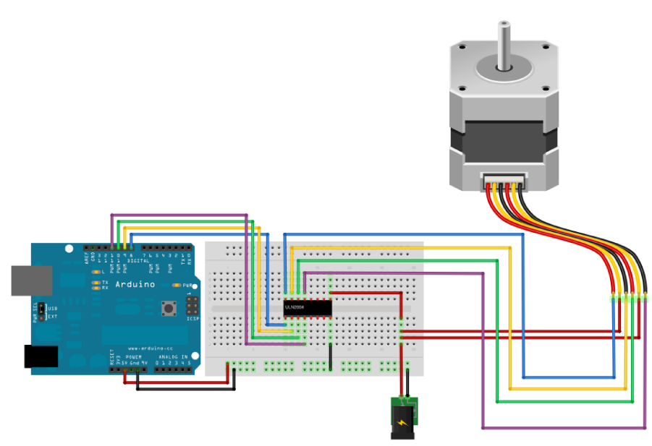
Unipolar hookup; control with four pins
Yellow motor leads are center tap, connected to external power supply (jack hanging off bottom)

Slide 32
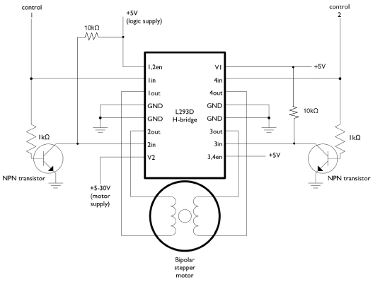
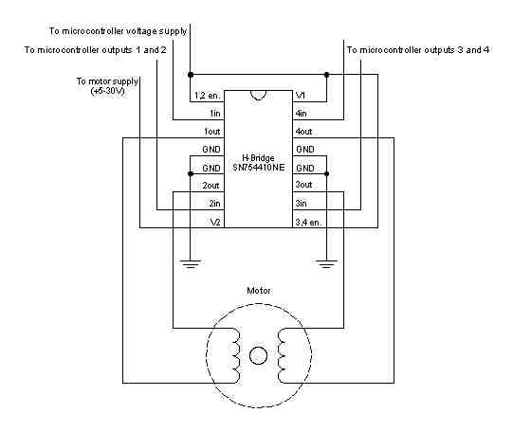
A Bipolar Stepper Motor: No Center Tap
In this case, the coil must see one side at ground while the other is at the supply voltage
At left is 2-pin control; right is 4-pin control
H-bridge is L293D or equiv.
transistors just make for logic inversion (1in opp. 2in, etc.)

Slide 33
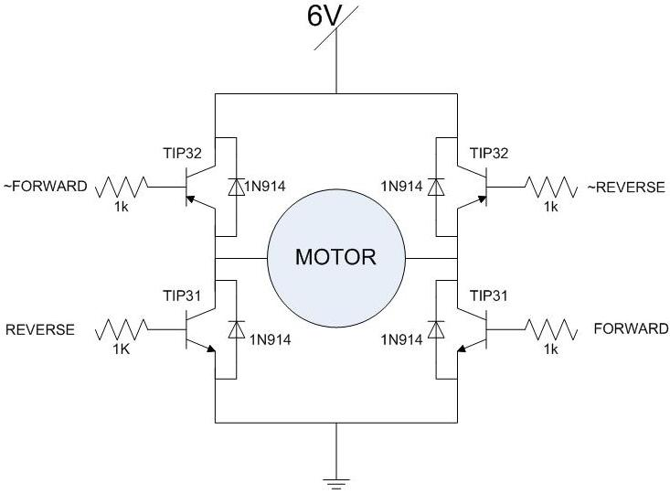
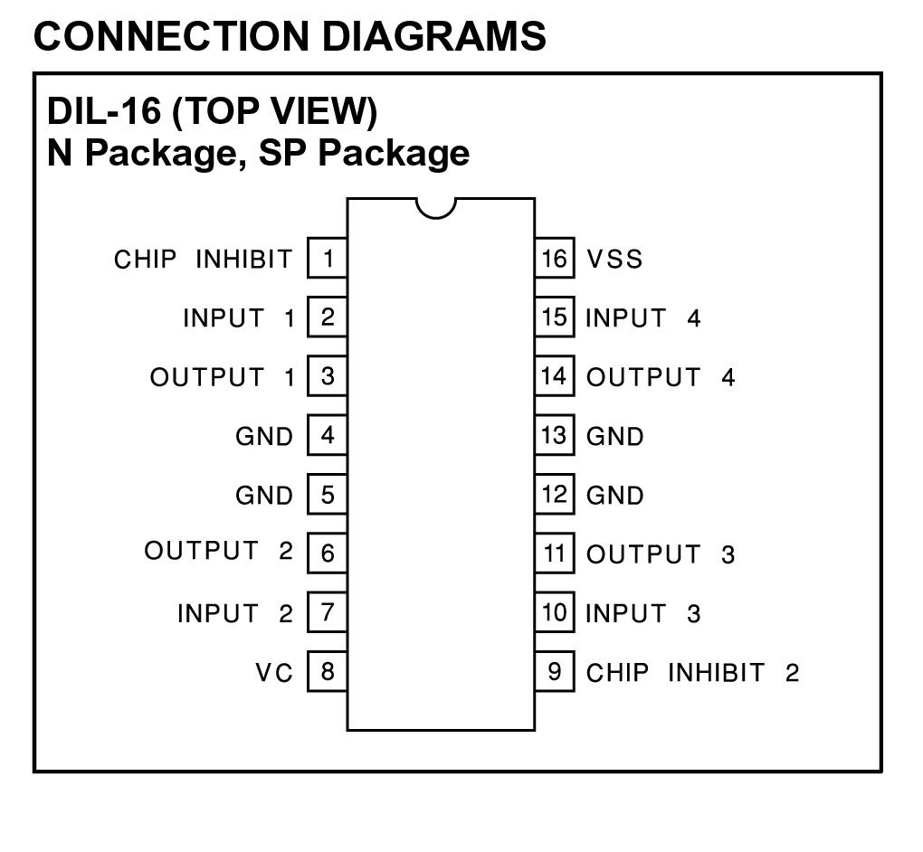
H-bridge Internals
An H-bridge is so-called because of the arrangement of transistors with a motor coil spanning across
two transistors (diagonally opposite) will conduct at a time, with the motor coil in between

Slide 34
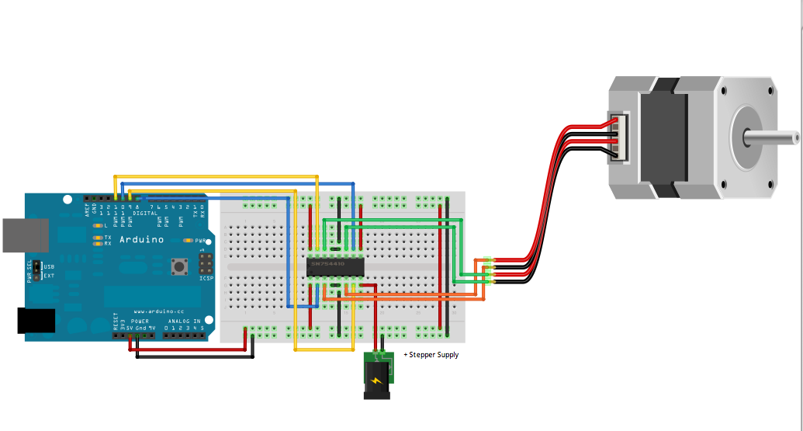
Bipolar Hookup; control with four pins
Input supply shown as jack hanging off bottom

Slide 35
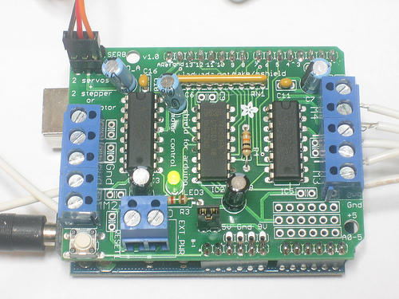
The Motor Shield
We have kit shields that can drive a “motor party”
2 servos plus 2 steppers, or
2 servos plus 4 DC motors, or
2 servos plus 2 DC motors plus 1 stepper
Allows external power supply: motors can take a lot of juice

Slide 36
The Motor Shield’s Associated Library
See instructions at
http://learn.adafruit.com/adafruit-motor-shield
Install library linked from above site
follow instructions found at top of above page
may need to make directory called libraries in the place where your Arduino sketches are stored
specified in Arduino preferences
and store in it the unpacked libraries as the directory AFMotor
Once installed, just include in your sketch:
#include <AFMotor.h>
Open included examples to get going quickly

Slide 37
Example Code
Stepper Commands in AFMotor
#include <AFMotor.h>
grab library
AF_Stepper my_stepper(# S/R, port);
my_stepper is arbitrary name you want to call motor
arguments are steps per revolution, which shield port (1 or 2)
my_stepper.setSpeed(30);
set RPM of motor for large moves (here 30 RPM)
my_stepper.step(NSTEPS, DIRECTION, STEP_TYPE);
take NSTEPS steps, either FORWARD or BACKWARD
can do SINGLE, DOUBLE, INTERLEAVE, MICROSTEP
my_stepper.release();
turn off coils for free motion

Slide 38
Step Types
SINGLE
one lead at a time energized, in sequence 3, 2, 4, 1
as counted downward on left port (port 1) on motor shield
normal step size
DOUBLE
two leads at a time are energized: 1/3, 3/2, 2/4, 4/1
splits position of previous steps; tug of war
normal step size, but twice the current, power, torque
INTERLEAVE
combines both above: 1/3, 3, 3/2, 2, 2/4, 4, 4/1, 1
steps are half-size, alternating between single current and double current (so 50% more power than SINGLE)
MICROSTEP
uses PWM to smoothly ramp from off to energized
in principle can be used to go anywhere between hard steps

Slide 39
DC Motors with motor shield/AFMotor
DC motors are handled with the following commands
#include <AFMotor.h>
grab library
AF_DCMotor mymotor(port);
port is 1, 2, 3, or 4 according to M1, M2, M3, M4 on shield
mymotor.setSpeed(200);
just a PWM value (0−255) to moderate voltage sent to motor
not RPM, not load-independent, etc. — crude control
mymotor.run(DIRECTION);
FORWARD, BACKWARD, or RELEASE
depends, of course, on hookup direction

Slide 40
Servos on the Shield
Two Servo hookups are provided on the shield
Really just power, ground, and signal control
signal control is Arduino pins 9 and 10
use Servo.h standard library
pin 9 → Servo2 on shield; pin 10 → Servo1 on shield

Slide 41
Announcements
TA office hours:
Clayton: M 3-4; Tu 1-2
Paul: F 2-3; M 2-3
Turn in prev. week’s lab by start of next lab period, at 2PM (day dep. on Tue/Wed section)
can drop in slot on TA room in back of MHA 3544 anytime
Midterm to verify basic understanding of Arduino coding
blank paper, will tell you to make Arduino do some simple task (at the level of first week labs, without complex logic aspects)

