Slide 1
APOLLO
Overview
Data Quality Assessment
Site Metrology

Slide 2
LLR through the decades
Previously
200 meters

Slide 3
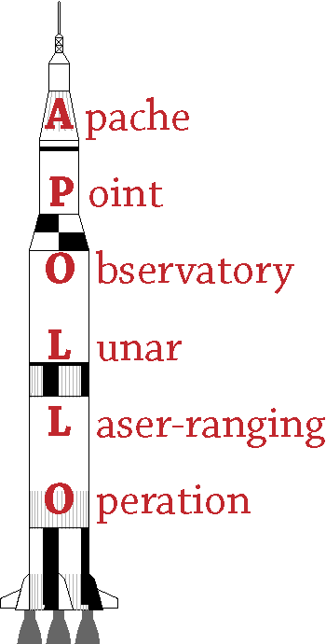
APOLLO: the next big thing in LLR
APOLLO offers order-of-magnitude improvements to LLR by:
Using a 3.5 meter telescope
Operating at 20 pulses/sec
Using advanced detector technology
Gathering multiple photons/shot
Achieving millimeter range precision
Tightly integrating experiment and analysis
Having the best acronym
funded by NASA & NSF

Slide 4
The APOLLO Collaboration
UCSD:
Tom Murphy (PI)
Eric Michelsen
Nathan Johnson
U Washington:
Eric Adelberger
Erik Swanson
Apache Point Obs.
Russet McMillan
Harvard:
Chris Stubbs
MIT:
James Battat
Northwest Analysis:
Ken Nordtvedt
Humboldt State:
C. D. Hoyle

Slide 5
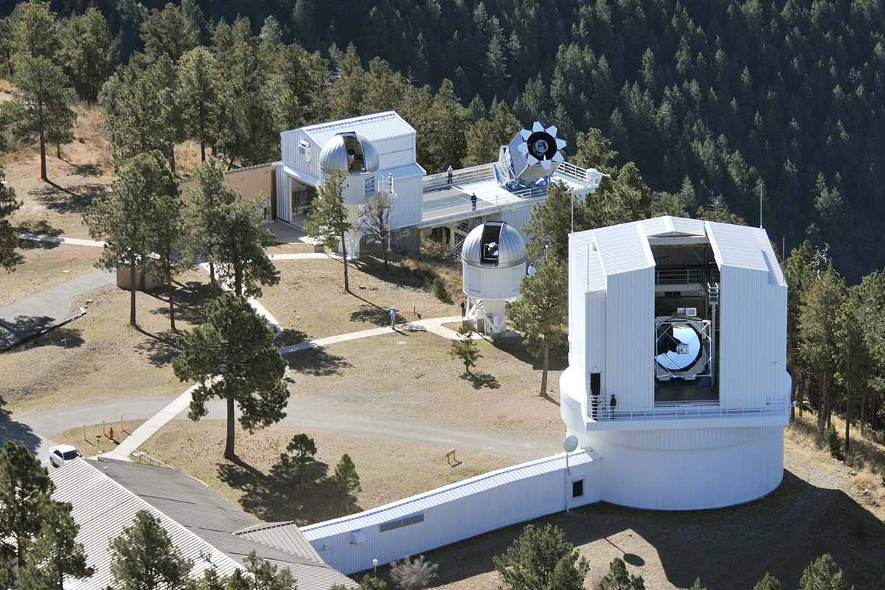
The Earth-End
2.5 meter
3.5 meter
laser
people

Slide 6
APOLLO’s Secret Weapon: Aperture
The Apache Point Observatory’s 3.5 meter telescope
Southern NM (Sunspot)
9,200 ft (2800 m) elevation
Great “seeing”: 1 arcsec
Flexibly scheduled, high-class research telescope
APOLLO gets ~8 < 1 hour sessions per lunar month
7-university consortium (UW NMSU, U Chicago, Princeton, Johns Hopkins, Colorado, Virginia)

Slide 7
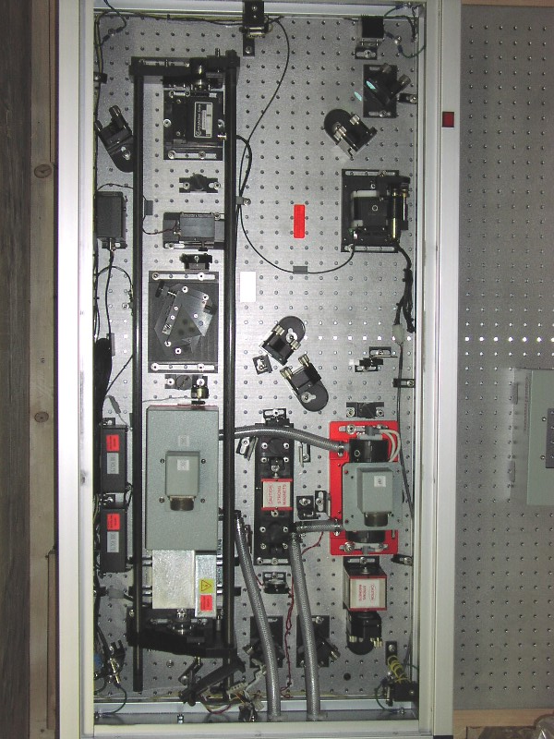
APOLLO Laser
Nd:YAG; flashlamp-pumped; mode-locked; cavity-dumped
Frequency-doubled to 532 nm
57% conversion efficiency
90 ps pulse width (FWHM)
115 mJ (green) per pulse
after double-pass amplifier
20 Hz pulse repetition rate
2.3 Watt average power
GW peak power!!
Beam is expanded to 3.5 meter aperture
Less of an eye hazard
Less damaging to optics

Slide 8
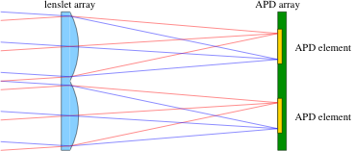
Catching All the Photons
Several photons per pulse necessitates multiple “buckets” to time-tag each one
Avalanche Photodiodes (APDs) respond only to first photon
Lincoln Lab prototype APD arrays are perfect for APOLLO
4×4 array of 30 μm elements on 100 μm centers
Lenslet array in front recovers full fill factor
Resultant field is 1.4 arcsec on a side
Focused image is formed at lenslet
2-D tracking capability facilitates optimal efficiency

Slide 9
Laser Mounted on Telescope

Slide 10
A Telescope in Reverse

Slide 11
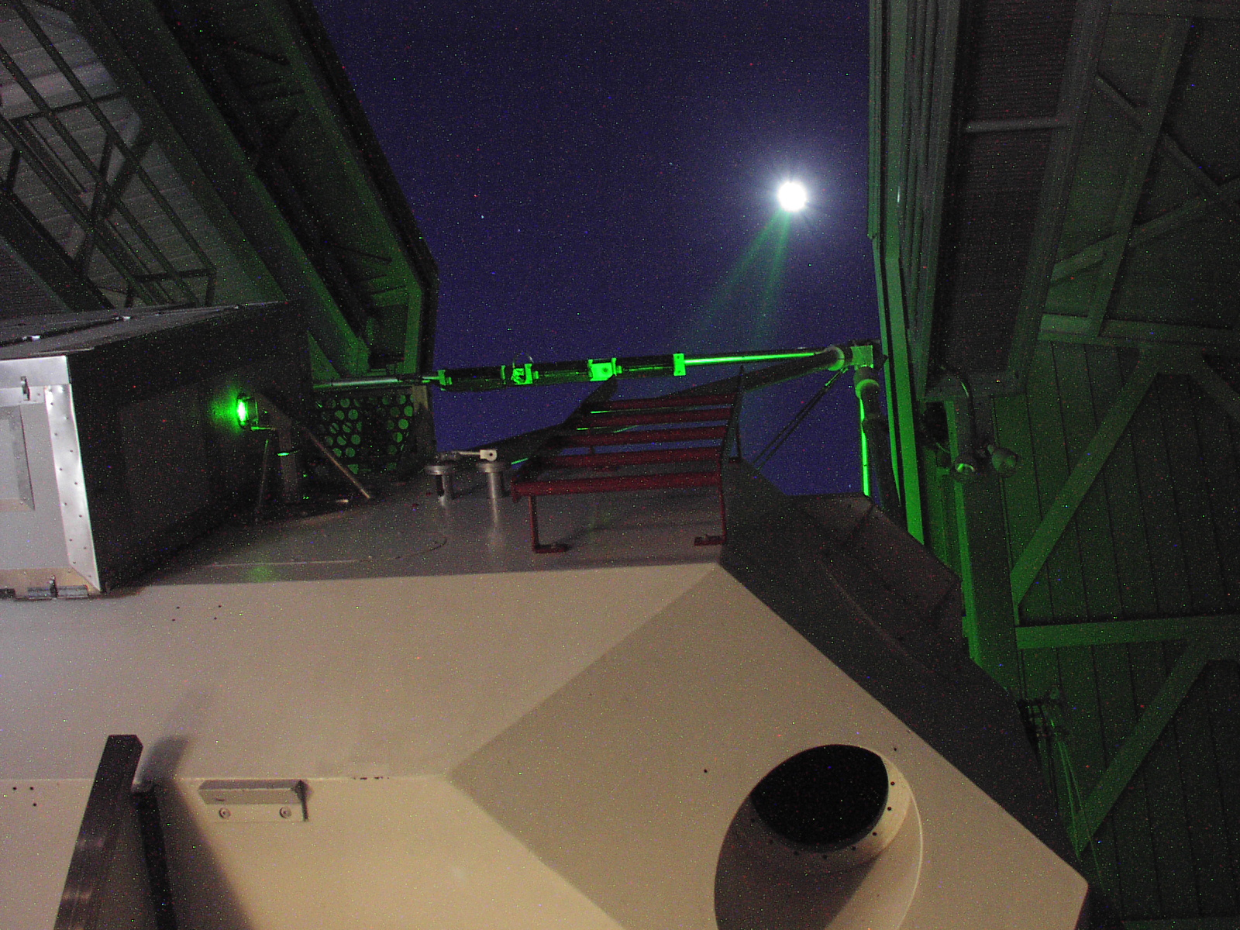
Gigantic Laser Pointer

Slide 12
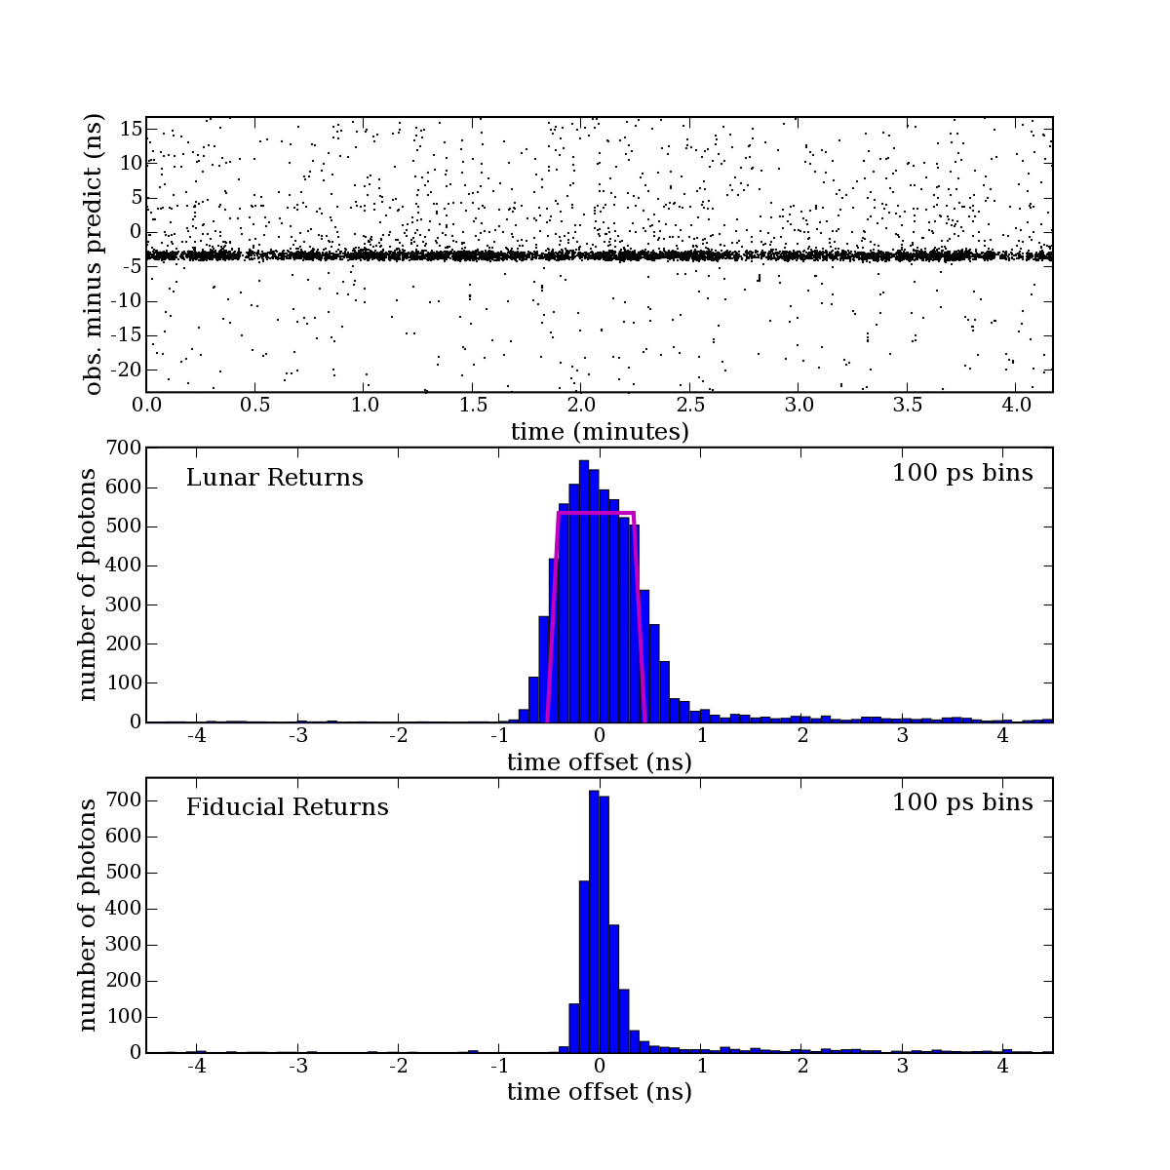
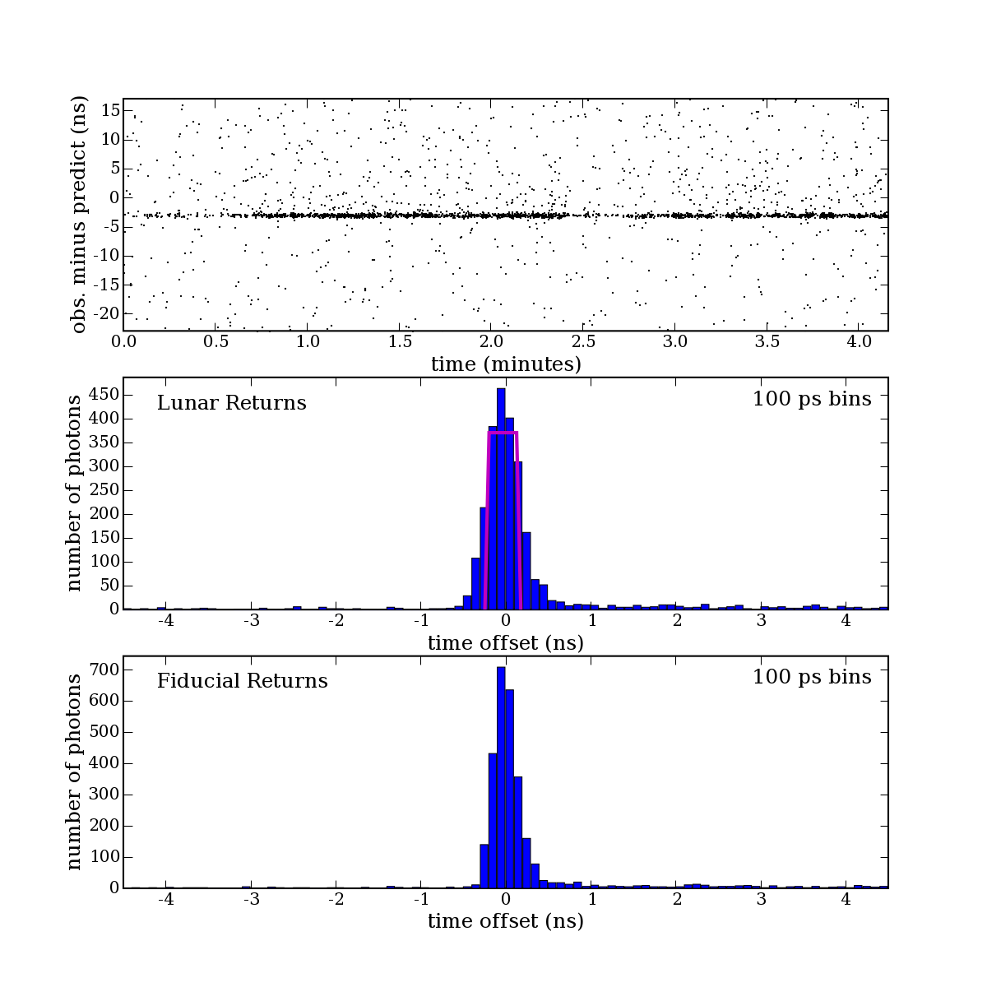
Strong Returns
Apollo 15
2007.11.19
Apollo 11
red curves are theoretical profiles: get convolved with fiducial to make lunar return
represents system
capability: laser;
detector; timing
electronics; etc.
RMS = 120 ps
(18 mm)
6624 photons in 5000 shots
369,840,578,287.4 ± 0.8 mm
4 detections with 10 photons
2344 photons in 5000 shots
369,817,674,951.1 ± 0.7 mm
1 detection with 8 photons

Slide 13
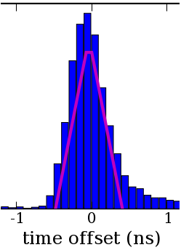
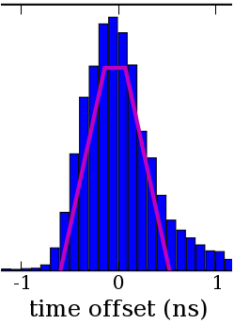
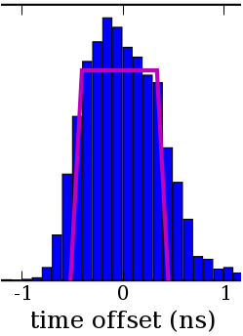
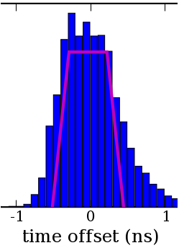
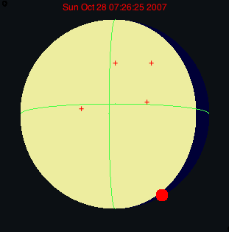
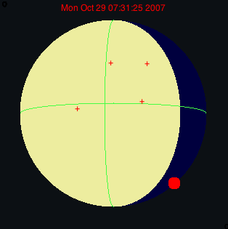
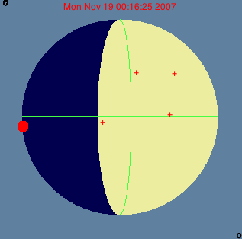
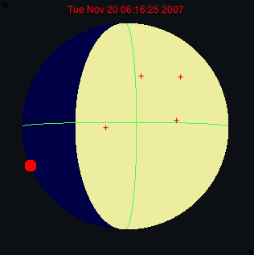
Sensing the Array Size & Orientation
2007.10.28
2007.10.29
2007.11.19
2007.11.20

Slide 14
Breaking All Records
Reflector | APOLLO max photons/5-min | APOLLO max photons/shot (5 min avg)
Apollo 11 | 5395 (65×) | 0.90
Apollo 14 | 9125 (69×) | 1.52
Apollo 15 | 18875 (67×) | 3.15
Lunokhod 2 | 900 (31×) | 0.15
(relative to pre-APOLLO record)
APOLLO has greatly surpassed previous records
max rates for French and Texas stations about 0.1 and 0.02, respectively
APOLLO can operate at full moon
other stations can’t (except during eclipse), though EP signal is max at full moon!
Often a majority of APOLLO returns are multiple-photon events
record is 12 photons in one shot (out of 12 functioning APD elements)
APD array (many buckets) is crucial

Slide 15
APOLLO Data Campaign
Steady accumulation of data; less reliance on Apollo 15 over time
Found Lunokhod 1 in April 2010

Slide 16
APOLLO Data Quality
Uncertainties are per night, per reflector; pre-APOLLO sub-centimeter rare
Medians are 2.4, 3.5, 2.4, 1.8, 3.3 mm for A11, L1, A14, A15, L2, resp.
Combined nightly median range error is 1.45 mm

Slide 17
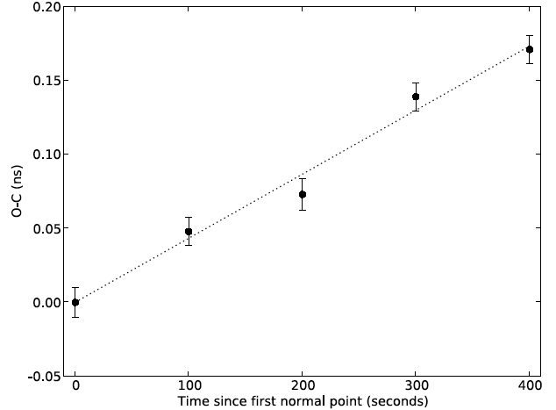
Residuals During a Contiguous Run
Breaking 10,000-shot run into 5 chunks, we can evaluate the stability of our measurement
Comparison is against imperfect prediction, which can leave linear drift
No scatter beyond that expected statistically
15 mm
individual error bars: σ ≈ ±1.5 mm

Slide 18
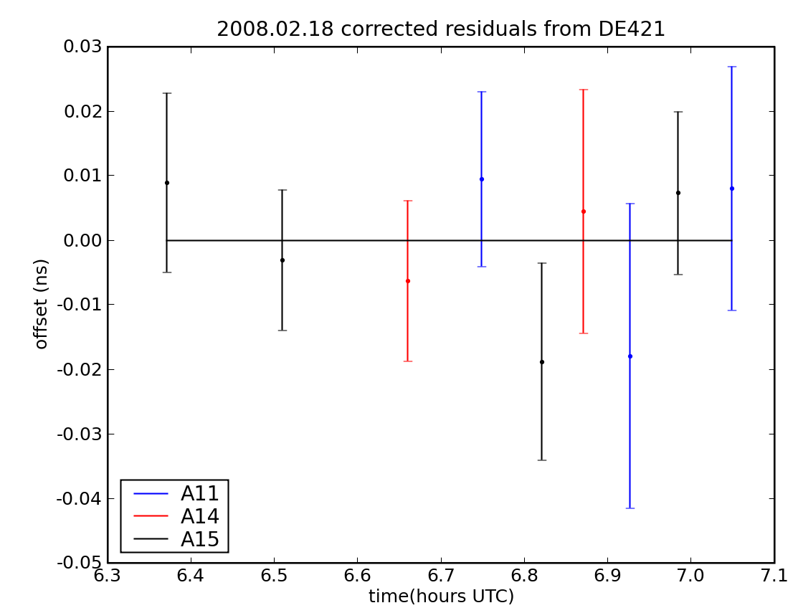
Residuals from Prediction
Our prediction, based on DE421, is well suited for acquisition, but is not a full model of earth orientation, etc.
residuals have offset and trend, but linear over short periods
Cycling through reflectors shows lunar orientation offset…
…but no excess scatter
~2 mm error estimates look okay

Slide 19
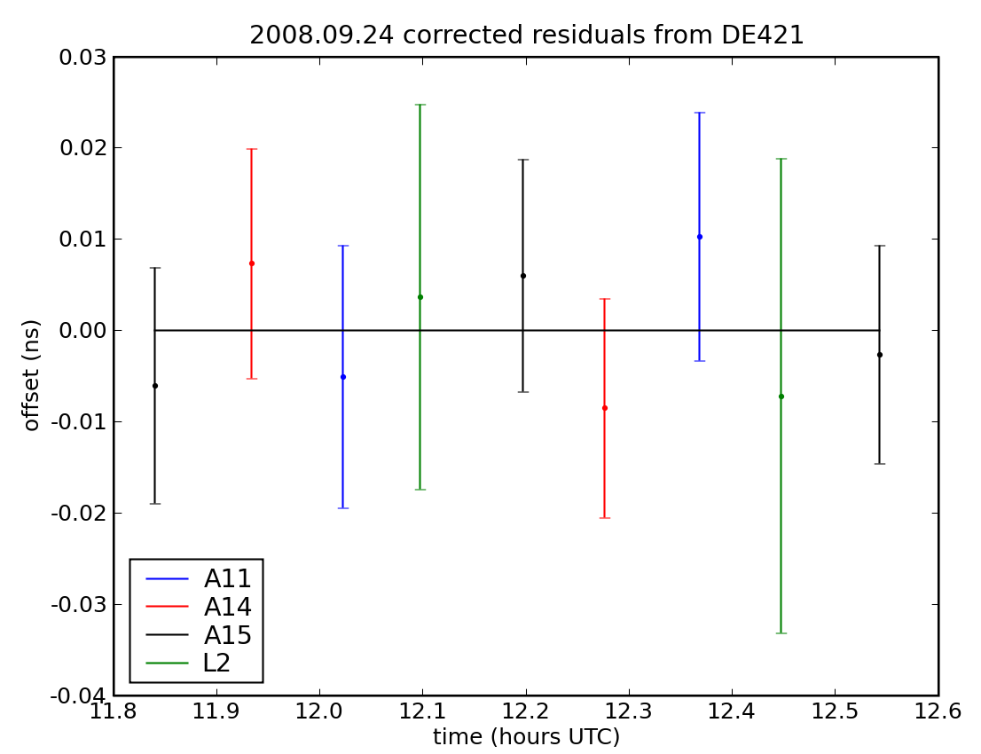
Residuals from Prediction
Same story with four reflectors
Today’s best models do not produce χ²=1, so not yet able to assess possible error sources

Slide 20
Selected residuals, 0.1 ns RSS applied
Residuals from JPL

Slide 21
Selected Residuals, nominal uncertainties
Residuals from JPL

Slide 22
More evidence for internal consistency

Slide 23
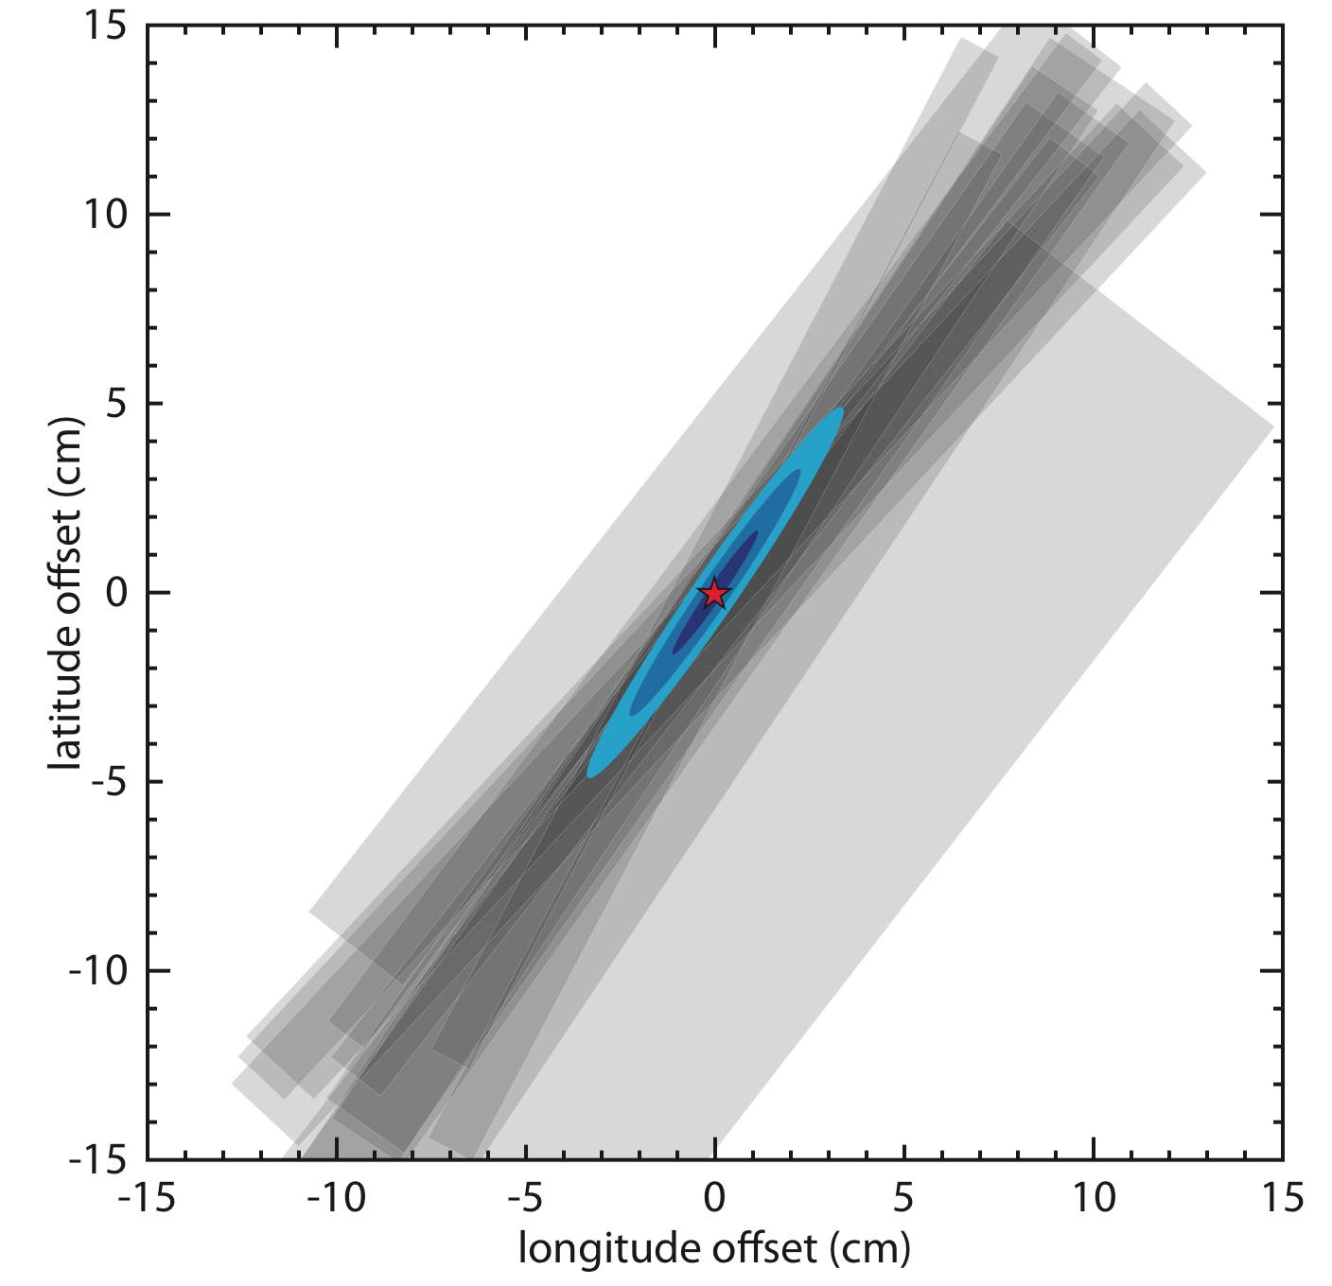
Lunokhod 1 Position Determination
Based on a few months of observation at a limited sampling of librations, we have a centimeter-level position determination
Error ellipses are 1σ, 2σ, 3σ
Best-fit position, in DE421 Principal-Axis coordinates:
r = 1734928.72
lat = 38.3330784°
lon = -35.036674°
Location of L1 makes it especially valuable for science
Notes:
23

Slide 24
Potential Impact on Science
L1 is the farthest reflector from the apparent lunar center
Offers best leverage on libration determination
key for C.o.M. motion → gravity
also for lunar interior study
Unlike Apollo reflectors, L1 (and L2) offer both latitude and longitude libration sensitivity
More reflectors probe tidal deformation
Reflector | θ from center | libration sensitiv. | longitude sensitiv. | latitude sensitiv.
A11 | 23.5° | 0.40 | 0.40 | 0.01
A14 | 17.9° | 0.31 | 0.30 | 0.06
A15 | 26.4° | 0.44 | 0.06 | 0.44
L1 | 50.0° | 0.77 | 0.45 | 0.51
L2 | 39.5° | 0.63 | 0.46 | 0.37

Slide 25
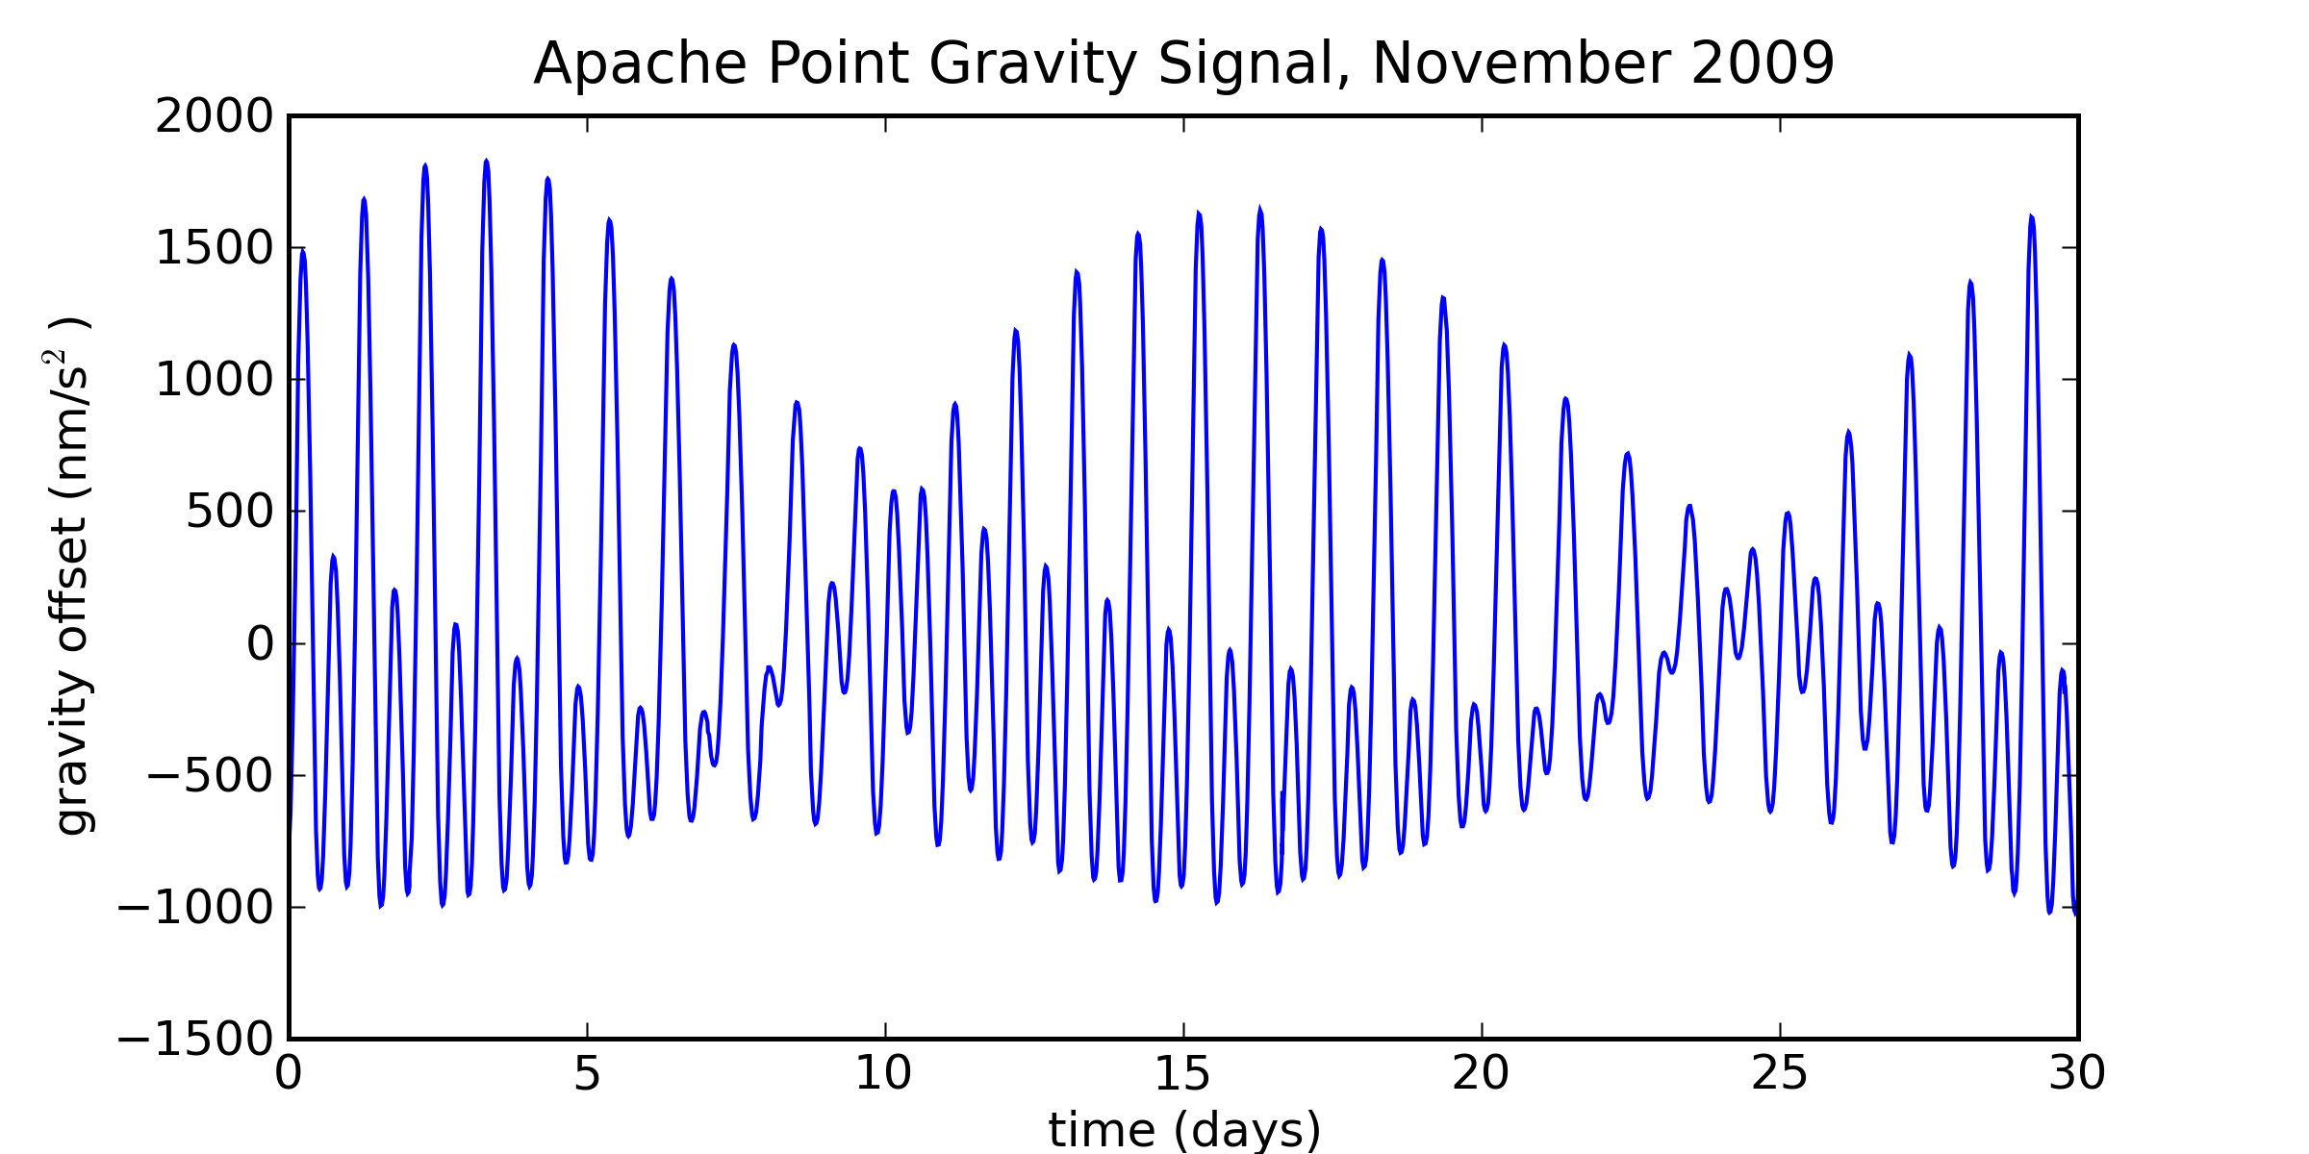
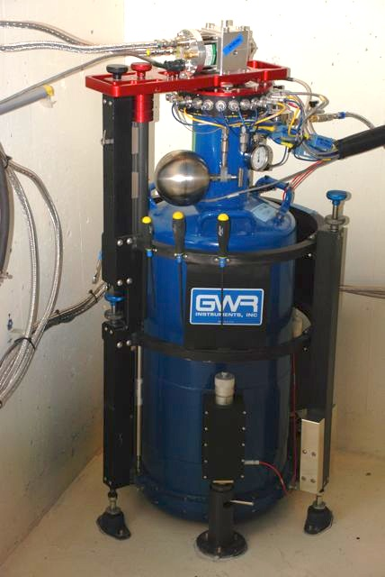
Superconducting Gravimeter Installed
We care about millimeter displacements of floppy Earth crust
gravimeter has sub-millimeter height sensitivity
Will help us characterize tides, measure loading of crust
fight gravity with gravity!
Notes:
25

Slide 26
EarthScope GPS Pitching In
The NSF-funded Plate Boundary Observatory (part of EarthScope) installed a GPS station 2.5 km away from APOLLO
Resolution in monthly interval is 0.3 mm horizontal, 1.2 mm vertical
Will help constrain crust motion, loading phenomena

Slide 27
Summary
APOLLO has delivered LLR into a new signal regime
By our internal checks, we see no excess scatter beyond that predicted by our random uncertainty estimates
The ability of the JPL model to reduce scatter as a function of weighting further indicates data integrity
the physical model is capable of adjusting lunar orientation appropriately
APOLLO systematics are not excluded, just constrained
Supplemental site metrology may enhance our ability to model the LLR range

