Slide 1
LLR Analysis Workshop
9–10 December, 2010
Cambridge, MA
Sponsored by APOLLO and LUNAR

Slide 2
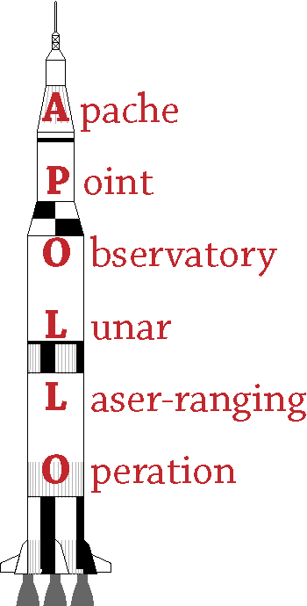
Sponsors
Funding for this workshop provided by:
APOLLO (NSF and NASA)
LUNAR (Lunar University Network for Astrophysics Research

Slide 3
Participants
Eric Adelberger: University of Washington; APOLLO Co-I
James Battat: M.I.T.; APOLLO Collaborator
John Chandler: Harvard/Smithsonian CfA; PEP developer
Franz Hofmann: Uni. Hannover; LLR analysis
Nathan Johnson: UCSD; APOLLO grad student
Hervé Manche: Paris; LLR analysis
Tom Murphy: UCSD; APOLLO PI
Ken Nordtvedt: Northwest Analysis; gravitational phenomenology
Bob Reasenberg: Harvard/Smithsonian CfA; PEP developer
Irwin Shapiro: Harvard University; initiated PEP
Christopher Stubbs: Harvard University; APOLLO Co-I
Jim Williams/Dale Boggs/Bill Folkner: JPL (via phone); LLR analysis

Slide 4
Workshop Goals
How do we advance LLR analysis to millimeter accuracy?
How are various models constructed?
What are the limiting factors?
What tests can we use to check the models?
Encourage dialog between analysis and experimental groups

Slide 5
Agenda
Thursday (Palfrey)
what’s in your model: presentations from four groups
Ken Nordtvedt on LLR gravitational science
APOLLO observing (optional 19:00-20:00)
Friday Morning (Lyman 330)
APOLLO data quality overview
Residuals comparisons
Discussions on weighting and unmodeled effects
Friday Afternoon (Palfrey)
Discussions on model verification/comparison/improving
Workshop wrap-up, resolutions, plans

