Slide 1
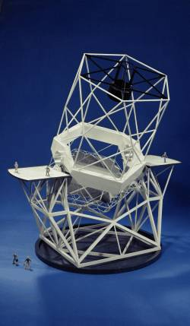
Materials
Properties
Mechanics

Slide 2
Why we need to know about materials
Stuff is made of stuff
what should your part be made of?
what does it have to do?
how thick should you make it
The properties we usually care about are:
stiffness
electrical conductivity
thermal conductivity
heat capacity
coefficient of thermal expansion
density
hardness, damage potential
machine-ability
surface condition
suitability for coating, plating, etc.

Slide 3
Electrical Resistivity
Expressed as ρ in Ω·m
resistance = ρ·L/A
where L is length and A is area
conductivity is 1/ρ
Material | ρ (×10⁻⁶ Ω·m) | comments
Silver | 0.0147 | $$
Gold | 0.0219 | $$$$
Copper | 0.0382 | cheapest good conductor
Aluminum | 0.047
Stainless Steel | 0.06–0.12

Slide 4
Thermal Conductivity
Expressed as κ in W m⁻¹ K⁻¹
power transmitted = κ·A·ΔT/t,
where A is area, t is thickness, and ΔT is the temperature across the material
Material | κ (W m⁻¹ K⁻¹) | comments
Silver | 422 | room T metals feel cold
Copper | 391 | great for pulling away heat
Gold | 295
Aluminum | 205
Stainless Steel | 10–25 | why cookware uses S.S.
Glass, Concrete,Wood | 0.5–3 | buildings
Many Plastics | ~0.4 | room T plastics feel warm
G-10 fiberglass | 0.29 | strongest insulator choice
Stagnant Air | 0.024 | but usually moving…
Styrofoam | 0.01–0.03 | can be better than air!

Slide 5
Specific Heat (heat capacity)
Expressed as c_{p} in J kg⁻¹ K⁻¹
energy stored = c_{p}·m·ΔT
where m is mass and ΔT is the temperature change
Material | c_{p} (J kg⁻¹ K⁻¹) | comments
water | 4184 | powerhouse heat capacitor
alcohol (and most liquids) | 2500
wood, air, aluminum, plastic | 1000 | most things!
brass, copper, steel | 400
platinum | 130

Slide 6
Coefficient of Thermal Expansion
Expressed as α = δL/L per degree K
length contraction = α·ΔT·L,
where ΔT is the temperature change, and L is length of material
Material | α (×10⁻⁶ K⁻¹) | comments
Most Plastics | ~100
Aluminum | 24
Copper | 20
Steel | 15
G-10 Fiberglass | 9
Wood | 5
Normal Glass | 3–5
Invar (Nickel/Iron alloy) | 1.5 | best structural choice
Fused Silica Glass | 0.6

Slide 7
Density
Expressed as ρ = m/V in kg·m⁻³
Material | ρ (kg m⁻³) | comments
Platinum | 21452
Gold | 19320 | tell this to Indiana Jones
Lead | 11349
Copper, Brass, Steels | 7500–9200
Aluminum Alloys | 2700–2900
Glass | 2600 | glass and aluminum v. similar
G-10 Fiberglass | 1800
Water | 1000
Air at STP | 1.3

Slide 8
Stress and Strain
Everything is a spring!
nothing is infinitely rigid
You know Hooke’s Law:
F = k·δL
where k is the spring constant (N/m), δL is length change
for a given material, k should be proportional to A/L
say k = E·A/L, where E is some elastic constant of the material
Now divide by cross-sectional area
F/A = σ = k·δL/A = E·ε σ = E·ε
where ε is δL/L: the fractional change in length
This is the stress-strain law for materials
σ is the stress, and has units of pressure
ε is the strain, and is unitless

Slide 9
Stress and Strain, Illustrated
A bar of material, with a force F applied, will change its size by:
δL/L = ε = σ/E = F/AE
Strain is a very useful number, being dimensionless
Example: Standing on an aluminum rod:
E = 70×10⁹ N·m⁻² (Pa)
say area is 1 cm² = 0.0001 m²
say length is 1 m
weight is 700 N
σ = 7×10⁶ N/m²
ε = 10⁻⁴ → δL = 100 μm
compression is width of human hair
L
F
F
A
δL
σ = F/A
= δL/L
σ = E·ε

Slide 10
Elastic Modulus
Basically like a spring constant
for a hunk of material, k = E(A/L), but E is the only part of this that is intrinsic to the material: the rest is geometry
Units are N/m², or a pressure (Pascals)
Material | E (GPa)
Tungsten | 350
Steel | 190–210
Brass, Bronze, Copper | 100–120
Aluminum | 70
Glass | 50–80
G-10 fiberglass | 16
Wood | 6–15
most plastics | 2–3

Slide 11
Bending Beams
tension: stretched
neutral “plane”
compression
A bent beam has a stretched outer surface, a compressed inner surface, and a neutral surface somewhere between
If the neutral length is L, and neutral radius is R, then the strain at some distance, y, from the neutral surface is (R + y)/R − 1
ε = y/R
because arclength for same Δθ is proportional to radius
note L = RΔθ
So stress at y is σ = Ey/R

Slide 12
In the Moment
Since each mass/volume element is still, the net force is zero
Each unit pulls on its neighbor with same force its neighbor pulls on it, and on down the line
Thus there is no net moment (torque) on a mass element, and thus on the whole beam
otherwise it would rotate: angular momentum would change
But something is exerting the bending influence
Bending Moments
dV
And we call this “something”
the moment (balanced)

Slide 13
What’s it take to bend it?
At each infinitesimal cross section in rod with coordinates (x, y) and area dA = dxdy:
dF = σdA = (Ey/R)dA
where y measures the distance from the neutral surface
the moment (torque) at the cross section is just dM = y·dF
so dM = Ey²dA/R
integrating over cross section:
where we have defined the “moment of inertia” as

Slide 14
Energy in the bent beam
We know the force on each volume element:
dF = σ·dA = E·ε·dA = (Ey/R)dA
We know that the length changes by δL = εdz = σ·dz/E
So energy is:
dW = dF·δL = dF·ε·dz = E·ε·dA × ε·dz = E(y/R)²dxdydz
Integrate this throughout volume
So W = M(L/R) ≈ Mθ ∝ θ²
where θ is the angle through which the beam is bent
z-direction

Slide 15
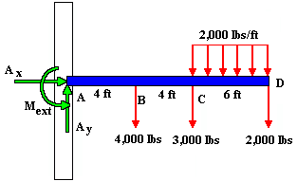
Calculating beam deflection
We start by making a free-body diagram so that all forces and torques are balanced
otherwise the beam would fly/rotate off in some direction
In this case, the wall exerts forces and moments on the beam (though A_{x}=0)
This example has three point masses and one distributed load

Slide 16
Tallying the forces/moments
A_{x} = 0; A_{y} = 21,000 lbs
M_{ext} = (4)(4000) + (8)(3000) + (14)(2000) + (11)(6)(2000) = 200,000 ft-lbs
last term is integral:
where λ is the force per unit length (2000 lbs/ft)

Slide 17
A Simpler Example
F_{y} = mg = λL
M_{ext} = λ<z>Δz = λ(L/2)L = ½ λL²
z-axis
force per unit length = λ; total force = mg = λL
A cantilever beam under its own weight (or a uniform weight)
F_{y} and M_{ext} have been defined above to establish force/moment balance
At any point, distance z along the beam, we can sum the moments about this point and find:
validating that we have no net moment about any point, and thus the beam will not spin up on its own!

Slide 18
What’s the deflection?
F_{y} = mg = λL
M_{ext} = λ<z>Δz = λ(L/2)L = ½ λL²
z-axis
force per unit length = λ; total force = mg = λL
At any point, z, along the beam, the unsupported moment is given by:
From before, we saw that moment and radius of curvature for the beam are related:
M = EI/R
And the radius of a curve, Y, is the reciprocal of the second derivative:
d²Y/dz² = 1/R = M/EI
so for this beam, d²Y/dz² = M/EI =

Slide 19
Calculating the curve
If we want to know the deflection, Y, as a function of distance, z, along the beam, and have the second derivative…
Integrate the second derivative twice:
where C and D are constants of integration
at z=0, we define Y=0, and note the slope is zero, so C and D are likewise zero
so, the beam follows:
with maximum deflection at end:

Slide 20
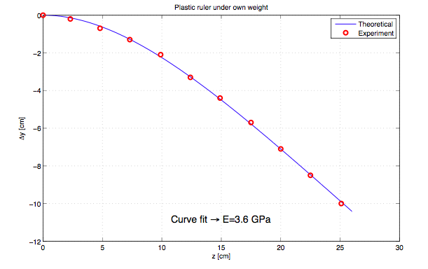
Bending Curve, Illustrated
Plastic ruler follows expected cantilever curve!

Slide 21
End-loaded cantilever beam
F_{y} = F
M_{ext} = FL
F
Playing the same game as before (integrate moment from z to L):
which integrates to:
and at z=0, Y=0 and slope=0 → C = D = 0, yielding:

Slide 22
Simply-supported beam under own weight
F_{y} = mg/2 = λL/2
F_{y} = mg/2 = λL/2
force per unit length = λ; total force = mg = λL
This support cannot exert a moment
at z=0, Y=0 → D = 0; at z=L/2, slope = 0 → C = −L³/12

Slide 23
Simply-supported beam with centered weight
F_{y} = F/2
F_{y} = F/2
F
Working only from 0 < z < L/2 (symmetric):
integrating twice, setting Y(0) = 0, Y’(L/2) = 0:
and the max deflection (at z=L/2):

Slide 24
S-flex beam
F
“walls” are held vertical; beam flexes in
“S” shape
total M(z) = 2M_{ext} − Fz − F(L−z) = 0 for all z
M_{ext} = FL/2
M_{ext} = FL/2
F
Playing the same game as before (integrate moment from z to L):
which integrates to:
and at z=0, Y=0 and slope=0 → C = D = 0, yielding:
as it should be

Slide 25
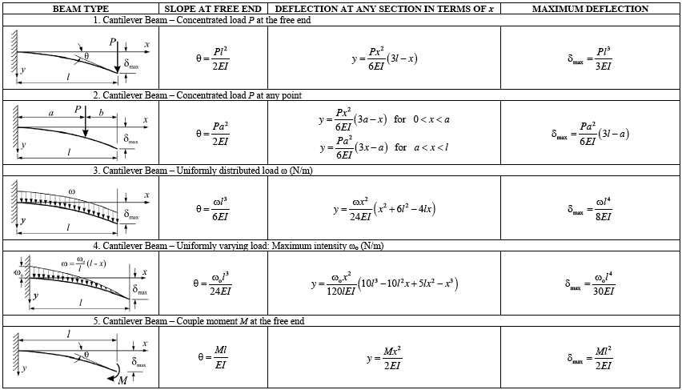
Cantilevered beam formulae

Slide 26
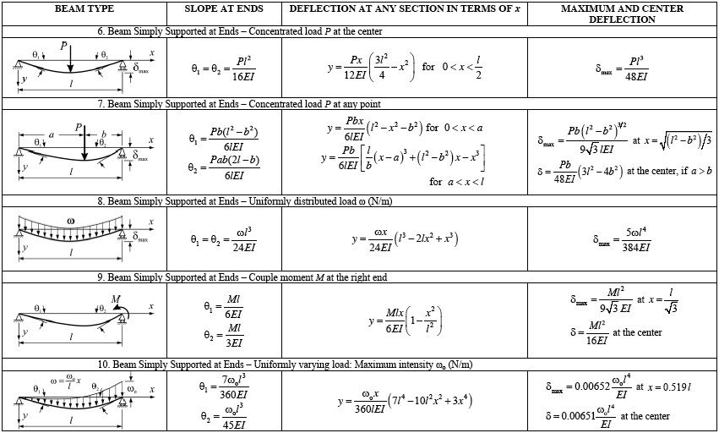
Simply Supported beam formulae

Slide 27
Lessons to be learned
All deflections inversely proportional to E
the stiffer the spring, the less it bends
All deflections inversely proportional to I
cross-sectional geometry counts
All deflections proportional to applied force/weight
in linear regime: Hooke’s law
All deflections proportional to length cubed
pay the price for going long!
beware that if beam under own weight, mg ∝ L also (so L⁴)
Numerical prefactors of maximum deflection, Y_{max}, for same load/length were:
1/3 for end-loaded cantilever
1/8 for uniformly loaded cantilever
1/48 for center-loaded simple beam
5/384 ~ 1/77 for uniformly loaded simple beam
Thus support at both ends helps: cantilevers suffer

Slide 28
Getting a feel for the I-thingy
The “moment of inertia,” or second moment came into play in every calculation
Calculating this for a variety of simple cross sections:
Rectangular beam:
note the cube-power on b: twice as thick (in the direction of bending) is 8-times better!
For fixed area, win by fraction b/a
b
a

Slide 29
Moments Later
Circular beam
work in polar coordinates, with y = rsinθ
note that the area-squared fraction (1/4π) is very close to that for a square beam (1/12 when a = b)
so for the same area, a circular cross section performs almost as well as a square
Circular tube
radius, R
inner radius R₁, outer radius R₂
or, outer radius R, thickness t

Slide 30
And more moments
Circular tube, continued
if R₂ = R, R₁ = R−t, for small t: I ≈ (A²/4π)(R/t)
for same area, thinner wall stronger (until crumples/dents compromised integrity)
Rectangular Tube
wall thickness = t
and if t is small compared to a & b:
note that for a = b (square), side walls only contribute 1/4 of the total moment of inertia: best to have more mass at larger y-value: this is what makes the integral bigger!
a
b
and for a square geom.:

Slide 31
The final moment
The I-beam
we will ignore the minor contribution from the “web” connecting the two flanges
note this is just the rectangular tube result without the side wall. If you want to put a web member in, it will add an extra b³t/12, roughly
in terms of area = 2at:
The I-beam puts as much material at high y-value as it can, where it maximally contributes to the beam stiffness
the web just serves to hold these flanges apart
a
b

Slide 32
Lessons on moments
Thickness in the direction of bending helps to the third power
always orient a 2×4 with the “4” side in the bending direction
For their weight/area, tubes do better by putting material at high y-values
I-beams maximize the moment for the same reason
For square geometries, equal material area, and a thickness 1/20 of width (where appropriate), we get:
square solid: I ≈ A²/12 ≈ 0.083A²
circular solid: I ≈ A²/4π ≈ 0.080A²
square tube: I ≈ 20A²/24 ≈ 0.83A²
circular tube: I ≈ 10A²/4π ≈ 0.80A²
I-beam: I ≈ 20A²/8 ≈ 2.5A²
I-beam wins hands-down
10× better than solid form
func. of assumed 1/20 ratio

Slide 33
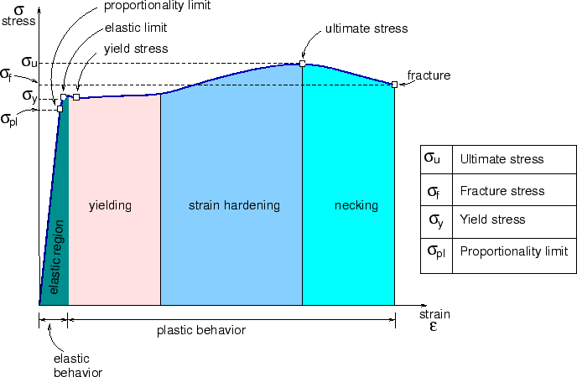
Beyond Elasticity
Materials remain elastic for a while
returning to exact previous shape
But ultimately plastic (permanent) deformation sets in
and without a great deal of extra effort

Slide 34
Breaking Stuff
Once out of the elastic region, permanent damage results
thus one wants to stay below the yield stress
yield strain = yield stress / elastic modulus
Material | Yield Stress (MPa) | Yield Strain
Tungsten* | 1400 | 0.004
Steel | 280–1600 | 0.0015–0.0075
Brass, Bronze, Copper | 60–500 | 0.0005–0.0045
Aluminum | 270–500 | 0.004–0.007
Glass* | 70 | 0.001
Wood | 30–60 | 0.0025–0.005
most plastics* | 40–80 | 0.01–0.04
* ultimate stress quoted (see next slide for reason)

Slide 35
Notes on Yield Stress
The entries in red in the previous table represent ultimate stress rather than yield stress
these are materials that are brittle, experiencing no plastic deformation, or plastics, which do not have a well-defined elastic-to-plastic transition
There is much variability depending on alloys
the yield stress for steels are
stainless: 280–700
machine: 340–700
high strength: 340–1000
tool: 520
spring: 400–1600 (want these to be elastic as long as possible)
aluminum alloys
6061-T6: 270 (most commonly used in machine shops)
7075-T6: 480

Slide 36
Shear Stress
dA
wall
bolt
F
γ
τ = F/A, where A is bolt’s
cross-sectional area
hanging mass
huge force, F
τ = Gγ
τ is the shear stress (N·m⁻²) = force over area = F/dA
dA is now the shear plane (see diagram)
G is the shear modulus (N·m⁻²)
γ is the angular deflection (radians)
The shear modulus is related to E, the elastic modulus
E/G = 2(1+ν)
ν is called Poisson’s ratio, and is typically around 0.27–0.33

Slide 37
Practical applications of stress/strain
Infrared spectrograph bending (flexure)
dewar whose inner shield is an aluminum tube 1/8 inch (3.2 mm) thick, 5 inch (127 mm) radius, and 1.5 m long
weight is 100 Newtons
loaded with optics throughout, so assume (extra) weight is 20 kg → 200 Newtons
If gravity loads sideways (when telescope is near horizon), what is maximum deflection, and what is maximum angle?
calculate I ≈ (A²/4π)(R/t) = 2×10⁻⁵ m⁴
E = 70×10⁹
Y_{max} = mgL³/8EI = 90 μm deflection
Y’_{max} = mgL²/6EI = 80 μR angle
Now the effect of these can be assessed in connection with the optical performance

Slide 38
Applications, continued
A stainless steel flexure to permit parallel displacement
each flexing member has length L = 13 mm, width a = 25 mm, and bending thickness b = 2.5 mm, separated by d = 150 mm
how much range of motion do we have?
stress greatest on skin (max tension/compression)
Max strain is ε = σ_{y}/E = 280 MPa / 200 GPa = 0.0014
strain is y/R, so b/2R = 0.0014 → R = b/0.0028 = 0.9 m
θ = L/R = 0.013/0.9 = 0.014 radians (about a degree)
so max displacement is about d·θ = 2.1 mm
energy in bent member is EIL/R² = 0.1 J per member → 0.2 J total
W = F·d → F = (0.2 J)/(0.002 m) = 100 N (~ 20 lb)
d

Slide 39
Flexure Design
Sometimes you need a design capable of flexing a certain amount without breaking, but want the thing to be as stiff as possible under this deflection
strategy:
work out deflection formula;
decide where maximum stress is (where moment, and therefore curvature, is greatest);
work out formula for maximum stress;
combine to get stress as function of displacement
invert to get geometry of beam as function of tolerable stress
example: end-loaded cantilever
Δy is displacement from
centerline (half-thickness)

Slide 40
Flexure Design, cont.
Note that the ratio F/I appears in both the Y_{max} and σ_{max} formulae (can therefore eliminate)
If I can tolerate some fraction of the yield stress
σ_{max} = σ_{y}/Φ, where Φ is the safety factor (often chosen to be 2)
so now we have the necessary (maximum) beam thickness that can tolerate a displacement Y_{max} without exceeding the safety factor, Φ
You will need to go through a similar procedure to work out the thickness of a flexure that follows the S-bend type (prevalent in the Lab 2)
where h = 2Δy
is beam thickness

Slide 41
Notes on Bent Member Flexure Design
When the flex members have moments at both ends, they curve into more-or-less an arc of constant radius, accomplishing angle θ
R = EI/M, and θ = L/R = ML/EI, where L is the length of the flexing beam (not the whole assembly)
σ_{max} = Eε_{max} = EΔy/R = hθE/2L, so h = (σ_{y}/ΦE)×(2L/θ)
where h = 2Δy and R = L/θ

Slide 42
Kinematic Design
Physicists care where things are
position and orientation of optics, detectors, etc. can really matter
Much of the effort in the machine shop boils down to holding things where they need to be
and often allowing controlled adjustment around the nominal position
Any rigid object has 6 degrees of freedom
three translational motions in 3-D space
three “Euler” angles of rotation
take the earth: need to know two coordinates in sky to which polar axis points, plus one rotation angle (time dependent) around this axis to nail its orientation
Kinematic design seeks to provide minimal/critical constraint

Slide 43
Basic Principles
A three-legged stool will never rock
as opposed to 4-legged
each leg removes one degree of freedom, leaving 3
can move in two dimensions on planar floor, and can rotate about vertical axis
A pin & hole constrain two translational degrees of freedom
A second pin constrains rotation
though best if it’s a diamond-shaped-pin, so that the device is not over-constrained
cut/grinding lines
dowel pin
a diamond pin is a home-made
modification to a dowel pin:
sides are removed so that the
pin effectively is a one-dim.
constraint rather than 2-d

Slide 44
Diamond Pin Idea
part with holes
part with holes
part with holes
dowel pin
two dowel pins
wrong separation
diamond pin
thermal stress, machining error
perfect (lucky) fit
does not fit
but over-constrained
constrains only rotation
diamond pin must be ground on grinder from dowel pin: cannot buy

Slide 45
Kinematic Summary
Combining these techniques, a part that must be located precisely will:
sit on three legs or pads
be constrained within the plane by a dowel pin and a diamond pin
Reflective optics will often sit on three pads
when making the baseplate, can leave three bumps in appropriate places
only have to be 0.010 high or so
use delrin-tipped (plastic) spring plungers to gently push mirror against pads

Slide 46
References and Assignment
For more on mechanics:
Mechanics of Materials, by Gere and Timoshenko
For a boatload of stress/strain/deflection examples worked out:
Roark’s Formulas for Stress and Strain
Suggested reading from reference text:
Section 1.5; 1.5.1 & 1.5.5; 1.6, 1.6.1, 1.6.5, 1.6.6 (3rd ed.)
Section 1.2.3; 1.6.1; 1.7 (1.7.1, 1.7.5, 1.7.6) (4th ed.)
Additional reading on Phys239 website
https://tmurphy.physics.ucsd.edu/phys239/lectures/phys239_2016_lec12.pdf
very similar development to this lecture, with more text

