Slide 1
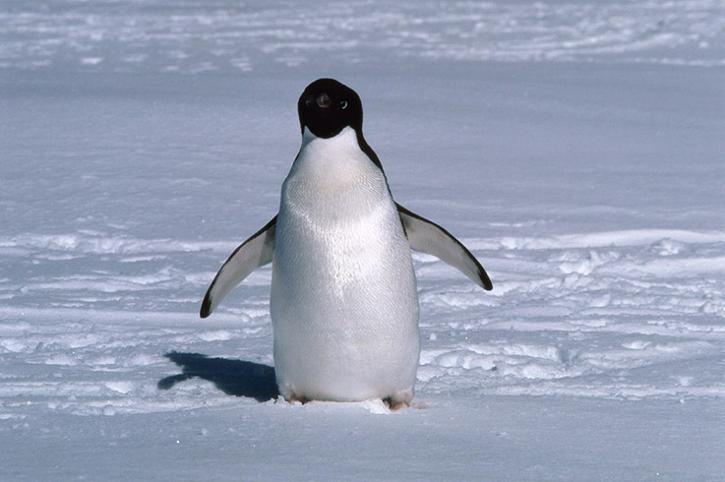
Thermal Design
Heat Transfer
Temperature Measurement
The prevalence of the number 5.7

Slide 2
Why Care about Thermal?
Scientific equipment often needs temperature control
especially in precision measurement
Want to calculate thermal energy requirements
how much energy to change temperature?
how much power to maintain temperature?
Want to calculate thermal time constants
how long will it take to change the temperature?
Want to understand relative importance of radiation, convection, conduction
which dominates?
how much can we limit/exaggerate a particular process?

Slide 3
Chief Thermal Properties
Thermal Conductivity
κ measured in W/m/K
heat flow (in W) is
P = κ·ΔT·A/t
note that heat flow increases with increasing ΔT, increasing surface area, and decreasing thickness (very intuitive)
Specific Heat Capacity
c_{p} measured in J/kg/K
energy locked up in heat is:
E = c_{p}·ΔT·m
energy stored proportional to ΔT, and mass (intuitive)
Emisivity, ε
power radiated is P = εAσT⁴

Slide 4
Thermal Conductivity of Materials
(copied from materials lecture)
Material | κ (W m⁻¹ K⁻¹) | comments
Silver | 422 | room T metals feel cold
Copper | 391 | great for pulling away heat
Gold | 295
Aluminum | 205
Stainless Steel | 10–25 | why cookware uses S.S.
Glass, Concrete,Wood | 0.5–3 | buildings
Many Plastics | ~0.4 | room T plastics feel warm
G-10 fiberglass | 0.29 | strongest insulator choice
Stagnant Air | 0.024 | but usually moving…
Styrofoam | 0.01–0.03 | can be better than air!

Slide 5
Conduction: Heated Box
A 1 m × 1 m × 2.5 m ice-fishing hut stands in the −10° C cold with 2.5 cm walls of wood
A = 12 m²
t = 0.025 m
κ ≈ 1 W/m/K
To keep this hut at 20° C would require
P = κ·ΔT·A/t = (1.0)(30)(12)/(0.025) = 14,400 W
Outrageous!
Replace wood with insulation: κ = 0.02; t = 0.025
P = κ·ΔT·A/t = (0.02)(30)(12)/(0.025) = 288 W
This, we can do for less than $40 at Target
First example unfair
air won’t carry heat away this fast: more on this later

Slide 6
A Cold Finger
Imagine a plug of aluminum connecting the inside to the outside
how much will it change the story?
cylindrical shape, length t, radius R
κ = 205 W/m/K
just based on conduction alone, since difference in thermal conductivity is a factor of 10,000, the cold finger is as important as the whole box if it’s area is as big as 1/10,000 the area of the box.
this corresponds to a radius of 2 mm !!!
So a cold finger can “short-circuit” the deliberate attempts at insulation
provided that heat can couple to it effectively enough: this will often limit the damage

Slide 7
R-value of insulation
In a hardware store, you’ll find insulation tagged with an “R-value”
thermal resistance R-value is t/κ
R-value is usually seen in imperial units: ft²·F·hr/Btu
Conversion factor is 5.67:
R-value of 0.025-thick insulation of κ = 0.02 W/m/K is:
R = 5.67×t/κ = 5.67×0.025/0.02 = 7.1
Can insert Home-Depot R=5 insulation into formula:
P = 5.67×A·ΔT/R
so for our hut with R = 5: P ≈ 5.67×(12)(30)/5 = 408 W
note our earlier insulation example had R = 7.1 instead of 5, in which case P = 288 W (check for yourself!)

Slide 8
Wikipedia on R-values:
Note that these examples use the non-SI definition and are per inch. Vacuum insulated panel has the highest R-value of (approximately 45 in English units) for flat, Aerogel has the next highest R-value 10, followed by isocyanurate and phenolic foam insulations with, 8.3 and 7, respectively. They are followed closely by polyurethane and polystyrene insulation at roughly R–6 and R–5. Loose cellulose, fiberglass both blown and in batts, and rock wool both blown and in batts all possess an R-value of roughly 3. Straw bales perform at about R–1.45. Snow is roughly R–1.
Absolutely still air has an R-value of about 5 but this has little practical use: Spaces of one centimeter or greater will allow air to circulate, convecting heat and greatly reducing the insulating value to roughly R–1

Slide 9
Convective Heat Exchange
Air (or any fluid) can pull away heat by physically transporting it
really conduction into fluid accompanied by motion of fluid
full, rigorous, treatment beyond scope of this class
General behavior:
power convected = P = h·ΔT·A
A is area, ΔT is temperature difference between surface and bath
h is the convection coefficient, units: W/K/m²
still air has h ≈ 2–5 W/K/m²
higher when ΔT is higher: self-driven convective cells
note that h = 5.67 is equivalent to R = 1
gentle breeze may have h ≈ 5 –10 W/K/m²
forced air may be several times larger (h ≈ 10–50)

Slide 10
Convection Examples
Standing unclothed in a 20° C light breeze
h ≈ 5 W/K/m²
ΔT = 17° C
A ≈ 1 m²
P ≈ (5)(17)(1) = 85 W
Our hut from before:
h ≈ 5 W/K/m²
ΔT = 30° C (if the skin is at the hot temperature)
A ≈ 12 m²
P ≈ (5)(30)(12) = 1800 W

Slide 11
Radiative Heat Exchange
The Stephan-Boltzmann law tells us:
P = εAσ(T_{h}⁴ − T_{c}⁴)
The Stephan-Boltzmann constant, σ = 5.67×10⁻⁸ W/m²/K⁴
in thermal equilibrium (T_{h} = T_{c}), there is radiative balance, and P = 0
the emissivity ranges from 0 (shiny) to 1 (black)
“black” in the thermal infrared band (λ ≈ 10 μm) might not be intuitive
your skin is nearly black (ε ≈ 0.8)
plastics/organic stuff is nearly black (ε ≈ 0.8–1.0)
even white paint is black in the thermal infrared
metals are almost the only exception
for small ΔT around T, P ≈ 4εAσT³ ΔT = (4εσT³)·A·ΔT
which looks like convection, with h = 4εσT³
for room temperature, h ≈ 5.7ε W/K/m², so similar in magnitude to convection

Slide 12
Radiative Examples
Standing unclothed in room with −273° C walls
and assume emissivity is 0.8 for skin
A ≈ 1 m²
ΔT = 310 K
P ≈ (0.8)(1)(5.67×10⁻⁸)(310⁴) = 419 W (burr)
Now bring walls to 20° C
ΔT = 17° C
P ≈ (0.8)(1)(5.67×10⁻⁸)(310⁴ − 293⁴) = 84 W
pretty similar to convection example
note that we brought our cold surface to 94.5% the absolute temperature of the warm surface, and only reduced the radiation by a factor of 5 (not a factor of 18): the fourth power makes this highly nonlinear

Slide 13
Combined Problems
Two-layer insulation
must compute temperature at interface
Conduction plus Convection
skin temperature must be solved
Conduction plus Radiation
skin temperature must be solved
The whole enchilada
conduction, convection, radiation

Slide 14
Two-Layer insulation
Let’s take our ice-fishing hut and add insulation instead of replacing the wood with insulation
each still has thickness 0.025 m; and surface area 12 m²
Now have three temperatures: T_{in} = 20°, T_{mid}, T_{out} = −10°
Flow through first is: P₁ = κ₁·(T_{in} − T_{mid})·A₁/t₁
Flow through second is: P₂ = κ₂·(T_{mid} − T_{out})·A₂/t₂
In thermal equilibrium, must have P₁ = P₂
else energy is building up or coming from nowhere
We know everything but T_{mid}, which we easily solve for:
T_{mid}(κ₁A₁/t₁ + κ₂A₂/t₂ ) = κ₁A₁T_{in}/t₁ + κ₂A₂T_{out}/t₂
find T_{mid} = −9.412 or T_{mid} = 19.412 depending on which is interior or exterior
heat flow is 282 W (compare to 288 W before: wood hardly matters)

Slide 15
Conduction plus Convection
Let’s take our hut with just wood, but considering convection
The skin won’t necessarily be at T_{out}
Again, thermal equilibrium demands that power conducted through wall equals power wafted away in air
P = h·(T_{skin} − T_{out})·A = κ·(T_{in} − T_{skin})·A/t
for which we find T_{skin} = (κT_{in}/t + hT_{out})/(h + κ/t) = 16.7° C
so the skin is hot
P = (5)(26.7)(12) ≈ 1600 W
So a space heater actually could handle this (no radiation)
lesson: air could not carry heat away fast enough, so skin warms up until it can carry enough heat away—at the same time reducing ΔT across wood
h may tend higher due to self-induced airflow with large ΔT
also, a breeze/wind would help cool it off

Slide 16
Convection plus Radiation
How warm should a room be to stand comfortably with no clothes?
assume you can put out P = 100 W metabolic power
2000 kcal/day = 8,368,000 J in 86400 sec ≈ 100 W
P = h·(T_{skin} − T_{out})·A + εAσ(T_{skin}⁴ − T_{out}⁴) ≈ (hA + 4εAσT³)ΔT
with emissivity = 0.8, T = 293 K
100 = ((5)(1) + 4.56)ΔT
ΔT = 10.5°
so the room is about 310 − 10.5 = 299.5 K = 26.5° C = 80° F
iterating (using T = 299.5); 4.56 → 4.87; ΔT → 10.1°
assumes skin is full internal body temperature
some conduction in skin reduces skin temperature
so could tolerate slightly cooler

Slide 17
The whole enchilada
Let’s take a cubic box with a heat source inside and consider all heat transfers
P = 1 W internal source
inside length = 10 cm
thickness = 2.5 cm
R-value = 5
so 5.67×t/κ = 5 → κ = 0.028 W/m/K
effective conductive area is 12.5 cm cube → A_{c} = 0.09375 m²
external (radiative, convective) area is 15 cm cube → A_{ext} = 0.135 m²
assume h = 5 W/K/m², ε = 0.8, T_{ext} = 293 K
assume the air inside is thoroughly mixed (perhaps 1 W source is a fan!)

Slide 18
The enchilada calculation
power generated = power conducted = power convected plus power radiated away
P = κ·(T_{in} − T_{skin})·A_{c}/t = (hA_{ext} + 4εA_{ext}σT³)·(T_{skin} − T_{ext})
first get T_{skin} from convective/radiative piece
T_{skin} = T_{ext} + P/ (hA_{ext} + 4εA_{ext}σT³) = 20° + 1.0/(0.675+0.617)
T_{skin} = 20.8° (barely above ambient)
now the ΔT across the insulation is P·t/(A_{c}·κ) = 9.5°
so T_{in} = 30.3°
Notice a few things:
radiation and convection nearly equal influence (0.617 vs. 0.675)
shutting off either would result in small (but measurable) change

Slide 19
Timescales
So far we’ve looked at steady-state equilibrium situations
How long will it take to “charge-up” the system?
Timescale given by heat capacity times temperature change divided by power
τ ≈ c_{p}·m·ΔT/P
For ballpark, can use c_{p} ≈ 1000 J/kg/K for just about anything
so the box from before would be 2.34 kg if it had the density of water; let’s say 0.5 kg in truth
average charge is half the total ΔT, so about 5°
total energy is (1000)(0.5)(5) = 2500 J
at 1W, this has a 40 minute timescale

Slide 20
Heating a lump by conduction
Heating food from the outside, one relies entirely on thermal conduction/diffusion to carry heat in
Relevant parameters are:
thermal conductivity, κ (how fast does heat move) (W/m/K)
heat capacity, c_{p} (how much heat does it hold) (J/kg/K)
mass, m (how much stuff is there) (kg)
size, R—like a radius (how far does heat have to travel) (m)
Just working off units, derive a timescale:
τ ≈ (c_{p}/κ)(m/R) ≈ 4(c_{p}/κ)ρR²
where ρ is density, in kg/m³: ρ ≈ m/((4/3)πR³) ≈ m/4R³
faster if: c_{p} is small, κ is large, R is small (these make sense)
for typical food values, τ ≈ 6 minutes × (R/1 cm)²
egg takes ten minutes, turkey takes 5 hours

Slide 21
Lab Experiment
We’ll build boxes with a heat load inside to test the ideas here
In principle, we can:
measure the thermal conductivity of the insulation
see the impact of emissivity changes
see the impact of enhanced convection
look for thermal gradients in the absence of circulation
look at the impact of geometry on thermal state
see how serious heat leaks can be
Nominal box:
10 cm side, 1-inch thick, about 1.5 W (with fan)

Slide 22
Lab Experiment, cont.
We’ll use power resistors rated at 5 W to generate the heat
25 Ω nominal
P = V²/R
At 5 V, nominal value is 1 W
can go up to 11 V with these resistors to get 5 W
a 12 Ω version puts us a bit over 2 W at 5 V
Fans to circulate
small fans operating at 5 V (and about 0.5 W) will keep the air moving
Aluminum foil tape for radiation control
several varieties available
Standard building insulation

Slide 23
Lab Experimental Suite
experiment | R | int. airflow | ext. airflow | int. foil | ext. foil | geom.
A (control) | 25 Ω | 1 fan | none | no | no | 10 cm cube
B (ext. convec) | 25 Ω | 1 fan | fan | no | no | 10 cm cube
C (ext. radiation) | 25 Ω | 1 fan | none | no | yes | 10 cm cube
D (ext. conv/rad) | 25 Ω | 1 fan | fan | no | yes | 10 cm cube
E (gradients) | 25 Ω | none | none | no | no | 10 cm cube
F (int. radiation) | 25 Ω | 1 fan | none | yes | no | 10 cm cube
G (radiation) | 25 Ω | 1 fan | none | yes | yes | 10 cm cube
H (more power) | 12 Ω | 1 fan | none | no | no | 10 cm cube
I (larger area) | 12 Ω | 2 fans | none | no | no | 17.5 cm cube
J (area and thick.) | 12 Ω | 2 fans | none | no | no | 17.5 cm cube

Slide 24
Random Notes
Rig fan and resistor in parallel, running off 5V
fan can accept range: 4.5–5.5 V
if you want independent control, don’t rig together
Use power supply current reading (plus voltage) to ascertain power (P = IV) being delivered into box
Make sure all RTDs read same thing on block of thermally stabilized chunk of metal
account for any offset in analysis
Don’t let foil extend to outside as a cold finger
Make sure you have no air gaps: tape inside and out of seams
but need to leave top accessible
nice to tape fan to top (avoid heat buildup here)
can hang resistor, RTD from top as well (easy to assemble)

Slide 25
Random Notes, continued
Measure temp. every 15 seconds, initially
tie white leads of RTDs to common DVM all together
label red lead so you know where it goes
After equilibrium is reached, measure skin temperatures
hold in place with spare foam (not finger or thermal conductor!)
We have limited RTDs, so 3−4 per group will be standard
locate inside RTD in fan exhaust, so representative
use external RTD for ambient, skin (double duty)
some experiments will want more RTDs (gradients)
Once equilibrated, go to configuration B
turn on external fan, coat with foil, poke a hole, cold finger

Slide 26
Random Notes, continued
Send your data points to me via e-mail so I can present the amalgam of results to the class
use format:
Δt T₁ T₂ T₃ etc.
example:
165.0 27.6 31.2 32.2 24.8
include a description of what each column represents
Also include basic setup and changes in e-mail so I know what I’m plotting
Also include in the message temperatures you measure only once, or occasionally (like skin temp.)
I’ll make the data available for all to access for the write-ups

Slide 27
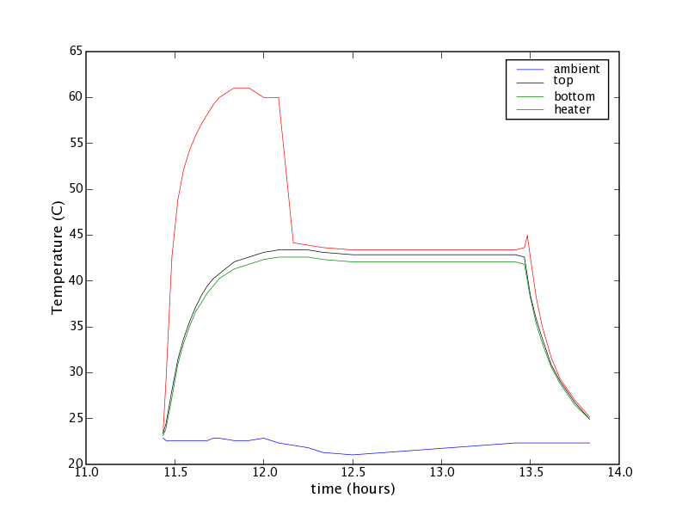
Example Series

Slide 28
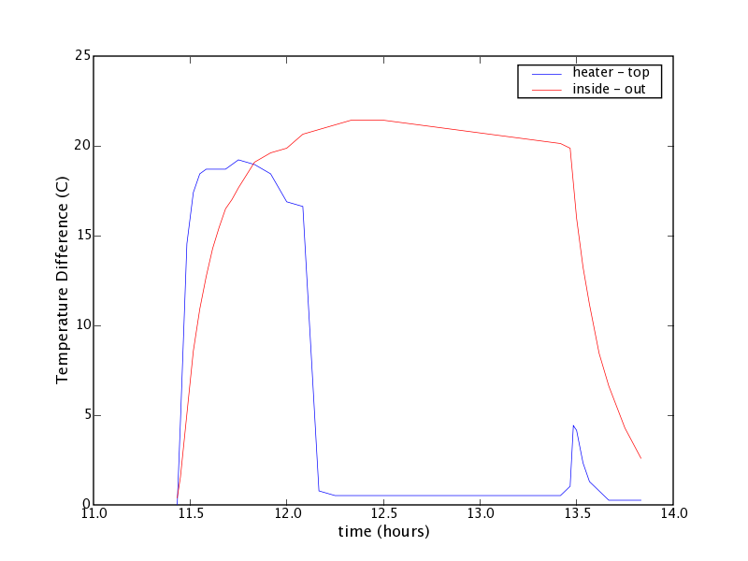
Temperature differences

Slide 29
References and Assignment
Useful text:
Introduction to Heat Transfer: Incropera & DeWitt
Reading in text:
Chapter 8 (7 in 3rd ed.) reading assignment: check web page for details

Slide 30
Thermal Building Design
You can get R-values for common construction materials online
see http://www.coloradoenergy.org/procorner/stuff/r-values.htm
Recall that R = 5.67×t/κ
so power, P = 5.67AΔT/R
Composite structures (like a wall) get a net R-value
some parts have insulation, some parts just studs
if we have two areas, A₁ with R₁ and A₂ with R₂, total power is
P = 5.67A₁ΔT/R₁ + 5.67A₂ΔT/R₂
so we can define net R so that it applies to A_{tot} = A₁ + A₂
1/R_{tot} = (A₁/A_{tot})/R₁ + (A₂/A_{tot})/R₂
in example on web site, studs take up 15%, rest of wall 85%
P = 5.67A_{tot}ΔT/R_{tot}

Slide 31
Handling External Flow as R-value
On the materials site, they assign R-values to the air “layer” up against the walls
outside skin R = 0.17
inside skin R = 0.68
This accounts for both convection and radiation. How?
recall that power through the walls has to equal the power convected and radiated
P = 5.67A(T_{in}−T_{skin})/R = h_{conv}A(T_{skin}−T_{out}) + h_{rad}A(T_{skin}−T_{out})
P = 5.67A(T_{in}−T_{skin})/R = h_{eff}A(T_{skin}−T_{out})
where h_{rad} ≈ 4σεT³, and h_{eff} = h_{conv} + h_{rad}
We can solve this for T_{skin}, to find
T_{skin} = (5.67T_{in}/R + h_{eff}T_{out})/(5.67/R +h_{eff})

Slide 32
Putting Together
Inserting the expression for T_{skin} into the conduction piece, we get:
P = 5.67A(T_{in}−T_{skin})/R = 5.67A(T_{in}−(5.67T_{in}/R+h_{eff}T_{out})/(5.67/R+h_{eff}))/R
multiply the solitary T_{in} by (5.67/R+h_{eff})/(5.67/R+h_{eff})
5.67T_{in}/R term cancels out
P = 5.67A((h_{eff}T_{in} − h_{eff}T_{out})/(5.67/R+h_{eff}))/R
P = 5.67A(T_{in}−T_{out})×h_{eff}/(5.67+h_{eff}R)
which now looks like a standard conduction relation between inside and outside temperatures, with an effective R:
R_{eff} = R + 5.67/h_{eff}
The effective R is the R-value of the original wall plus a piece from the air that looks like 5.67/h_{eff}
the site has interior air layer R_{eff}=0.68, or h_{eff} = 8.3, which is appropriate for radiation plus convection
for exterior, they use R_{eff} = 0.17, or h_{eff} = 33, representing windy conditions

Slide 33
A model house
Ignoring the floor, let’s compute the heat load to keep a house some ΔT relative to outside
useful to formulate G = P/ΔT in W/K as property of house
Assume approx 40×40 ft floorplan (1600 ft²)
8 feet tall, 20% windows on wall
Wall: 100 m², windows: 20 m², ceiling: 150 m², roof 180 m²
Can assess for insulation or not, different window choices, etc.
G_{window} = 125, 57, 29 for single, double, or deluxe window
G_{wall} = 142, 47 for no insul, insul
G_{ceil} = 428, 78 for no insul, insul
G_{roof} = 428, 90 for no insul, insul

Slide 34
Dealing with the Ceiling
The G_{ceil} and G_{roof} require interpretation, since the ΔT across these interfaces is not the full ΔT between inside and outside
there is a T_{attic} in between
but we know that the heat flow through the ceiling must equal the heat flow through the roof, in equilibrium
so G_{ceil}(T_{in}−T_{attic}) = G_{roof}(T_{attic}−T_{out})
then T_{attic} = (G_{ceil}T_{in}+G_{roof}T_{out})/(G_{ceil}+G_{roof})
so that G_{ceil}(T_{in}−T_{attic}) = G_{up}(T_{in}−T_{out})
where G_{up} = G_{ceil}G_{roof}/(G_{ceil}+G_{roof}), in effect acting like a parallel combination
So G_{up} evaluates to:
G_{up} = 214, 74, 66, 42 for no/no, ceil/no, no/roof, ceil/roof insulation combinations

Slide 35
All Together Now
The total power required to stabilize the house is then
P_{tot} = G_{tot} ΔT, where G_{tot} = G_{window} + G_{wall} + G_{up}
For a completely uninsulated house:
G_{tot} = 481 W/K
requires 7.2 kW to maintain ΔT = 15°C
over 5 months (153 days), this is 26493 kWh, costing $2649 at $0.10/kWh
Completely insulated (walls, ceiling, roof, best windows), get G_{tot} = 118 W/K
four times better!
save $2000 per cold season (and also save in warm season)

