Slide 1
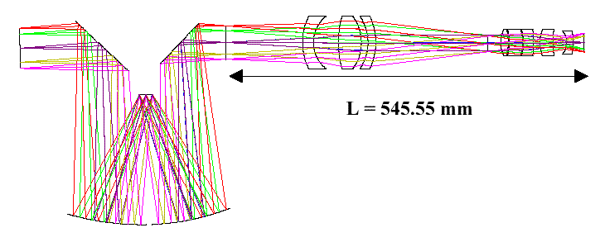
Optics Intro
Geometric Optics
Raytracing

Slide 2
Reflection
We describe the path of light as straight-line rays
“geometrical optics” approach
Reflection off a flat surface follows a simple rule:
angle in (incidence) equals angle out
angles measured from surface “normal” (perpendicular)
surface normal
same
angle
exit ray
incident ray

Slide 3
Reflection, continued
Also consistent with “principle of least time”
If going from point A to point B, reflecting off a mirror, the path traveled is also the most expedient (shortest) route
A
shortest path;
equal angles
too long
B

Slide 4
Hall Mirror
Useful to think in terms of images
“real” you
mirror only
needs to be half as
high as you are tall. Your
image will be twice as far from you
as the mirror.
“image” you

Slide 5
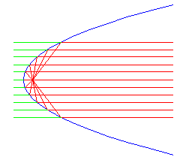
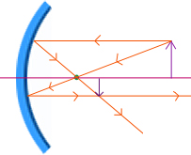
Curved mirrors
What if the mirror isn’t flat?
light still follows the same rules, with local surface normal
Parabolic mirrors have exact focus
used in telescopes, backyard satellite dishes, etc.
also forms virtual image

Slide 6
Refraction
Light also goes through some things
glass, water, eyeball, air
The presence of material slows light’s progress
interactions with electrical properties of atoms
The “light slowing factor” is called the index of refraction
glass has n = 1.52, meaning that light travels about 1.5 times slower in glass than in vacuum
water has n = 1.33
air has n = 1.00028
vacuum is n = 1.00000 (speed of light at full capacity)

Slide 7
Refraction at a plane surface
Light bends at interface between refractive indices
bends more the larger the difference in refractive index
can be effectively viewed as a “least time” behavior
get from A to B faster if you spend less time in the slow medium
A
Snell’s Law:
n₁sinθ₁ = n₂sinθ₂
θ₁
n₁ = 1.0
n₂ = 1.5
θ₂
B

Slide 8
Driving Analogy
Let’s say your house is 12 furlongs off the road in the middle of a huge field of dirt
you can travel 5 furlongs per minute on the road, but only 3 furlongs per minute on the dirt
this means “refractive index” of the dirt is 5/3 = 1.667
Starting from point A, you want to find the quickest route:
straight across (AD)—don’t mess with the road
right-angle turnoff (ACD)—stay on road as long as possible
angled turnoff (ABD)—compromise between the two
A
B
C
leg dist. Δt@5 Δt@3
AB 5 1 —
AC 16 3.2 —
AD 20 — 6.67
BD 15 — 5
CD 12 — 4
road
dirt
D (house)
AD: 6.67 minutes
ABD: 6.0 minutes: the optimal path is a “refracted” one
ACD: 7.2 minutes
Note: both right triangles in figure are 3-4-5

Slide 9
Total Internal Reflection
At critical angle, refraction no longer occurs
thereafter, you get total internal reflection
n₂sinθ₂ = n₁sinθ₁ → θ_{crit} = sin⁻¹(n₁/n₂)
for glass, the critical internal angle is 42°
for water, it’s 49°
a ray within the higher index medium cannot escape at shallower angles (look at sky from underwater…)
incoming ray hugs surface
n₁ = 1.0
n₂ = 1.5
42°

Slide 10
Refraction in Suburbia
Think of refraction as a pair of wheels on an axle going from sidewalk onto grass
wheel moves slower in grass, so the direction changes
Note that the wheels
move faster (bigger space)
on the sidewalk, slower
(closer) in the grass

Slide 11
Even gets Total Internal Reflection Right
Moreover, this analogy is mathematically equivalent to the actual refraction phenomenon
can recover Snell’s law: n₁sinθ₁ = n₂sinθ₂
Wheel that hits sidewalk starts to go faster,
which turns the axle, until the upper wheel
re-enters the grass and goes straight again

Slide 12
Reflections, Refractive offset
Let’s consider a thick piece of glass (n = 1.5), and the light paths associated with it
reflection fraction = [(n₁ – n₂)/(n₁ + n₂)]²
using n₁ = 1.5, n₂ = 1.0 (air), R = (0.5/2.5)² = 0.04 = 4%
n₁ = 1.5
n₂ = 1.0
incoming ray
(100%)
image looks displaced
due to jog
96%
8% reflected in two
reflections (front & back)
4%
92% transmitted
4%
0.16%

Slide 13
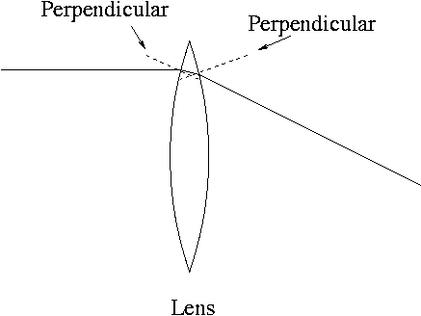
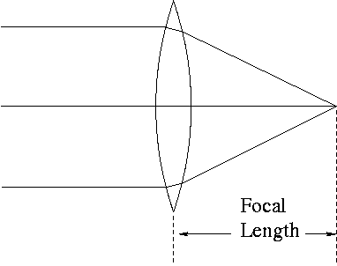
Let’s get focused…
Just as with mirrors, curved lenses follow same rules as flat interfaces, using local surface normal
A lens, with front and back curved surfaces, bends
light twice, each diverting incoming ray towards
centerline.
Follows laws of refraction at each surface.
Parallel rays, coming, for instance from a specific
direction (like a distant bird) are focused by a convex
(positive) lens to a focal point.
Placing film at this point would record an image of
the distant bird at a very specific spot on the film.
Lenses map incoming angles into positions in the
focal plane.

Slide 14
Cameras, in brief
object
pinhole
image at
film plane
In a pinhole camera, the hole is so small that light hitting any particular point
on the film plane must have come from a particular direction outside the camera
object
image at
film plane
lens
In a camera with a lens, the same applies: that a point on the film plane
more-or-less corresponds to a direction outside the camera. Lenses have
the important advantage of collecting more light than the pinhole admits

Slide 15
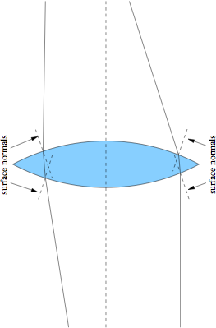
Positive Lenses
Thicker in middle
Bend rays toward axis
Form real focus

Slide 16
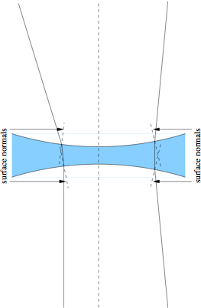
Negative Lenses
Thinner in middle
Bend rays away from the axis
Form virtual focus

Slide 17
Raytracing made easier
In principle, to trace a ray, one must calculate the intersection of each ray with the complex lens surface, compute the surface normal here, then propagate to the next surface
computationally very cumbersome
We can make things easy on ourselves by making the following assumptions:
all rays are in the plane (2-d)
each lens is thin: height does not change across lens
each lens has a focal length (real or virtual) that is the same in both directions

Slide 18
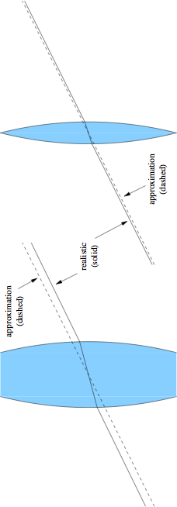
Thin Lens Benefits
If the lens is thin, we can say that a ray through the lens center is undeflected
real story not far from this, in fact: direction almost identical, just a jog
the jog gets smaller as the lens gets thinner

Slide 19
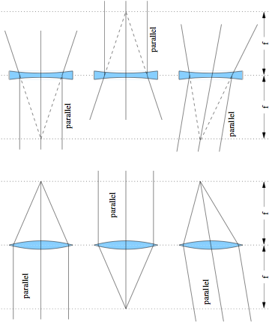
Using the focus condition
real foci
virtual foci
s = ∞
s’ = f
s = ∞
s’ = −f
s = f
s’ = ∞
s = −f
s’ = ∞
s = ∞
s’ = f
s = ∞
s’ = −f

Slide 20
Tracing an arbitrary ray (positive lens)
draw an arbitrary ray toward lens
stop ray at middle of lens
note intersection of ray with focal plane
from intersection, draw guiding (helper) ray straight through center of lens (thus undeflected)
original ray leaves lens parallel to helper
why? because parallel rays on one side of lens meet each other at the focal plane on the other side

Slide 21
Tracing an arbitrary ray (negative lens)
draw an arbitrary ray toward lens
stop ray at middle of lens
draw helper ray through lens center (thus undeflected) parallel to the incident ray
note intersection of helper with focal plane
emerging ray will appear to come from this (virtual) focal point
why? parallel rays into a negative lens appear to diverge from the same virtual focus on the input side

Slide 22
Image Formation
Place arrow (object) on left, trace through image:
1) along optical axis (no defl.); 2) parallel to axis, goes through far focus with optical axis ray; 3) through lens center; 4) through near-side focus, emerges parallel to optical axis; 5) arbitrary ray with helper
Note convergence at image position (smaller arrow)
could run backwards just as well

Slide 23
Notes on Image Formation
Note the following:
image is inverted
image size proportional to the associated s-value: ray 3 proves it
both s and s’ are larger than f (s = 120; s’ = 80; f = 48)
Gaussian lens formula (simple form):

Slide 24
Virtual Images
If the object is inside the focal length (s < f):
a virtual (and larger) image is formed
non-inverted
Ray numbers are same procedure as previous
This time s’ is negative:
s = 40; f = 60; s’ = –120
negative image distances indicate virtual images

Slide 25
The lens-maker’s formula
We saw the Gaussian lens formula before:
f is positive for positive lenses, negative for negative lenses
s is positive on left, s’ is positive on right
But in terms of the surface properties:
R₁ is for the left surface (pos. if center of curvature to right)
R₂ is for right surface (pos. if center of curvature to right)
bi-convex (as in prev. examples) has R₁ > 0; R₂ < 0
n is the refractive index of the material (assume in air/vac)

Slide 26
Deriving Gaussian Formula from Rays
Object has height, h; image height = h’
tangent of ray 3 angle is −h/s, so h’ = −h(s’/s)
ray 2 angle is −h/f, so h’ = (−h/f)×(s’ − f)
set the two expressions for h’ equal, and divide by hs’
the result will pop out
can do the same trick using virtual images too

Slide 27
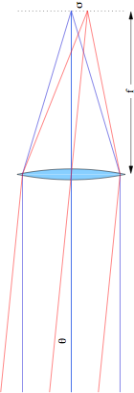
Lenses map directions into displacements
Two objects at infinity an angle θ apart produce distinct spots separated by σ
following geometry, σ = f·tanθ ≈ f·θ for small θ
hint: look at central rays
so lens turns angle (θ) into displacement (σ)

Slide 28
Telescope
A telescope has an “objective” lens and an eyepiece
sharing a focal plane; giving the eye the parallel light it wants
Everything goes as ratio of focal lengths: f₁/f₂
magnification is just M = θ₂/θ₁ = f₁/f₂
after all: magnification is how much bigger things look
displacement at focal plane, σ = f₁θ₁ = f₂θ₂ → relation above
ratio of collimated beam (pupil) sizes: P₁/P₂ = f₁/f₂ = M

Slide 29
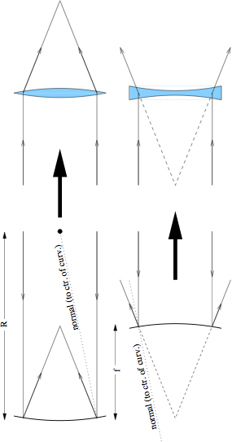
Reflector/Refractor Analogy
For the purposes of understanding a reflecting system, one may replace with lenses (which we know how to trace/analyze)
focal length and aperture the same; rays on other side
for a reflector, f = R/2 [compare to 1/f = (n − 1)(1/R₁ − 1/R₂) for lens]
for n = 1.5, R₂ = −R₁ (symmetric lens), f = R
so glass lens needs twice the curvature of a mirror

Slide 30
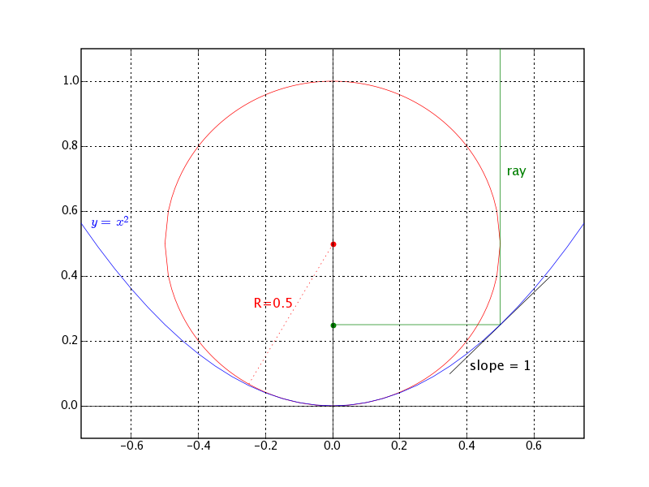
Parabolic Example
Take the parabola:
y = x²
Slope is y’ = 2x
Curvature is y’’ = 2
So R = 1/y’’ = 0.5
Slope is 1 (45°) at:
x = 0.5; y = 0.25
So focus is at 0.25:
f = R/2
Note that pathlength to focus is the same for depicted ray and one along x = 0

Slide 31
Cassegrain Telescope
A Cassegrain telescope can be modeled as as positive and negative lens
eyepiece not shown: only up to focus
Final focus depends on placement of negative lens
if |s| = |f₂|, light is collimated; if |s| > |f₂|, light will diverge
both s and f₂ are negative
For the Apache Point 3.5 meter telescope, for example:
f₁ = 6.12 m; f₂ = −1.60 m; d₁₂ = 4.8 m; s = d₁₂ − f₁ = −1.32 m
yields s’ = 7.5 m using 1/s + 1/s’ = 1/f₂

Slide 32
Cassegrain focus
Abstracting mirrors as lenses, then lenses as sticks:
trace central ray with angle θ₁
figure out θ₂ and then focal length given s’ and d₁₂
y₂ = d₁₂θ₁ (adopt convention where θ₁ is negative as drawn)
y₁ = f₂θ₁ (f₂ is negative: negative lens)
θ₂ = (y₁ − y₂)/f₂ = θ₁(f₂ − d₁₂)/f₂
y_{f} = y₂ + θ₂s’ = θ₁(d₁₂ + s’(f₂ − d₁₂)/f₂)
f_{eff} = d₁₂ + s’(f₂ − d₁₂)/f₂ = −f₁s’/s after lots of algebra
for Apache Point 3.5 meter, this comes out to 35 meters

Slide 33
f-numbers
f = D
f = 4D
D
D
f/1 beam: “fast”
f/4 beam: “slow”
The f-number is a useful characteristic of a lens or system of lenses/mirrors
Simply η = f/D
where f is the focal length, and D is the aperture (diameter)
“fast” converging beams (low f-number) are optically demanding to make without aberrations
“slow” converging beams (large f-number) are easier to make
aberrations are proportional to 1/η²
so pay the price for going “fast”

Slide 34
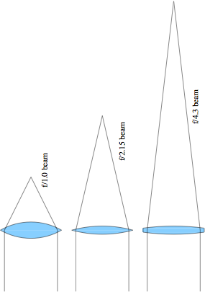
f-numbers, compared
Lens curvature to scale for n = 1.5
obviously slow lenses are easier to fabricate: less curvature

Slide 35
Pupils
Consider two “field points” on the focal plane
e.g., two stars some angle apart
The rays obviously all overlap at the aperture
called the entrance pupil
The rays are separate at the focus (completely distinct)
Then overlap again at exit pupil, behind eyepiece
want your pupil here
just an image of the entrance pupil satisfying 1/s’ + 1/(f₁ + f₂) = 1/f₂
size is smaller than entrance pupil by magnification factor
M = f₁/f₂; in this picture, f₁ = 48; f₂ = 12; M = 4; s’ = 15

Slide 36
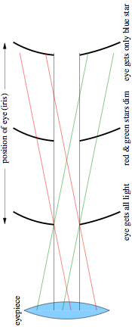
Pupils within Pupils
Looking at three stars (red, green, blue) through telescope, eye position is important
So is pupil size compared to eye pupil
dark adapted pupil up to 7 mm diameter (2–3 mm in daylight)
sets limit on minimum magnification (if you want to use the full aperture)
210 mm aperture telescope must have M > 30
for f/5 scope, means f₂ < 35 mm; f/10 scope means f₂ < 70 mm
3.5-m scope means M > 500; at f/10, f₂ < 70 mm

Slide 37
Vignetting
Rays that don’t make it through an optical system are said to be vignetted (shadowed)
maybe a lens isn’t big enough
maybe your eye’s pupil isn’t big enough, or is improperly placed
Often appears as a gradual darkening as a function of distance from the field center
the farther out you go, the bigger your lenses need to be
every optical system has a limited (unvignetted) field of view
beyond this, throughput goes down

Slide 38
Infrared Cold Stop
An infrared detector is very sensitive to terrestrial heat
so want to keep off of detector
if detector located at primary focal plane, it is inundated with emission from surroundings and telescope structure
note black lines intersecting primary focal plane
Putting a “cold” stop at a pupil plane eliminates stray emission
cool to LN₂; image of primary objective onto cold stop
only light from the primary passes through; detector focal plane then limits field of view to interesting bit
Also the right place for filters, who prefer collimated light

Slide 39
Raytrace Simulations
In Google, type in: phet
top link is one to University of Colorado physics education page
on this page, click: go to simulations:physics
on the left-hand bar, go to: light and radiation
then click the geometric optics simulation link (picture)
Can play with lots of parameters
real and virtual images
lens radius of curvature, diameter, and refractive index
see principle rays (ones you’d use to raytrace)
see marginal rays
use a light source and screen
see the effect of two sources

Slide 40
Aberrations: the real world
Lenses are thick, sinθ ≠ θ
sinθ ≈ θ − θ³/6 + θ⁵/120 − θ⁷/5040 + …
tanθ ≈ θ + θ³/3 + 2θ⁵/15 + 17θ⁷/315 + …
Different types of aberration (imperfection)
spherical aberration
all spherical lenses possess; parabolic reflector does not
coma
off-axis ailment: even aspheric elements have this
chromatic aberration
in refractive systems only: refractive index is function of λ
astigmatism
if on axis, then lens asymmetry; but can arise off-axis in any system
field curvature/distortion
detectors are flat: want to eliminate significant field curvature

Slide 41
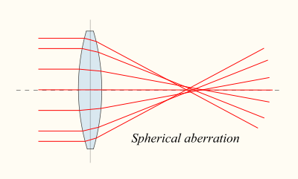
Spherical Aberration
Rays at different heights focus at different points
Makes for a mushy focus, with a halo
Positive spherical lenses have positive S.A., where exterior rays focus closer to lens
Negative lenses have negative S.A., as do plates of glass in a converging beam
“Overcorrecting” a positive lens (going too far in making asphere) results in neg. S.A.
neg. S.A.
lens side
zero S.A.
pos. S.A.

Slide 42
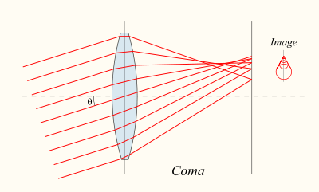
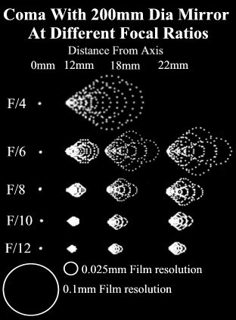
Coma
Off-axis rays meet at different places depending on ray height
Leads to asymmetric image, looking something like a comet (with nucleus and flared tail)
thus the name coma
As with all aberrations, gets worse with “faster” lenses
Exists in parabolic reflectors, even if no spherical aberration

Slide 43
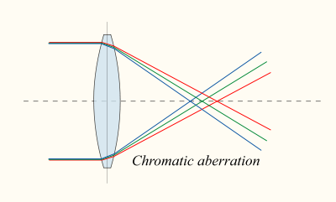
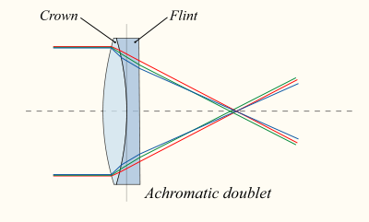
Chromatic Aberration
Glass has slightly different refractive index as a function of wavelength
so not all colors will come to focus at the same place
leads to colored blur
why a prism works
Fixed by pairing glasses with different dispersions (dn/dλ)
typically a positive lens of one flavor paired with a negative lens of the other
can get cancellation of aberration
also helps spherical aberration to have multiple surfaces (more design freedom)

Slide 44
Optical Alignment Techniques
The performance of an optical system often depends vitally on careful positioning of the optical elements
A step-wise approach is best, if possible: aligning as the system is built up
if using a laser, first make sure the beam is level on the table, and going straight along the table
install each element in sequence, first centering the incident beam on the element
often reflections from optical faces can be used to judge orientation (usually should roughly go back toward source)
a lens converts position to direction, so careful translation cross-wise to beam is important
orientation is a second-order concern
Whenever possible, use a little telescope to look through system: the eye is an excellent judge

Slide 45
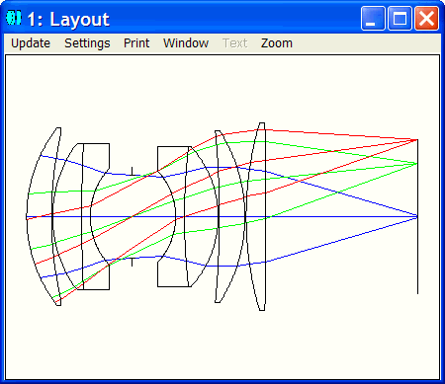
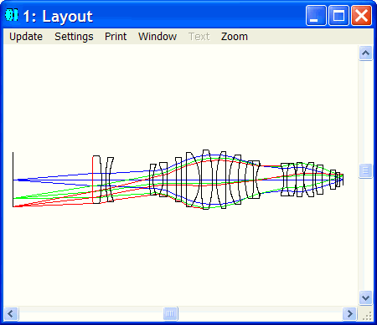
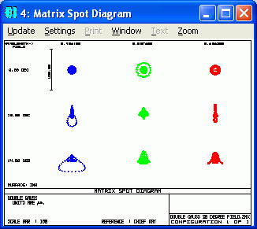
Zemax Examples

Slide 46
Lab 4: Raytracing
While it may not be Zemax, I’ve cobbled together a Python program to do raytracing of any number of lenses
restricted to the following conditions:
ray path is sequential: hitting surfaces in order defined
ray path is left-to-right only: no backing up
elements are flat or have conic surfaces; on and normal to optical axis
refractive index is constant, and ignorant of dispersion
We will use this package to:
analyze simple lens configurations
look at aberrations
build lens systems (beam expanders, telescopes)
learn how to compile and run C programs (and modify?)
in conjunction with some geometrical design

Slide 47
Raytracing Algorithm
Detailed math available on website under Lab Info
Basically, compute intersection of ray with surface, then apply Snell’s Law
Can have as many surfaces as you want!
Must only take care in defining physical systems
e.g., make sure lens is thick enough for the diameter you need

Slide 48
References and Assignments
Optics, by Eugene Hecht
a most excellent book: great pictures, clear, complete
Reading in associated textbook:
Ray Tracing; Paraxial Ray Tracing; other topics of interest
Apertures, Stops, Pupils; Vignetting
Geometrical Aberrations & skim 5 types thereof
Simple and Gal. Telescopes; Laser beam expanders & spatial filters; Lens aberrations
Flip through rest of chapter 4 to learn what’s there
Lab Prep: read raytrace-2d.pdf on raytrace algorithm

